Slide 1
Who Does What: Identifying External Actor and DFSA Outcomes
[include date here]
Notes:
As discussed, a TOC is not limited to the changes that one project will influence. Typically, many stakeholders contribute to changes necessary to reach a common overarching goal. By using stakeholder mapping and asking various stakeholders to vet the TOC we can determine who exactly will be responsible for what.

Slide 2
Session Objectives
To understand how we will:
Prioritize which domains and outcomes our proposed Activity will address
Identify domains and outcomes that will be addressed by external actors
Set a foundation for prioritizing (e.g., necessary and sufficient) proposed interventions

Slide 3
TOC Process and Timeline
 | Month 1 |  |  |  | Month 2 |  |  |  | Month 3 |  |  |  |  | Month 4 |  |  |  | Month 5 |  |  |  | Month 6
WEEK | 1 | 2 | 3 | 4 | 5 | 6 | 7 | 8 | 9 | 10 | 11 | 12 | 13 | 14 | 15 | 16 | 17 | 18 | 19 | 20 | 21 | 22 | 23
Data collection and organization
Problem Tree development
TOC diagram and complementary documentation development
Prioritize interventions
Refine TOC graphics
Logframe transfer and select indicators
Quality and completeness review
Notes:
Facilitator: Modify to align to your organizational timeline.

Slide 4
TOC Development Part 2: Who does what?
WHAT | WHO (examples only) | Week | Week | Week | Week | Week
Agree on outcomes the DFSA will address and those that will be addressed by external actors | 4-10 staff representing diverse perspectives
Document supporting evidence for external actors in complementary documentation | 2-person team to document; support from full team to provide evidence
Graphically refine the TOC diagram (Round 1) | Graphic lead
Prioritize DFSA interventions | Technical leads

Slide 5
Which domains of change should we address?
Criteria:
Addressing the domain responds to donor interest and the opportunity for resources
Addressing the domain fills a gap. Use the stakeholder mapping matrix to confirm that other agencies are not currently focused on this domain
The domain has high synergy with other domains
Addressing the domain will maximize our organization’s comparative advantage
Addressing the domain has potential for partnering
The domains of change that our DFSA agrees to address will become Purposes. Those the DFSA does not address, remain in the TOC diagram, but are not referred to as Purposes.
Notes:
Remember that a TOC should show all the steps that lead to a change for a community or population as a result of the efforts of many stakeholders working toward a similar goal. Although a number of domains of change may surface during analysis, we may elect to not directly address all of them. Our design team needs to set criteria to determine which domains the DFSA will address.
The domains we select will become our Purposes.
If the first two criteria in bullets above are true, then consider the 3 criteria that follow.
The domain has high synergy with other domains: the combined impact of addressing two or more domains is greater than the sum of addressing each domain individually.
Addressing a domain maximizes your organization’s comparative advantage. The comparative advantage of an organization refers to the organization’s ability, skills, and experience in addressing an issue relative to any other given organization.
Addressing the domain has potential for partnering. In balance with comparative advantage, a complete TOC depends on partner agencies to address the cross-sectoral and multi-causal linkages.

Slide 6
Which outcomes should we address?
We may elect to address a DoC, but may NOT address all the outcomes within that domain’s pathway.
E.g., existing FtF efforts to improve market access.
Risk of not directly addressing an outcome is that we must rely on effectiveness of external actor efforts.
We make an assumption that efforts will be effective.
In these cases, monitoring the progress of external actors is especially critical.
Notes:
Often an activity will address all domains of change in a TOC, but will not directly address all the outcomes in the domain’s pathway. This typically happens because an external actor is already attempting to address various outcome.
The risk of not directly addressing every outcome in a pathway is that you must rely on the effectiveness of external actor efforts to achieve the domain of change/Purpose. Monitoring other actors’ progress on the outcome becomes especially critical and is manageable through effective communication and coordination. This will be discussed later.

Slide 7
Which outcomes should we address?
After identifying domains that the DFSA will address, start at the bottom of each pathway and identify all outcomes in each pathway that the DFSA will attempt to directly influence.
Same Criteria:
Addressing the outcome responses to donor interest.
Addressing the outcome fills a gap. Stakeholder mapping shows that other actors are not currently focused on this outcome.
Addressing the outcome will maximize your organization’s comparative advantage
The outcome has high synergy with other outcomes
Addressing the outcome has potential for partnering
Notes:
The reason for starting at the bottom is that our decisions about addressing or not addressing outcomes in the lower tiers of the TOC influences whether we can take responsibility for outcomes in the upper tiers. In other words, at some point, the causal logic becomes the determinant of outcome responsibility.

Slide 8
Stakeholder mapping
Technical Area | Name of agency / Contact info | Type of agency | Scope of assistance (time) | Scope of assistance (geographic) | Scope of assistance (participants) | Successful interventions/ &why | Un-successful Interventions/ & why | Relationship with other stakeholders
Component: Health and Nutrition
WASH
Prevention/ treatment of childhood illnesses
Family planning services
Nutrition services
Component: Agriculture and Livelihoods
NRM
Notes:
Use the stakeholder mapping template to determine where there are gaps

Slide 9
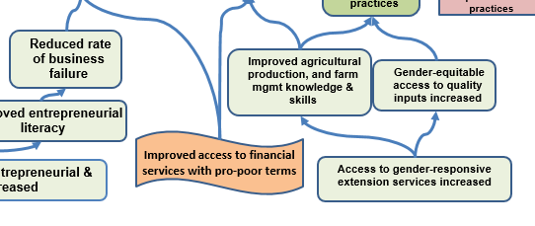
External actor outcomes Use a distinct shape and/or color
Notes:
Once we select the domains we will address, we move to the bottom of each pathway and start to work our way up, determining which outcomes we will attempt to achieve.
Make sure that the outcomes produced by external actors are clearly distinguishable from those that the DFSA will aim to achieve. Select a different shape, color, border or text to make these components stand out.

Slide 10
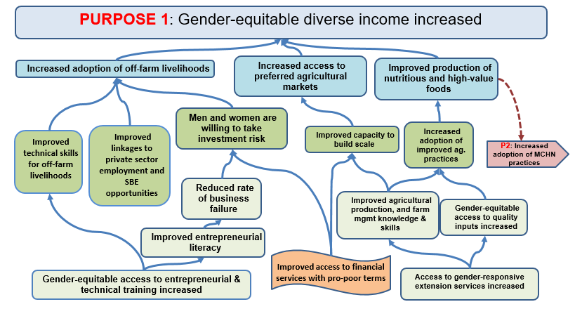
Selecting DFSA outcomes Why start at the bottom?
Notes:
Our decisions about outcomes in the lower tiers of the TOC will influence whether we take responsibility for outcomes in the upper tiers.
This slide demonstrates the selection process via a series of clicks.
First, point out that the domain of change “Gender equitable diverse income increased” now includes the label Purpose 1, to reflect that the organization plans to address it. Similarly, the linkage to “Increased adoption optimal MCHN practices” now has a label P2, to reflect another Purpose the organization plans to address.
Next move through the series of clicks, simulating the process of selecting project outcomes.
Click 1: We decide to address the outcome “gender equitable access to entrepreneurial and technical training increased.”
Click 2: We don’t need to make a decision about whether to address “improved entrepreneurial literacy” or “Improved technical skills for off-farm livelihoods” because the logic demonstrates that “gender equitable access to entrepreneurial and technical training increased” is the only precondition for these two outcomes. If we achieve improved access to training, we expect to see achievement in literacy and skills. Thus, we select both as DFSA outcomes.
Click 3 : The same is true for “Reduced rate of business failure”. The TOC logic states that the outcome will be achieved if the precondition is achieved. No discussion is necessary about whether or not to take responsibility for the outcome, we claim it.
Click 4: We must now move to another pathway tail, and make a decision about “improved linkages to private sector employment and SBE opportunities”. In this example, we also decide to address this outcome.
EXTERNAL ACTOR: Once we determine that an external actor will be responsible for improving access to financial services with pro-poor terms we need to change the outcome shape and color to clearly distinguish it from the outcomes we will address.
We must now make a decision about whether to take responsibility for “men and women are willing to take investment risk”, even though the DFSA will not be addressing all necessary preconditions (e.g., access to financial services). This is a case-by-case decision and will depend on how much change we expect to catalyze by achieving “reduced rate of business failure”) AND how confident they are that the external actor will achieve “improved access to formal and informal credit”. If we feel secure about both conditions we may elect to “claim” the investment risk outcome. If we do not claim this necessary outcome, then the same conversation needs to take place about whether we will be responsible for the outcome “Increased adoption of off-farm livelihoods”. Can we move the needle sufficiently on this outcome by achieving two of three preconditions (improved technical skills and linkages to off-farm opportunities)?

Slide 11
Sample External Actor Matrix for Complementary Documentation
Notes:
FFP requests that the TOC Complementary Documentation clearly identify actors outside the activity who are intervening or will intervene to produce outcomes and outputs that are preconditions in a TOC pathway.
The Complementary Documentation should also provide information about the scale of external actor intervention relative to the Activity’s coverage, a sense of the likelihood that the preconditions will be achieved by the time they are necessary to stimulate change in the pathway, and risks to the Activity or Pathway if they are not.
Finally, the complementary documentation should describe the activity’s level of collaboration with each actor, how that collaboration will better ensure the preconditions, and how the externally-produced outputs and outcomes will be monitored.
TOPS Matrix samples can be altered as a partner sees fit. The important thing is to provide FFP with the requested information.

Slide 12
Details on the efforts of external actors When would these external outcomes be required?
Notes:
Use the sequencing in the TOC pathway to help determine when an external outcome is required.
In this sample, to meet our targets of “increased adoption of off-farm livelihoods”, the MOE must experience success at improving technical skills for the off-farm livelihoods, around the same time that our DFSA successfully improves linkages to private sector employment and small business opportunities, AND around the same time that men and women demonstrate motivation to take investment risk.
This scenario highlights the need for close coordination with MOE efforts. It also highlights the need for effective sequencing of efforts to ensure that the motivation to take a risk does not occur long before the skills and linkages are in place. Or, that the linkages are not in place before the technical skills are improved, which would set participants up for failure and likely undermine future efforts to enhance linkages.

Slide 13
Thank you!

