Slide 1
TOC Transfer to Logframe & Indicators
[include date here]

Slide 2
Session Objectives
To understand the processes we will use to:
Transfer the TOC to a FFP DFSA logframe
Identify effective indicators for TOC outcomes and outputs so that the activity can recognize whether change has occurred at all TOC levels
Notes:
Understanding whether change has occurred at all TOC levels is necessary for informing adaptive management decisions

Slide 3
TOC Process and Timeline
 | Month 1 |  |  |  | Month 2 |  |  |  | Month 3 |  |  |  |  | Month 4 |  |  |  | Month 5 |  |  |  | Month 6
WEEK | 1 | 2 | 3 | 4 | 5 | 6 | 7 | 8 | 9 | 10 | 11 | 12 | 13 | 14 | 15 | 16 | 17 | 18 | 19 | 20 | 21 | 22 | 23
Data collection and organization
Problem Tree development
TOC diagram and Complementary Documentation development
Prioritize interventions
Refine TOC graphics
Logframe transfer and select indicators
Quality and completeness review
Notes:
Modify to align to your organizational timeline.

Slide 4
Logframe transfer and indicator selection
WHAT | WHO (examples only) | week | week | week |  | week | week | week
Agree on logframe numbering | 2-3 person team, including 1 M&E staff
Transfer outcomes and assumptions to lograme | 1 M&E staff
Map FFP required indicators to TOC, identify custom indicators to fill gaps | M&E team; technical advisors
Enter outcome indicators in logframe | 1 M&E staff
Transfer prioritized intervention outputs to logframe | 1 M&E staff
Identify indicators for outputs that will transfer to logframe | M&E team; technical advisors
Enter output indicators in logframe | 1 M&E staff
Notes:
Enter dates in top row.
Fill in appropriate staff

Slide 5
Transferring the TOC to a FFP Log frame

Slide 6
Theory of Change vs. Log frame
Theory of Change
Broad: Shows all domains and pathways needed to reach a goal, including those a project will not directly address.
Non-linear and adaptive
Describes and supports with evidence assumptions and rationales for pathway linkages
Helpful tool for understanding “the big picture”, reflecting, learning, adapting.
Log frame
Specific: Shows only the specific outcomes a project will directly address
Linear and structured
Lists assumptions, indicators, and their data sources
Primarily a tool to provide the accountability framework for an M&E system
Notes:
A logframe is different from, but complementary to, a TOC diagram. A logframe summarizes in table form, the specific objectives (Purposes, sub-purposes, and outcomes) related to project activities, as well as assumptions and indicators with targets that are connected to those objectives.

Slide 7
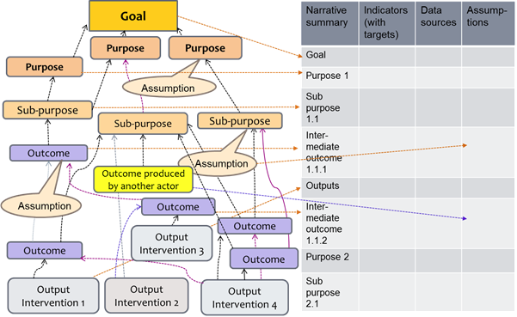
Transferring the TOC to a FFP Log frame

Slide 8
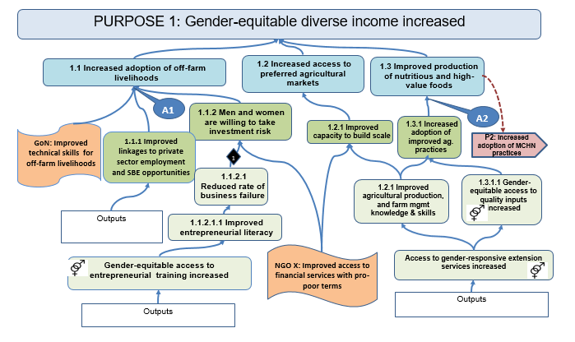
Helpful tips for transfer Save a copy of the TOC and number using log frame format
Notes:
The first step is simply to save an electronic copy of the TOC diagram, specifically for the purpose of numbering outcomes using a logframe format (1.1, 1.2, 1.3, etc.). Start with one Purpose and number only the outcomes that directly feed into that Purpose (those directly linked by an arrow). These outcomes will become sub-purposes. Then move to the next level below and number only the outcomes that directly feed into one sub-purpose. Repeat the process for each sub-purpose. Because a TOC is not a linear model, do not be surprised if the various levels do not line up horizontally the way they might in a results framework. What is most important is the hierarchical order of preconditions, not the physical space (high or low in the diagram) where a component is located.
For now, do not number the cross-purpose linkages. We’ll do that once all Purpose numbering is complete.

Slide 9
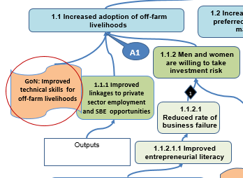
Helpful tips for transfer Do not number outcomes produced by other actors
Notes:
Do not number outcomes produced by external actors. As mentioned earlier, these transfer to the assumptions column. We’ll explain this in detail shortly.

Slide 10
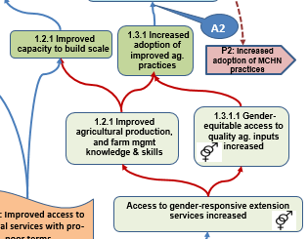
Helpful tips for transfer How to number outcomes that are preconditions for more than one outcome above?
Notes:
Often one outcome is a precondition for several outcomes above.
Try to reach consensus among your team about which outcome stream a ‘multiple pathway contributor’ primarily contributes to and number it accordingly. If all things are equal, simply pick one path or the other. You will have the opportunity to note the contributions to multiple pathway in the logframe notes.
comes. Numbering these ‘multiple contributors’ using a logframe format can be confusing.

Slide 11
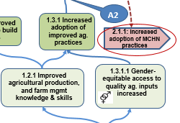
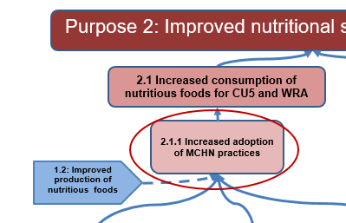
Helpful tips for transfer Match numbering to cross-purpose linkages.
Notes:
Once all the levels of the TOC are numbered, methodically go through and re-number all the cross-purpose linkages. Earlier we gave them a generic Purpose number (e.g. P2), now we want to direct users to the specific outcome in P2 (e.g. 2.1.1).
A two person team is very helpful for this effort.

Slide 12
Transferring the TOC to a Log frame
Notes:
Once all the levels of the TOC are numbered, begin to enter the TOC components into the logframe in the same hierarchy as they are displayed in the TOC. Use the exact same wording.
For outcomes that contribute to multiple levels above, make a small note in the Narrative column. For example, 1.1.2. Gender-equitable access to entrepreneurial & technical training increased (also contributes to 1.1.1.1).
Enter an assumption in the logframe row of the outcome for which it is a precondition.

Slide 13
Transferring assumptions to the logframe
Notes:
Enter an assumption on the same logframe row as the outcome for which it is a precondition.
Outcomes produced by external actors are also entered in the assumptions column of the logframe, because we assume (based on credible data sources) that the other actor will be successful in achieving their efforts. Your project may do its best to influence the other actors’ achievement, but ultimately, it is out of project control. In the assumptions column, phrase external actor outcomes as they relate to achievement (e.g., Feed the Future efforts will increase market access as projected).
After entering the entire Purpose 1 pathway in the logframe, repeat the process for all other Purposes. If your TOC includes an entire domain of change addressed by an external actor, do not enter the domain in the logframe. Instead, enter it as an assumption related to the overarching goal.

Slide 14
Sample log frame with assumptions
Assumption that the efforts of external actors will be achieved
External Assumptions: existing conditions that we expect will remain true for the LOA
Notes:
Sample logframe highlighting the two types of information that is entered in the assumptions column.
After entering the entire Purpose 1 pathway in the logframe, repeat the process for all other Purposes. If your TOC includes an entire domain of change addressed by an external actor, do not enter the domain in the logframe. Instead, enter it as an assumption related to the overarching goal.

Slide 15
Identify Indicators for all TOC levels

Slide 16
TOC Indicators
Quantitative OR qualitative variables, factors, or other measures that:
Tell us how to recognize achievement at each step in the TOC pathways
Verify whether intended changes actually occurred
Notes:
TOC indicators are signposts of change.
They can be quantitative or qualitative variables, measures, or other measures that verify whether an intended change actually occurred.
Indicators provide a simple and reliable means to tell us how success will be recognized at each step in the TOC pathways.

Slide 17
Indicator types and levels in the TOC
Notes:
Impact indicator: Measures the highest level of change your project is responsible for bringing about
Goal and Purposes/ Domains of Change are realized.
Outcome indicator: Measures the change in systems, behaviors, practices, attitudes, etc.
Output indicator: Measures implementation--the goods and services produced by the program activities.

Slide 18
Key areas that hinder effective TOC monitoring
Poor causal logic (inverted, big leaps, illogical linkages, etc.)
Insufficient information available to monitor pathways
Indicators that are inappropriate/ insufficient measures
Insufficient information about change in the middle and upper tiers of TOC (underutilized data)
Limited to no monitoring of assumptions
Limited to no monitoring of external actor efforts

Slide 19
Indicators: necessary & sufficient
In FFP-funded DFSAs:
Start by taking required and RIA FFP Baseline and Annual indicators and exploring how they overlay your TOC diagram
After mapping all applicable FFP indicators, start at the bottom of the TOC diagram and identify all outputs that do not have indicators.
Identify at least one indicator for every output that will transfer to the log frame.
Notes:
Printing a wall-sized version of the TOC is recommended for this exercise.

Slide 20
Indicators: necessary & sufficient
Next, rigorously move up each pathway and identify:
Outcomes that do not have any FFP OUTCOME indicator
Outcomes for which change is only captured by baseline & endline surveys
Outcomes that do not have sufficient FFP indicators to measure change
Notes:
A) Outcomes that do not have any OUTCOME indicator (output indicators are not sufficient to document change for outcomes);
B) Outcomes for which change is only captured by baseline and endline surveys executed by a third party. Many of required baseline/ endline indicators measure changes that you will want to track before the final year. For example, any indicators related to adoption of practices, changes in decision-making, etc.
C) Outcomes that do not have sufficient indicators to measure change: For example, the FFP annual monitoring indicator “ Percent of households with soap and water at a handwashing station commonly used by family members“ is an appropriate measure for the outcome “ Improved WaSH strategies are effectively employed by households“, but alone it is not sufficient to measure outcome achievement.

Slide 21
Insufficient FFP indicators
Insufficient indicators to monitor upper tiers of TOC
Don’t rely on 3rd party data for all outcomes
You will want to know if you are making progress on some key outcome indicators before Year 5!
Check the PIRS for all FFP indicator assigned to a TOC outcome (to what extent will it really tell us whether change is occurring?)

Slide 22
Indicators: necessary & sufficient
Agree on indicators to fill all gaps.
Must be able to understand if change is occurring as predicted, and while there is still time to redirect implementation, if necessary.
Indicators do not necessarily need to be quantitative factors obtained through annual surveys.
May be qualitative factors, or other criteria that provide objective, factual evidence
Notes:
In order to recognize success at each step in the TOC pathways, devise some type of indicator to fill these gaps, so that you are able to understand if change is occurring as predicted, and while there is still time to redirect implementation, if necessary. Indicators do not necessarily need to be quantitative factors obtained through annual surveys. As mentioned, indicators may be qualitative factors, or other criteria that provide objective, factual evidence.

Slide 23
Criteria for deciding WHAT to measure
Balance: needed information vs. useful information
Data that have most potential for adaptive management
Balance: need to know vs. ability to find out
Remember context!
Notes:
Balance needed information versus useful information: Make sure selected indicators actually measure something that you can reliably use to demonstrate progress toward outcomes. While certain information may be useful for program planning, it may not be the type of information needed to determine outcome achievement.
Data that have the most potential for adaptive managment: identify indicators that will enable a continual review of changes in TOC dynamics, such that programs can reevaluate and/or affirm implementation activities.
Balance the need to know versus the ability to find out: In order to measure progress, you must actually be able to collect data on the chosen indicators. If data collection is too difficult, it may hinder efforts to determine program progress.
Context of the situation, problem, and underlying causes: Indicators should be appropriate and relevant to the cultural, socioeconomic, and geographic context.
Source: Caldwell and Sprechmann. 1997. CARE International DM&E Workshop Series. Volume 2: Facilitators Manual

Slide 24
Documenting Indicators
Document indicators in the logframe.
You do not need to insert indicators in the TOC diagram for FFP.
It can be helpful to have an internal version of the TOC diagram that includes indicators.
FFP requires each purpose, sub-purpose, outcome and output transferred to the log frame to have a quantitative or qualitative indicator.

Slide 25
Questions?

Slide 26
Thank you!

