Slide 1
.
Integrating Nutrition Assessment, Counselling, and Support into Health Service Delivery
Training Course for Facility-Based Health Providers
Session 1.2
Malnutrition

Slide 2
Session Objectives
By the end of the session, participants will be able to:
  Explain the meaning of ‘malnutrition’
  Explain the types of malnutrition
  Discuss the causes, consequences, and prevention of undernutrition
  Discuss the causes, consequences, and prevention of overnutrition

Slide 3
Plenary Discussion
What is malnutrition?
What do you think of when you hear the term malnutrition?

Slide 4
Meaning of Malnutrition
Malnutrition is the condition that develops when the body does not get the right amount of the nutrients it needs to maintain healthy tissues and organ function.

Slide 5
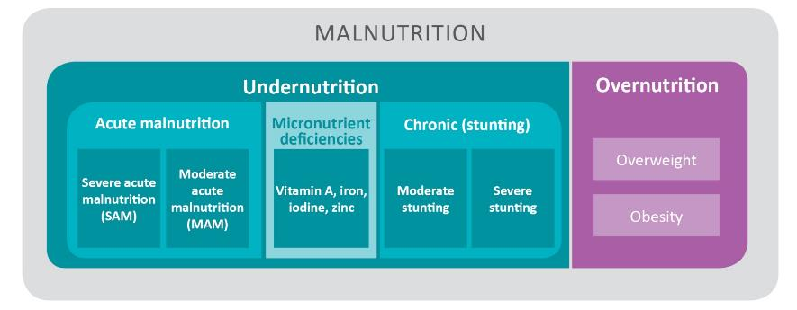
Types of Malnutrition
TYPES OF MALNUTRITION AND CATEGORIES OF ACUTE MALNUTRITION
Note: This course focuses on undernutrition.
Notes:
There are two main types of malnutrition: Undernutrition and overnutrition.
Undernutrition is a consequence of consuming too few essential nutrients, using or excreting them more rapidly than they can be replaced, or not being able to absorb the nutrients consumed, often due to illness or infection.
Acute malnutrition is caused by reduced food consumption and/or illness, resulting in bilateral pitting oedema or wasting, which is thinness measured as low weight-for-height. Children with severe acute malnutrition (SAM) are at increased risk of death and need treatment urgently.
•Chronic malnutrition is caused by long-term or repeated food deprivation or illness that impedes growth and development, resulting in stunting. A stunted child is too short for his or her age (low height-for-age). Stunting can begin in the womb, and children are at highest risk of stunting from pregnancy through their second birthday. Stunting is irreversible after about age 2; hence it must be prevented.
• Micronutrient deficiencies occur when someone has inadequate intake or does not absorb micronutrients, often due to illness. Micronutrient deficiencies that are of concern in Uganda include deficiencies in iron, vitamin A, iodine, and zinc.
Overnutrition results in overweight, obesity, or vitamin toxicity. Overnutrition is of increasing concern in Uganda. However, this course focuses mainly on undernutrition.

Slide 6
Plenary Discussion
Identify the types of malnutrition in the pictures shown.
Notes:
Eating habits: Consumption of sugary and highly processed foods and drinks, large portion size, and fried foods; lack of fruits and green vegetables in the diet; alcoholism
Health conditions: Illnesses, metabolic disorders, hormonal imbalance
Lack of physical activity: (sedentary life style)
Environmental factors: (educational attainment, income, access to food, safety of neighbourhood
Medication: (steroids, anti-depressants, anti-psychotics, anti-seizure drugs, some ARVs)

Slide 7
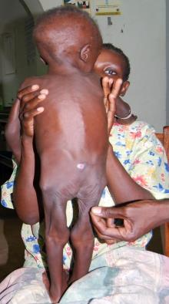
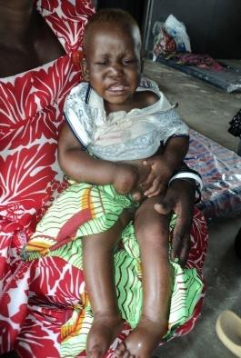
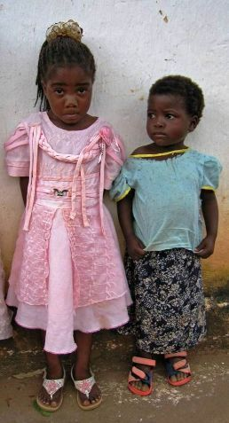
Common Forms of Undernutrition
Girls of the same age
Acute malnutrition
Chronic malnutrition
Notes:
Photo on the left: wasting
Middle photo: bilateral pitting edema (you can see the swelling in the legs and feet), indicating severe acute malnutrition.
Photo on the right: Child (on the right) may be stunted (She is much shorter than the child of the same age, but we don’t know where the other child falls on the growth reference). This would be confirmed, however, by measuring the child’s height and calculating his/her height-for-age

Slide 8
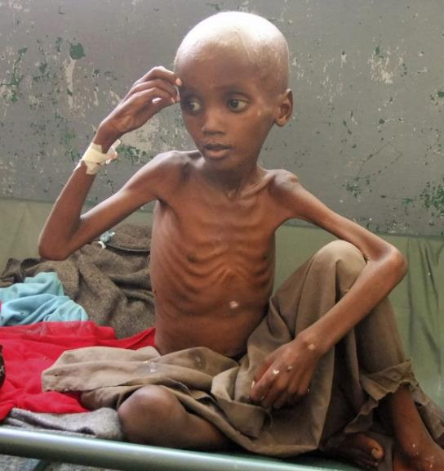
Notes:
Wasting (severe)

Slide 9
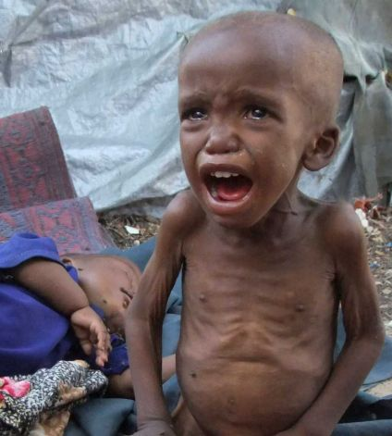
Notes:
wasting

Slide 10
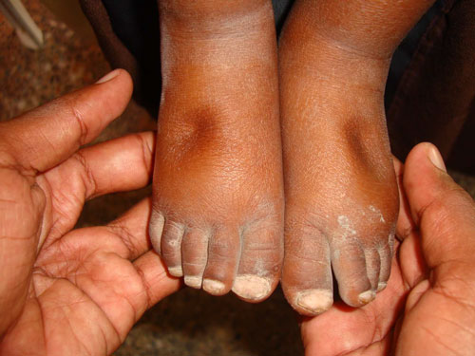
http://motherchildnutrition.org/early-malnutrition-detection/images/edema-step2.jpg
Notes:
Bilateral pitting oedema

Slide 11
Notes:
Wasting (adult)

Slide 12
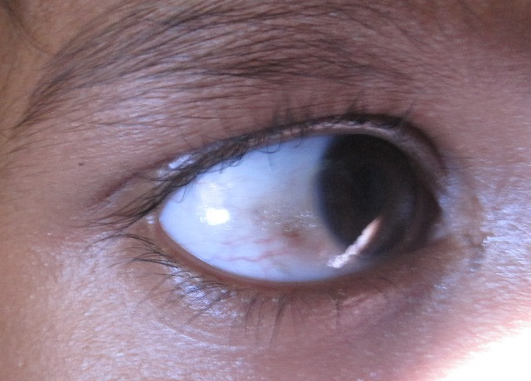
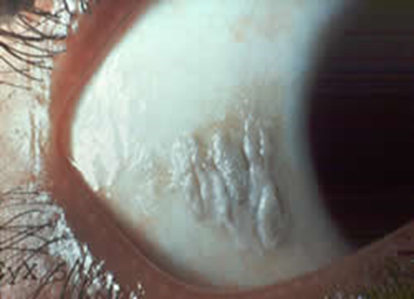
Notes:
Vitamin A deficiency

Slide 13
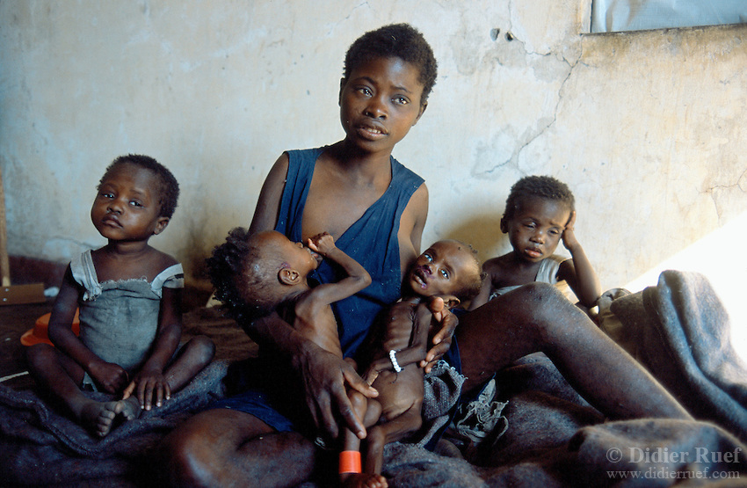
Notes:
wasting

Slide 14
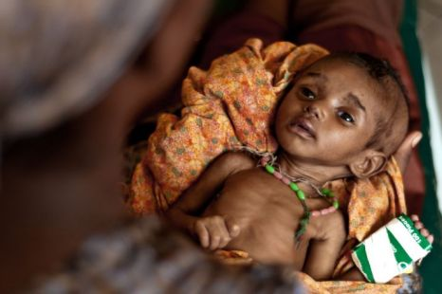
Notes:
wasting

Slide 15
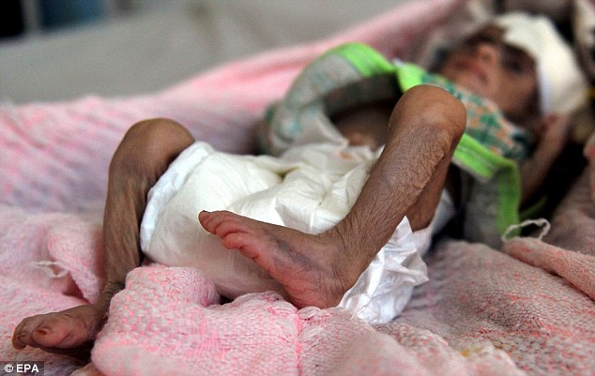
Notes:
Wasting

Slide 16

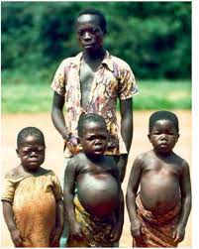
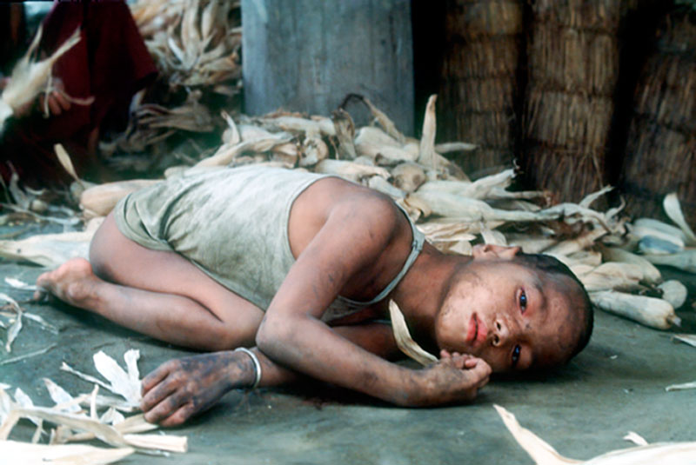
UNICEF/HQ93-2200/Pirozzi
Notes:
Goiter, wasting, acute malnutrition

Slide 17
UNDERNutrItion

Slide 18
Small Group Discussion and Presentation
Discuss the following:
Causes of undernutrition
Consequences of undernutrition
Who is at greatest risk of undernutrition?
How can undernutrition be prevented?
Group 1: At individual level
Group 2: At household level
Group 3: At community level
Group 4: At national level

Slide 19
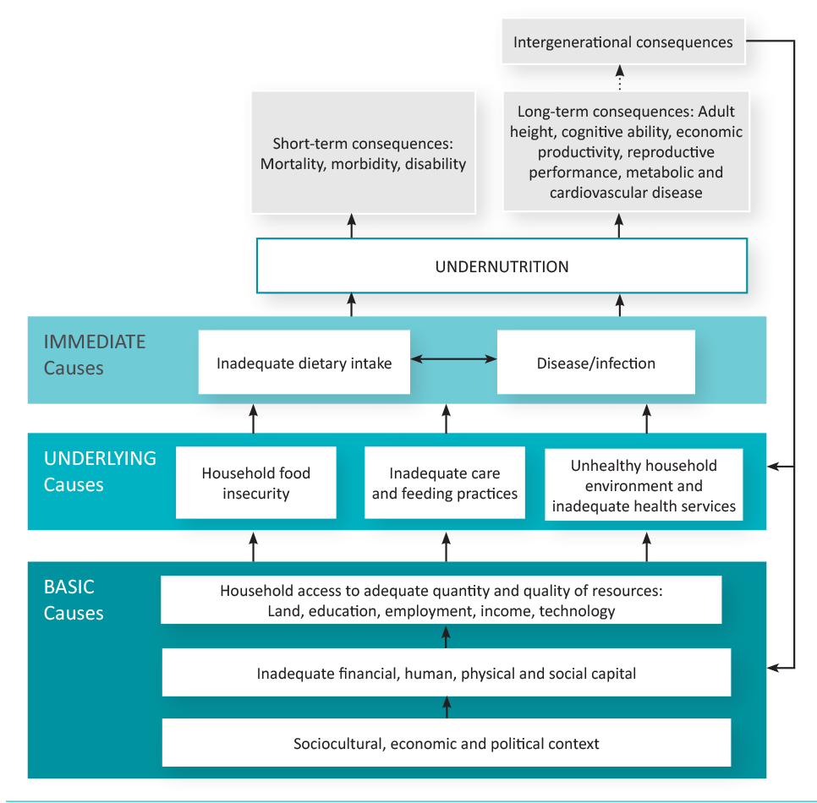
Causes of Undernutrition
(conceptual framework)
Adapted from Black et al. 2008
Notes:
There are several interconnected causes of malnutrition, ranging from policy issues to underlying community and cultural situations to household conditions (figure 1.2.3). The two immediate causes of malnutrition, inadequate dietary intake and infection and disease interact with each other in a cycle that increases a child’s risk of both illness/infection and malnutrition. This training focuses on addressing immediate causes and some elements of the underlying causes (care practices through counseling).
Immediate Causes
• Inadequate dietary intake including poor quality and quantity of food in the diet
• Infection and disease such as malaria, diarrhoeal diseases, acute respiratory infections, and worm infestations
Underlying causes
Household food insecurity including poor access to a diverse diet, inadequate quantity of food available and accessible, and seasonal fluctuations in food availability
• Inadequate maternal and child care, including sub-optimal maternal nutrition and infant feeding practices, often a result of heavy workloads for women and frequent births,
• Poor access to health care and inadequate water and sanitation, leading to increased illness
Basic causes
• Limited livelihood opportunities and unequal economic structure
• Inadequate educational opportunities
• Political and policies
• Priorities guiding the allocation of public funding and other resources
• Quality of social and political leadership

Slide 20
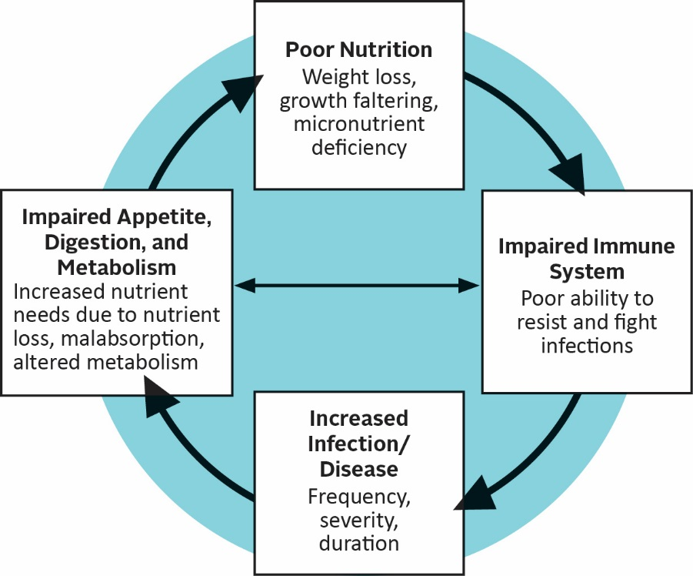
The Vicious Cycle of Undernutrition
HIV
Adapted from Tomkins and Watson 1989

Slide 21
Consequences of Undernutrition
High child mortality, disease, and disability
Newborns who are born small for their gestational age are more likely to die than children born at a healthy weight.
A severely stunted child is four times more likely to die than a healthy child.
A severely wasted child is nine times more likely to die than a healthy child.

Slide 22
Consequences of Undernutrition
High child mortality, disease, and disability
Micronutrient deficiencies—including vitamin A, zinc, and iron—impair the immune system, increasing risk of illness and death.
Anaemia increases risk of maternal and perinatal mortality.
Vitamin A deficiency causes blindness.
Children who are undernourished at birth, in infancy, and in young childhood and who also gain weight rapidly after age 2 are at increased risk for chronic disease in adulthood, including hypertension, cardiovascular disease, and high blood glucose concentrations.

Slide 23

Consequences of Undernutrition
Weakened brain development and nervous system
Impaired cognitive development, poor school achievement, absenteeism (stunting, iron deficiency, anaemia, iodine deficiency)
Neural tube defects (folic acid deficiency)
Impaired fetal brain development, brain damage, severe mental retardation, or congenital abnormalities (iodine deficiency in pregnancy)
Diminished income-earning capacity in adulthood
Notes:
Stunting leads to: Sub-optimal education achievement, Grade loss, Delay in starting school by 7 years (Alderman et al. 2003)
High absenteeism, Poor cognitive ability, Lower intelligence quotient
Iron deficiency can reduce children’s school performance and adults’ physical capacity for work.
Iodine deficiency in children affects their learning capacity, school performance, retention rates, and speech and hearing ability

Slide 24
Consequences of Undernutrition
  Socioeconomic consequences
Contributes to poverty
Cost of treating illnesses attributable to malnutrition
Cost of caring for sick
Lost care for other (not sick) household members

Slide 25

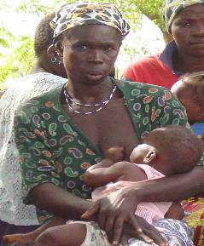
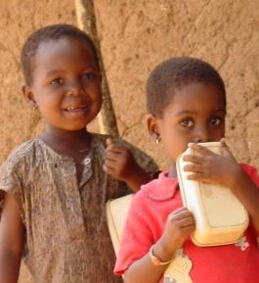
Who is at Greatest Risk of Undernutrition?
  Infants and children from pregnancy to age 2
  Non-breastfed children
  OVCs
  Women of child-bearing age (15-49)
  Pregnant and lactating women
  People suffering from chronic or infectious disease
  The elderly

Slide 26
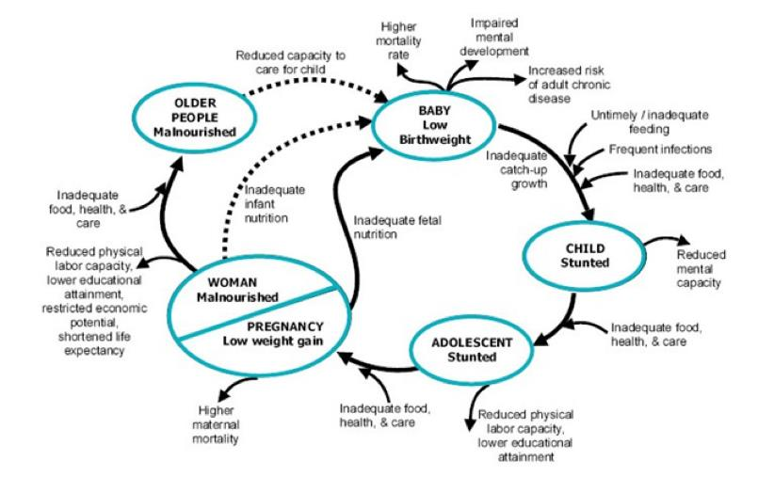
Undernutrition Across the Life Cycle
Notes:
occurs across generations.
Begins in utero (babies born small for gestational age)
Children born undernourished are at higher risk of developmental delays, death, more likely to be stunted
Undernourished children have increased risk of illness and death, impaired cognitive development and may be more likely to suffer from chronic disease in adulthood.
After age 2, don’t regain losses
Malnourished school children have reduced attendance and school performance.
These children enter adolescence stunted. Growth spurt may allow to regain lost growth, but not cognitive development.
Stunted adolescent likely to become a stunted adult, whose health and productivity are compromised.
Stunted women and adolescents are more likely to have a low birth weight baby, continuing the cycle.
There is an urgent need to break this cycle. The principal points of intervention to stop the cycle of malnutrition are the 1,000 days period from pregnancy to age 2 and in assuring the nutritional well-being of the adolescent girl or woman even before she is pregnant. (Figure 1.2.4)

Slide 27
Prevention of undernutrition
Promotion of exclusive breastfeeding and continued breastfeeding up to 2 years and beyond
Appropriate complementary feeding practices
Supplementation with Vitamin A and iron/folic acid
Immunization and deworming
Promotion of maternal nutrition
WASH practices
GMP
Notes:
Eating habits: Consumption of sugary and highly processed foods and drinks, large portion size, and fried foods; lack of fruits and green vegetables in the diet; alcoholism
Health conditions: Illnesses, metabolic disorders, hormonal imbalance
Lack of physical activity: (sedentary life style)
Environmental factors: (educational attainment, income, access to food, safety of neighbourhood
Medication: (steroids, anti-depressants, anti-psychotics, anti-seizure drugs, some ARVs)

Slide 28
OVERNutrItion

Slide 29
Overnutrition
Overnutrition is a condition caused by abnormal or excess fat accumulation in the body that may lead to health problems and reduced life expectancy.
Overnutrition starts as overweight and if left uncontrolled may progress to obesity,
Obesity is the severe form of overnutrition associated with adverse health conditions.

Slide 30

Overnutrition: Overweight

Slide 31
Plenary discussion
Common causes of overnutrition
Consequences of overnutrtion
Prevention of overnutrition

Slide 32
Causes of Overnutrition
Increased consumption of energy-dense, nutrient-poor foods combined with reduced physical activity.
Others
  Medications
  Metabolic syndrome
  Cushing’s syndrome
  Hypothyroidism
  Modern conveniences/lifestyles
  Genetic factors/ family history of obesity
  Company/peer pressure
  Psychological factors
  Health conditions
  Environmental factors

Slide 33
Consequences of Overnutrition
Overnutrition (overweight and obesity) during pregnancy increases risk of childhood obesity which in turn increases the risk of adolescent and adult obesity.
Maternal obesity is associated with complications during delivery, gestational diabetes, pre-eclampsia, maternal death, and neonatal and infant death.
Overweight increases the risk of coronary heart diseases (CHD), type 2 diabetes, gout, and hypertension

Slide 34
Consequences of Overnutrition
Obesity predisposes people to medical conditions commonly known as the ‘Obese syndrome’:
Related medical hazards: stroke, organ failures, arthritis, arteriosclerosis, varicose veins
HEART DISEASE
CANCERS
DIABETES
HIGH BLOOD PRESSURE
ARTHRITIS
OBESITY
SLEEP APNEA
QUALITY OF LIFE
HIGH CHOLESTEROL
RESPIRATORY PROBLEMS
HYPERTENSION

Slide 35
Prevention of Overnutrition
Education and behavior change at individual and programmatic levels:
Nutrition education and counselling on:
  Healthy food choices
  Healthy eating habits
  Increased physical activity
  Control amount of foods eaten
  Improve sleep
  Reduce stress
Routine nutrition assessment, counselling, and support

Slide 36
Thank you!
Questions, additions, and clarifications?

