Slide 1

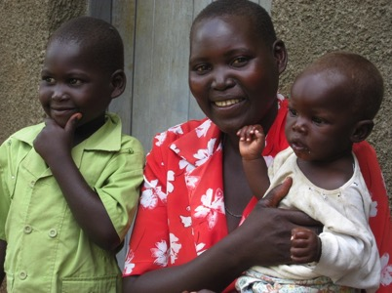
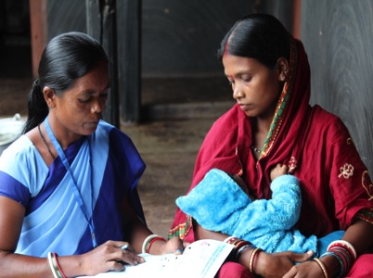
District Assessment Tool for Anemia (DATA) Overview
Notes:
This presentation will cover all aspects of DATA, including why the tool was developed, the purpose of DATA, the audience for DATA, the steps for using DATA, the inputs and outputs of DATA, and sectors/interventions included in the tool.

Slide 2
Why develop DATA?
Anemia is caused by multiple factors, which vary by context
Anemia is a multi-sectoral issue that needs coordination between stakeholders from the various sectors.
Decision-making in public health programming is decentralized to the district level.
Slide 2
Notes:
Anemia is a complex condition that can be caused by a wide range of risk factors, which act through various, interwoven mechanisms.
Anemia’s risk factors vary considerably by setting, and efforts to reduce anemia prevalence, if they are to be successful, must address the context-specific risk factors in a particular setting.
Given anemia’s multiple risk factors, effective prevention and control efforts need to foster communication and collaboration from all relevant sectors and stakeholders implicated in anemia programming.
In recent years, many countries have moved (or are moving) towards a decentralized health planning system, where districts are granted the autonomy to assess their specific situations and allocate funds to alleviate their most pressing health issues.
Within this context, DATA was developed to help district officials understand their situation with regards to anemia and develop action plans prioritizing interventions that address the major risk factors contributing to it.

Slide 3
Why develop DATA?
A district level tool:
  Acknowledges the importance of contextual factors
  Identifies the gaps, enablers, and barriers to addressing the risk factors that lead to anemia
  Assists with prioritization of district-level anemia interventions
Slide 3
Notes:
*Reiterate why DATA was developed by reading out loud the bullets on the slide. Slide 4 will delve further into the purpose of the tool.*

Slide 4
Purpose of DATA
Increases an understanding about anemia and its causes
Highlights current data and encourages further data collection
Helps prioritize activities and interventions in a way that is most likely to address the most important causes of anemia
Slide 4
Notes:
DATA is designed to:
Increase understanding about anemia and its causes
Awareness about anemia's multifactorial nature
Improved understanding of risk factors
Emphasis on multisectoral efforts needed to address anemia
Highlights current data and encourages further data collection
Uses data that is already-available data routinely collected by districts to inform decisions
Helps prioritize activities and interventions in a way that is most likely to address the most important causes of anemia
Walks participants through a barriers assessment exercise to identify the gaps in implementation

Slide 5






Audience: District level stakeholders across sectors
AGRICULTURE
DISEASE CONTROL
NUTRITION
REPRODUCTIVE HEALTH
WASH
EDUCATION
Slide 5
Notes:
Given that anemia’s risk factors and interventions span multiple sectors, the district-level workshop participants should include government stakeholders from the following sectors: the health sector, especially the nutrition, disease control, and reproductive health units, as well as the water, sanitation and hygiene (WASH), agriculture, and education divisions.
Non-governmental organizations, donor agencies, academia, and the private sector often have roles to play in anemia reduction and control efforts, and should be part of the workshop if they are involved or implicated in the implementation anemia-related interventions in the district.

Slide 6
Steps of Using DATA
Step 1: Review the anemia situation—consult Overview Dashboard
Step 2: Review anemia programs and policy—consult Findings Dashboard
Step 3: Review inputs to prioritization—discuss considerations for program implementation
Step 4: Identify and assess barriers to implementation—complete the barriers section
Step 5: Formulate a plan of action
Slide 6
Notes:
*Read out loud the five steps involved in using DATA, and explain to workshop participants that these steps will be covered in much more detail on Day 2, during the “Decision Framework for Prioritization of Anemia Action” presentation*

Slide 7
Step 1: Review the Anemia Situation
The national questionnaire is comprised of the following questions:
  Anemia prevalence among children under 5 and women of reproductive age at the national and sub-national levels
  National levels of iron deficiency and vitamin A deficiency
  Status of anemia-related national policies
Slide 7
Notes:
*Note that the national questionnaire is filled prior to the DATA workshop, and is instrumental as it gives the country context for the district.*

Slide 8
Step 2: Review Anemia Programs and Policy
The district questionnaire is comprised of seven sections
  Anemia prevalence at the district level
  Six sectoral sections: Nutrition, Reproductive Health, Disease Control, WASH, Agriculture, Education
  Additional guidance is often available via pop-up by clicking on the corresponding cell.
  Dropdown menus within the cell provide suggested responses
Slide 8
Notes:
Completing the District Questionnaire
Workshop participants will be asked to fill out a questionnaire to capture information on:
the prevalence of anemia in the district;
its prevalence of risk factors for anemia in the district;
the status of anemia-related interventions in the district.
The questions are divided by the following sectors: nutrition, reproductive health, disease control, water, sanitation and hygiene (WASH), agriculture, education.
Dropdown menus will provide additional instructions/guidance and suggestions for qualified options.
When prevalence or program coverage data is not available, participants will have the option to qualitatively rate the prevalence of anemia/risk factors and coverage of interventions.

Slide 9
Step 2: Data sources
Health information management system (HMIS)
Logistics management information system (LMIS)
Program reports
District annual reports
Surveys (demographic health survey, micronutrient survey, etc.)
Slide 9
Notes:
*Mention the various data sources that can be used to inform risk factor prevalence and program coverage. In the absence of reliable quantitative data, remind participants that they can leverage their expertise in their respective areas and their experience in the district to qualitatively rate prevalence or coverage.*

Slide 10
Step 3: Review Inputs to Prioritization,
Step 4: Assess Barriers to Implementation
Presence of a policy
Coverage
Commodities
Funding
Provider Skills/Training
Client demand
Slide 10
Notes:
Step 3 is when we turn to the Prioritization Process, where we list the inputs in the tool (presence of policy, coverage, commodities, funding, provider skills/training, and client demand) alongside any others identified by the participants.
Step 4 we look in detail at four specific barriers in the tool that also feature in the list of inputs - commodities, funding, provider skills/training, and client demand
Details of the list of inputs:
DATA considers six factors for successful program implementation and for decision making. These are listed in the Findings Dashboard and will help guide discussions during the barriers assessment segment of the workshop:
Presence of a policy (without which the intervention is not likely to be implemented): Policy is usually determined at the national level, with districts adhering to national policy. Districts need to be aware of these policies. Note that this will be filled out as part of the National Questionnaire.
Coverage: the overall percentage of the target population receiving the intervention, which depends on demand and quality of service delivery. Districts are also unlikely to have population-based coverage information; however, they may have reported information that will give some indication of coverage. Note that this will be filled out as part of the District Questionnaire.
Commodities: adequate and consistent supply of the commodity required for an intervention. Districts are likely to have logistics information on commodity outflow to health clinics. This can be useful to confirm that a needed commodity is available to service providers because, without the commodity, it is not possible to provide the service.
Funding: adequate and consistent allocation of resources to successfully implement an intervention.
Provider skills/training: adequate training of staff including refresher training and supportive supervision to ensure high quality of services.
Client demand: awareness of and interest in the intervention in the target population.

Slide 11
Step 5: Formulate Plan of Action
Review the outputs of the tool in two dashboards
Identify and prioritize actions that can help to alleviate anemia in the district
Formulate a plan of action by each sector
Slide 11
Notes:
After the participants answer all the questions in DATA, the tool will convert their responses into digestible information using dashboards, and this information can in term inform health program planning in the district.
The dashboards present the following information: the prevalence of anemia and its risk factors at the national, sub-national, and district levels; the status of policies and strategies for anemia reduction and control in the country; the coverage levels of anemia-related interventions in the district; and the barriers to implementation.
Equipped with this information, participants will be able to identify enablers and barriers to address anemia and develop a tailored action plan for coordinated and improved efforts in anemia programming.

Slide 12
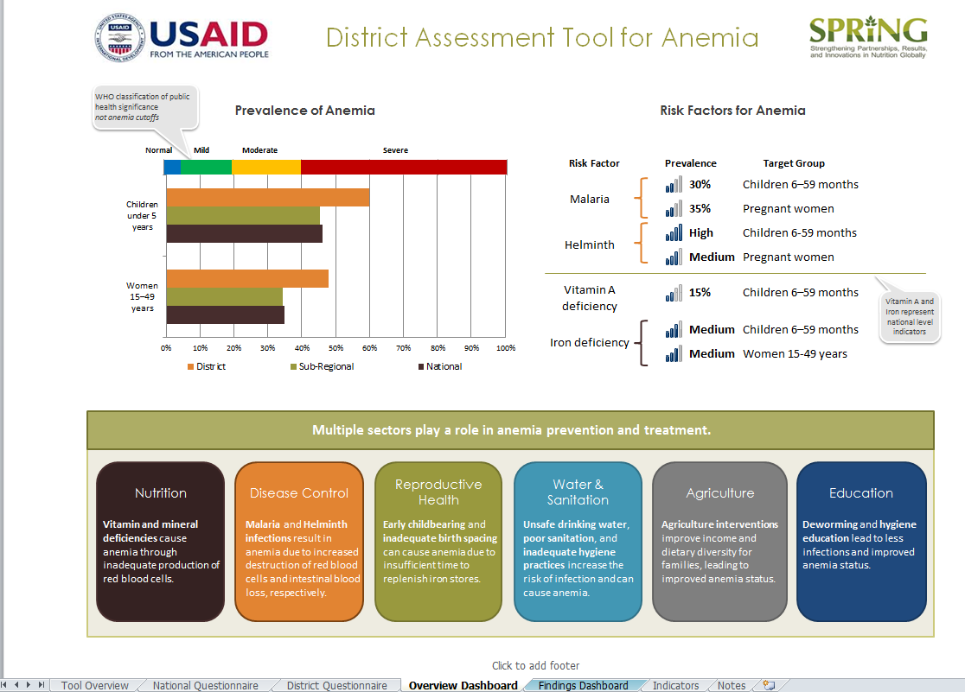
Using DATA: Overview Dashboard
Once the survey questions have been answered, the data can be viewed on dashboards by program area
  This information can be used to identify issues and prioritize actions
Prevalence
of anemia
Risk factors for anemia
Relevant sectors that play a role in anemia programming
Slide 12
Notes:
The Overview Dashboard tab displays high-level data, including: anemia prevalence for children under 5 years and women 15–49 years at the national, sub-national, and district levels; prevalence of anemia risk factors; and an overview of the sectors involved in anemia reduction.

Slide 13
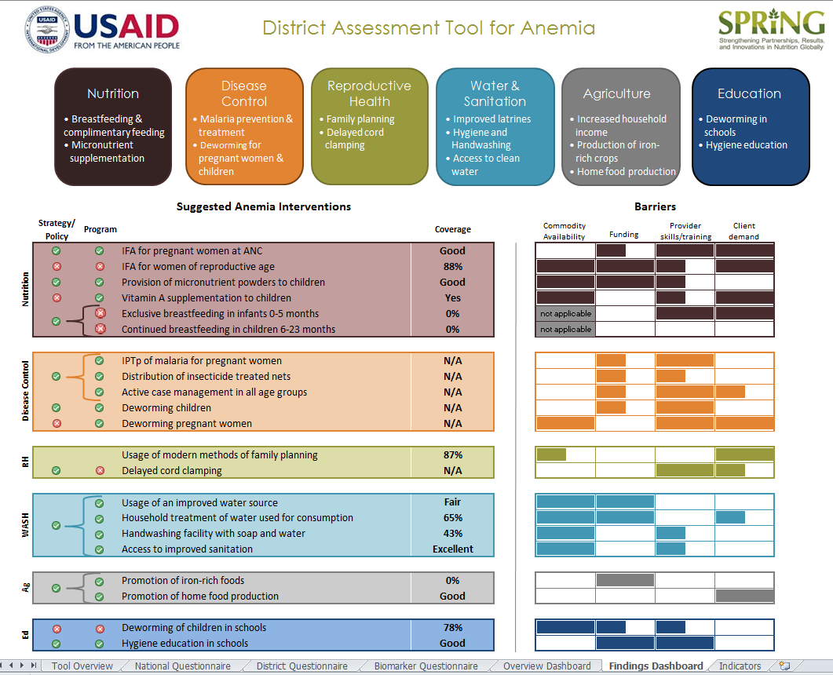
Using DATA: Findings Dashboard
Once the survey questions have been answered, the data can be viewed on dashboards by program area
  This information can be used to identify issues and prioritize actions
Interventions for anemia
Details on barriers for each intervention
Details on policy and program coverage for each intervention
Slide 13
Notes:
The Findings Dashboard includes: a list of interventions that are available for anemia reduction, and policy and program coverage information for these suggested programs in your district, based on the answers you provided in the National and District Questionnaires. The dashboard also includes a section on barriers to each of the suggested programs, which participants will complete as one large group. Depending on the data that is entered in the questionnaires, the information shown may be quantitative or qualitative.

Slide 14
Nutrition
Risks Related to Anemia
Suggested Interventions
Iron deficiency causes anemia through the inadequate production of red blood cells.
Vitamin deficiency, specifically vitamins A and B12 and folate (B9) also contribute to anemia.
Iron-folic acid supplementation for:
    Pregnant women
    Women of reproductive age
  Multivitamin supplementation, including micronutrient powders for children under 5 years
  Vitamin A supplementation for children 6-59 months
  Appropriate infant/young child feeding practices
Slide 14
Notes:
*Recall that these risks and interventions have been discussed at length in the Anemia Overview presentation. In this presentation, the risks and accompanying interventions are grouped by sector.*

Slide 15
Disease Control:
Malaria and Helminthic Infections
Risks Related to Anemia
Suggested Interventions
Malaria infections result in anemia when the destruction of red blood cells is increased or their production is reduced.
Helminthic infections are transmitted through the soil (e.g., hookworms, roundworms, and whipworms) or through water (e.g., schistosomes). These helminth infections cause anemia through iron deficiency brought on by chronic blood loss.
Malaria prevention, diagnosis, and treatment
Antihelminthic treatment for:
  Children
  Women
Slide 15
Notes:
*Recall that these risks and interventions have been discussed at length in the Anemia Overview presentation. In this presentation, the risks and accompanying interventions are grouped by sector.*

Slide 16
Reproductive Health
Risks Related to Anemia
Suggested Interventions
Early child bearing can cause anemia due to the increased nutritional demands placed on adolescent mothers.
Insufficient birth spacing can cause iron deficiency and anemia, as well as undernutrition, more broadly.
Family planning counseling services that include information on benefits to delayed child births and adequate birth spacing
Delayed cord clamping
Slide 16
Notes:
*Recall that these risks and interventions have been discussed at length in the Anemia Overview presentation. In this presentation, the risks and accompanying interventions are grouped by sector.*

Slide 17
Water and Sanitation
Risks Related to Anemia
Suggested Interventions
Unsafe drinking water, poor sanitation, and inadequate hygiene practices increase the risk of infection and can cause anemia
Access to and usage of:
  Improved water sources
  Improved sanitation facilities
  Hygiene facilities and programs
Slide 17
Notes:
*Recall that these risks and interventions have been discussed at length in the Anemia Overview presentation. In this presentation, the risks and accompanying interventions are grouped by sector.*

Slide 18
Agriculture
Risks Related to Anemia
Suggested Interventions
Limited dietary diversity and limited access to micronutrient-rich foods and biofortified foods increase the likelihood of anemia.
Production of micronutrient-rich and biofortified crops
Home food production (gardening and livestock breeding/ animal husbandry programs)
Slide 18
Notes:
*Recall that these risks and interventions have been discussed at length in the Anemia Overview presentation. In this presentation, the risks and accompanying interventions are grouped by sector.*

Slide 19
Education
Risks Related to Anemia
Suggested Interventions
Helminth infections cause anemia in school age children
Lack of hygiene causes inflammation and infection
Mass deworming of school age children
Hygiene education
Slide 19
Notes:
*Education was not explicitly discussed in the Anemia Overview presentation, because it is not a “risk” or “intervention” for anemia. Rather, education is a very useful platform through which many interventions for anemia can be administered efficiently and effectively. Two good examples of this are mass-deworming of school-age children and hygiene education. Schools, by definition, mobilize children and present an opportunity where these children can be targeted with messages about hygiene or nutrition, or where they can receive deworming pills.*

Slide 20
Thank you!

