Slide 1
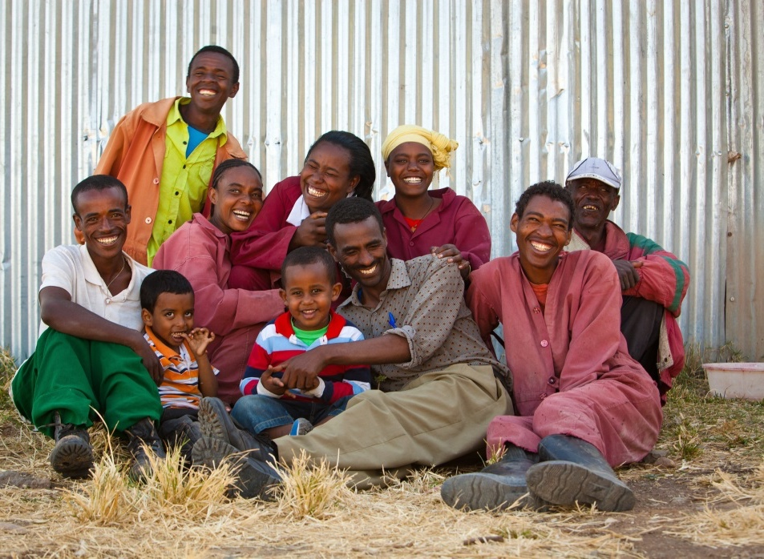
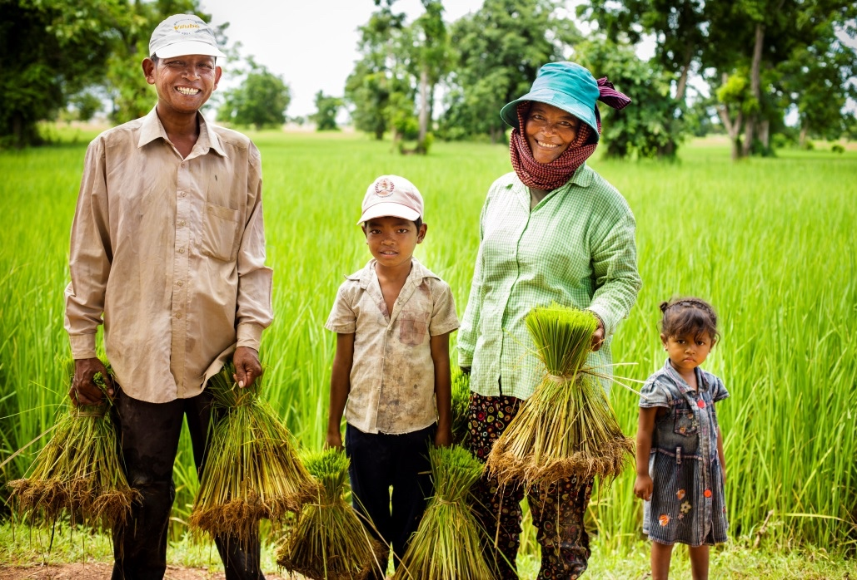
Designing Effective Nutrition-Sensitive Agriculture Activities
DECK 1
Nutrition-Sensitive Agriculture Training Resource Package
November 2022
Photos: (left) Morgana Wingard, USAID, (right) Fintrac, Inc.

Slide 2
Strengthening Nutrition Results through Agriculture Activities
Explicitly design agriculture activities to improve nutrition
The impact of malnutrition is serious:
45 percent of child deaths are due to undernutrition
lower IQ and school performance
reduced work productivity and earnings
across Asia and Africa, 11 percent of GDP is lost annually.
Focusing on food, income, and gender is key!

Slide 3
Workshop Objectives
Select nutrition-sensitive agriculture outcomes appropriate to the participants’ agricultural market systems development activity.
Analyze and prioritize strategies for reducing malnutrition.
Develop relevant practices, interventions, and indicators to include in the activity design.
Outline the next steps for implementation and monitoring.

Slide 4
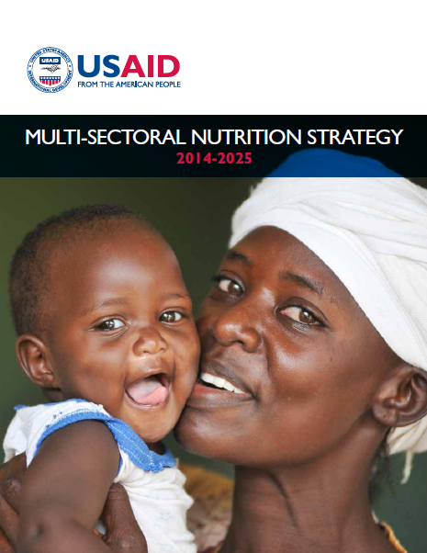
Nutrition-Sensitive Agriculture at USAID
USAID’s Multi-Sectoral Nutrition Strategy 2014–2025 aims to decrease chronic malnutrition through the Feed the Future and Global Health initiatives, the Bureau for Humanitarian Assistance development programs, resilience efforts, and other nutrition investments.
Overall goal: Improve nutrition to save lives, build resilience, increase economic productivity, and advance development.

Slide 5
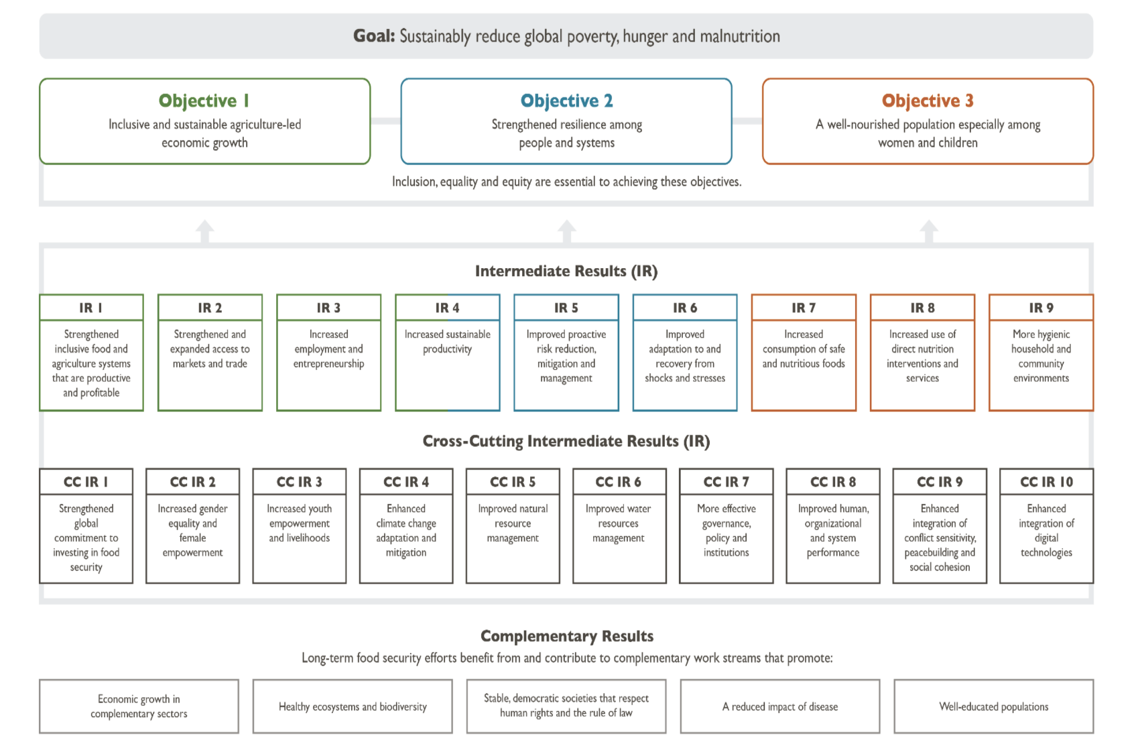
Global Food Security Strategy Results Framework
(USAID. 2021, 25)
Source: USAID. 2021. U.S. Government Food Security Strategy 2022–2026.Washington, D.C.: USAID.

Slide 6
Four Steps for Designing a Nutrition-Sensitive Agriculture Activity
Prioritize nutrition-sensitive agriculture outcomes for your activity.
Prioritize nutrition-sensitive agriculture strategies.
Identify practices and develop interventions.
Define monitoring indicators.

Slide 7
Activity Design Matrix
Nutrition-Sensitive Agriculture Outcome | Strategy | Practice | Intervention | Indicator

Slide 8
Activity Design Matrix—West Africa Example
STEP 1 | STEP 2 | STEP 3 |  | STEP 4
Nutrition-Sensitive Agriculture Outcome | Strategy | Practice | Intervention | Indicator
Improved availability of diverse, nutrient-rich foods in local markets | Strengthen capacity of cooperative members and farmer groups in appropriate post-harvest handling and storage practices for cowpeas and rice | Recognize damaged or spoiled cowpea seed Sort and remove damaged seeds/grains Test moisture level before storage | Train cowpea growers in good sorting, drying, and moisture testing practices before storage Train rice growers in good drying and moisture testing practices before storage | Output indicators: Number of rice/cowpea growers using improved drying technology Number of rice/cowpea growers measuring moisture levels for their commodity prior to storage Outcome indicator: Percent increase in volume of cowpeas and rice in local markets
Notes:
KM: Can the ‘Steps’ be made their own row or something?

Slide 9
Six Nutrition-Sensitive Agriculture Outcomes
Improved availability of diverse, nutrient-rich foods in local markets
Improved affordability of diverse, nutrient-rich foods in local markets
Improved desirability of diverse, nutrient-rich foods among target consumers
Improved environmental and food safety
Increased time and energy savings for women
Increased income control by women and equitable opportunities

Slide 10
Ensure a Common Understanding of Nutrition-Sensitive Agriculture
Photo: Clement Tardif, Feed the Future Senegal, Yaajeende project

Slide 11
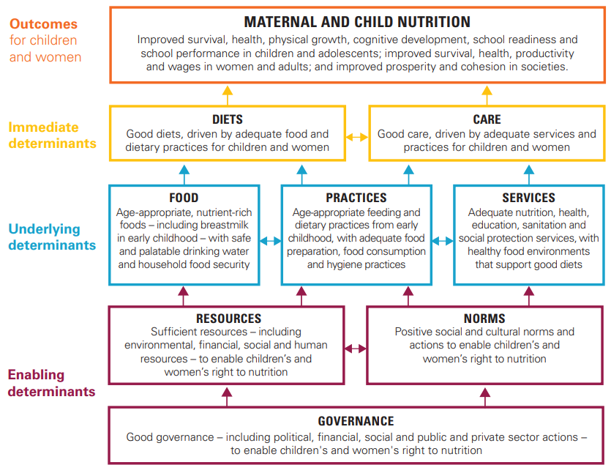
UNICEF Framework: Reducing Malnutrition
UNICEF. 2020. UNICEF Conceptual Framework on Maternal and Child Nutrition. Accessed April 8, 2022. ttps://www.unicef.org/documents/conceptual-framework-nutrition
Source: UNICEF (United Nations Children’s Fund). 1990. Strategy for Improved Nutrition of Children and Women in Developing Countries: A UNICEF Policy Review. New York: UNICEF.

Slide 12
Vote with Your Feet
Goal: Identify the differences between nutrition-specific and nutrition-sensitive interventions
Imagine the room is divided in two with a line down the middle. One side represents the nutrition-specific category; the other is nutrition-sensitive.
Listen to the example interventions and move to the side of the room that categorizes it as either nutrition-specific or nutrition-sensitive. Be prepared to explain your answer to the group.

Slide 13
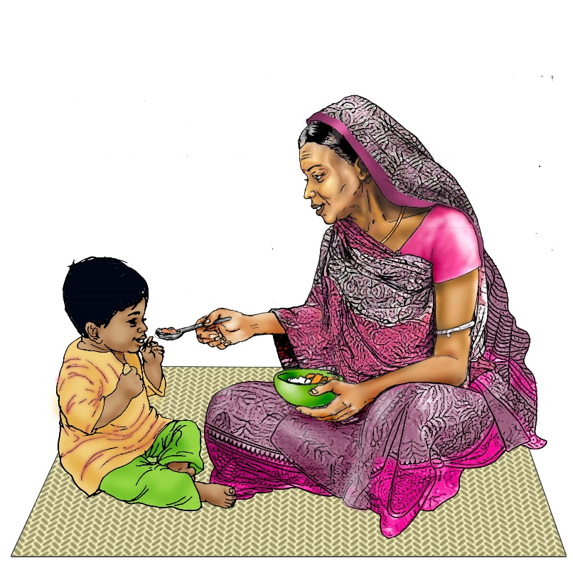
Essential Nutrition Concepts: Objectives
Describe five forms of malnutrition.
Analyze the essential needs of infants, children, and mothers, especially during the period from conception to the child’s second birthday.
Identify strategies for interrupting the cycle of malnutrition.
Credit: USAID Advancing Nutrition and UNICEF IYCF Image Bank

Slide 14
Teaching One Another
Goal: Establish a common understanding of essential nutrition concepts.
Divide into four groups. Each group will receive a set of notes that accompany a slide.
As a group, decide how you would like to present your content. Ensure that all members of your group have a role to play.
Each group will have 10 minutes to present this content.

Slide 15
Five Forms of Malnutrition
Malnutrition: General term that includes micronutrient deficiencies, undernutrition, and overweight/obesity
Form of Malnutrition | Description
Wasting | Weight too low for height
Stunting | Height too low for age
Underweight | Weight too low for age
Overweight/obesity | Weight too high for height
Micronutrient deficiency | Not enough essential vitamins and minerals present in the body

Slide 16
What Reduces Undernutrition?
Nutrition-sensitive interventions
Micronutrient
fortification &
supplementation
(iron, zinc, vitamin A)
Infant and young
child feeding
& Essential
Nutrition Actions
Community management
of acute malnutrition
Integrated management of childhood illness

Slide 17
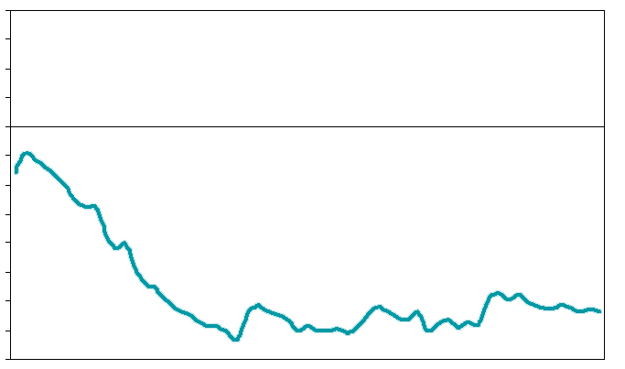
Reaching Children at the Right Time
Stunting (Height for Age) Among Children Under Five Years, Compiled Data from 54 Low-Income Countries
Z-scores
0
-1
-2
1
12
24
36
48
60
Age (months)
Source: Victora, C.G., M. de Onis, P.C. Hallal, M. Blössner, and R. Shrimpton. 2010. “Worldwide Timing of Growth Faltering: Revisiting Implications for Interventions.” Pediatrics. 125(3): e473–e480.
Doi.org/10.1542/peds.2009-1519

Slide 18
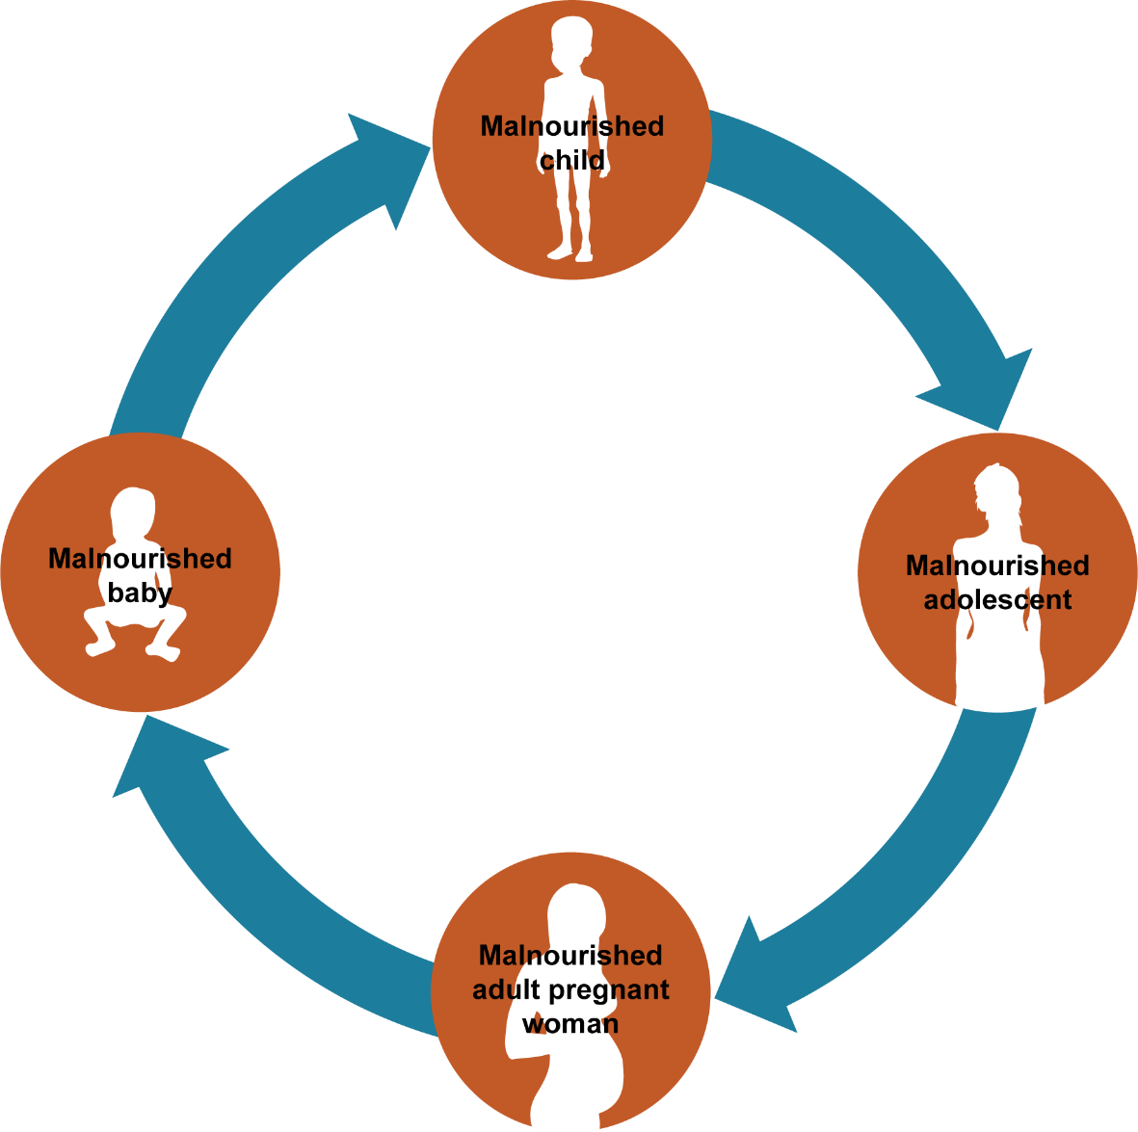
The Cycle of Malnutrition

Slide 19
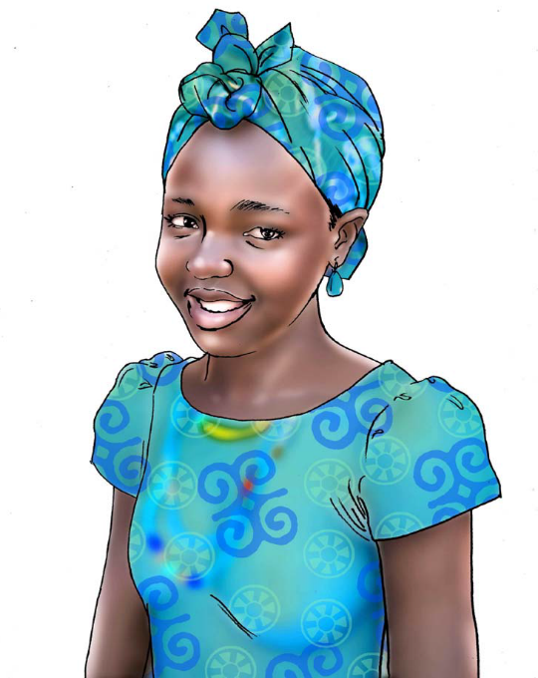
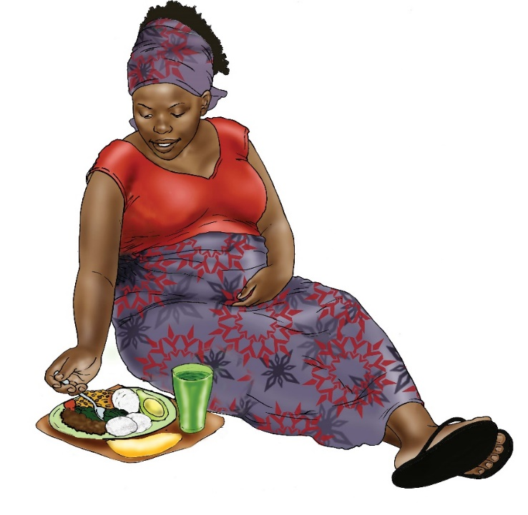
A Diverse Healthy Diet is Needed at All Stages of Life
Credit: USAID Advancing Nutrition and UNICEF IYCF Image Bank

Slide 20
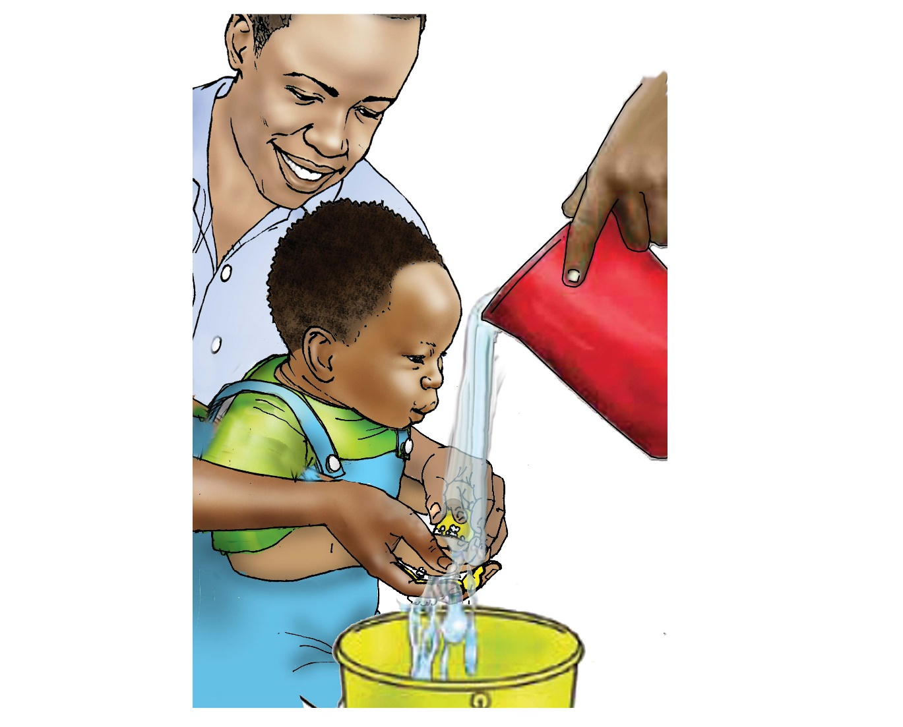
Other Important Practices
Credit: USAID Advancing Nutrition and UNICEF IYCF Image Bank

Slide 21
PLACEHOLDER: Nutrition Situation in Implementation Area

Slide 22
How Does Agriculture Affect Nutrition?
Food produced and consumed
Calories
Protein
Micronutrients
Safety
Income generated and how it is spent
Diverse diet and nutrient-rich foods
Health and water, sanitation, and hygiene services and products
Use of women’s time and energy
Managing demands on women’s time and energy
Maximizing women’s control of income

Slide 23
Agriculture as a Source of Food
Decisions about what to produce are influenced by—
market prices
relative costs/risks
productive assets
preferences
cultural norms.
The ability to process and store food affects—
shelf-life and safety
nutrient content
access to food during lean times.

Slide 24
Agriculture as a Source of Income
Improved year-round income and cash flow to meet household needs, including diverse, nutritious foods
Assumes nutritious foods are available in markets; reflects the importance of generating demand and need for nutrition education

Slide 25
Agriculture as a Means to Women’s Empowerment
Women are more likely to spend added income on the health and nutritional needs of the household.
Women’s access to income is considered more often than time and energy use.

Slide 26
Building the Agriculture-to-Nutrition Story
Goal: Discuss the different agriculture-to-nutrition pathways.
Arrange the icons with the goal of telling a story about the links between agriculture and nutrition. Feel free to interpret the images in whatever way makes sense for your story, but start with the image of the field/crops and end with the family.

Slide 27
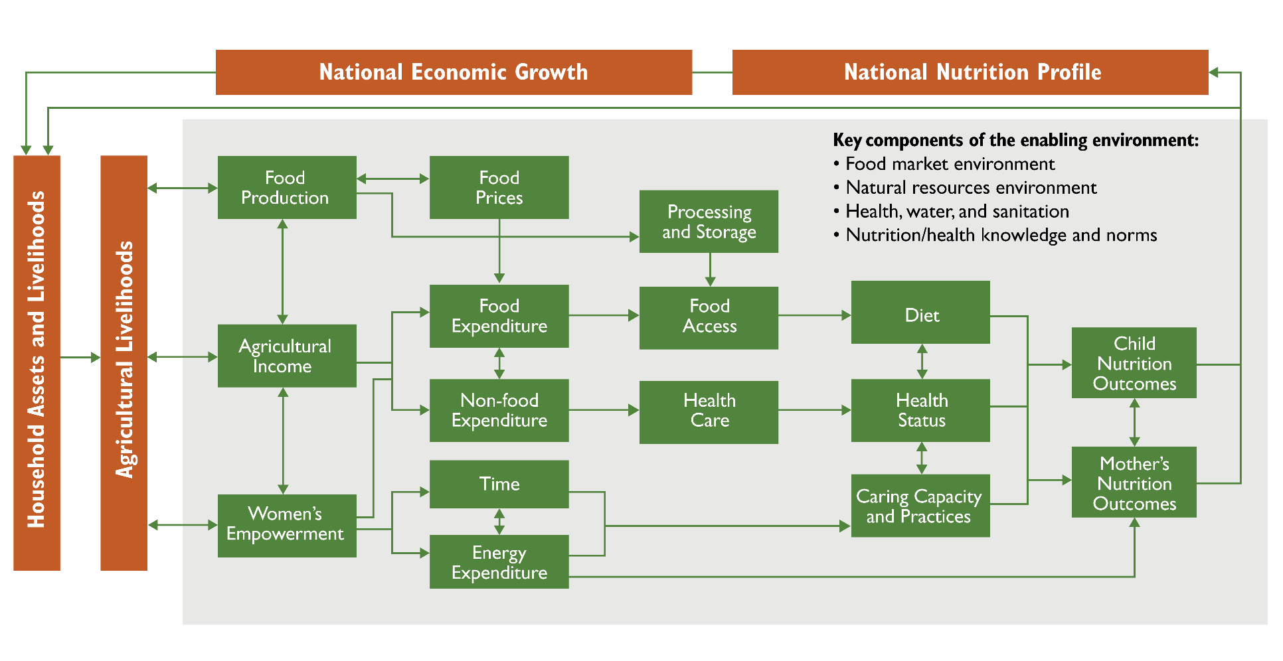
Agriculture-to-Nutrition Pathways
Headey, D., A. Chiu,, and S. Kadiyala. 2011. “Agriculture’s Role in the Indian Enigma: Help or Hindrance to the Undernutrition Crisis?” IFPRI discussion paper 01085. Washington, DC: IFPRI.
Kadiyala, S., J. Harris, D. Headey, S. Yosef, S. Gillespie. 2014. “Agriculture and Nutrition in India: Mapping Evidence to Pathways. Annals of New York Academy of Sciences. 1331:43–56. doi.org/10.111/nyas.12477

Slide 28
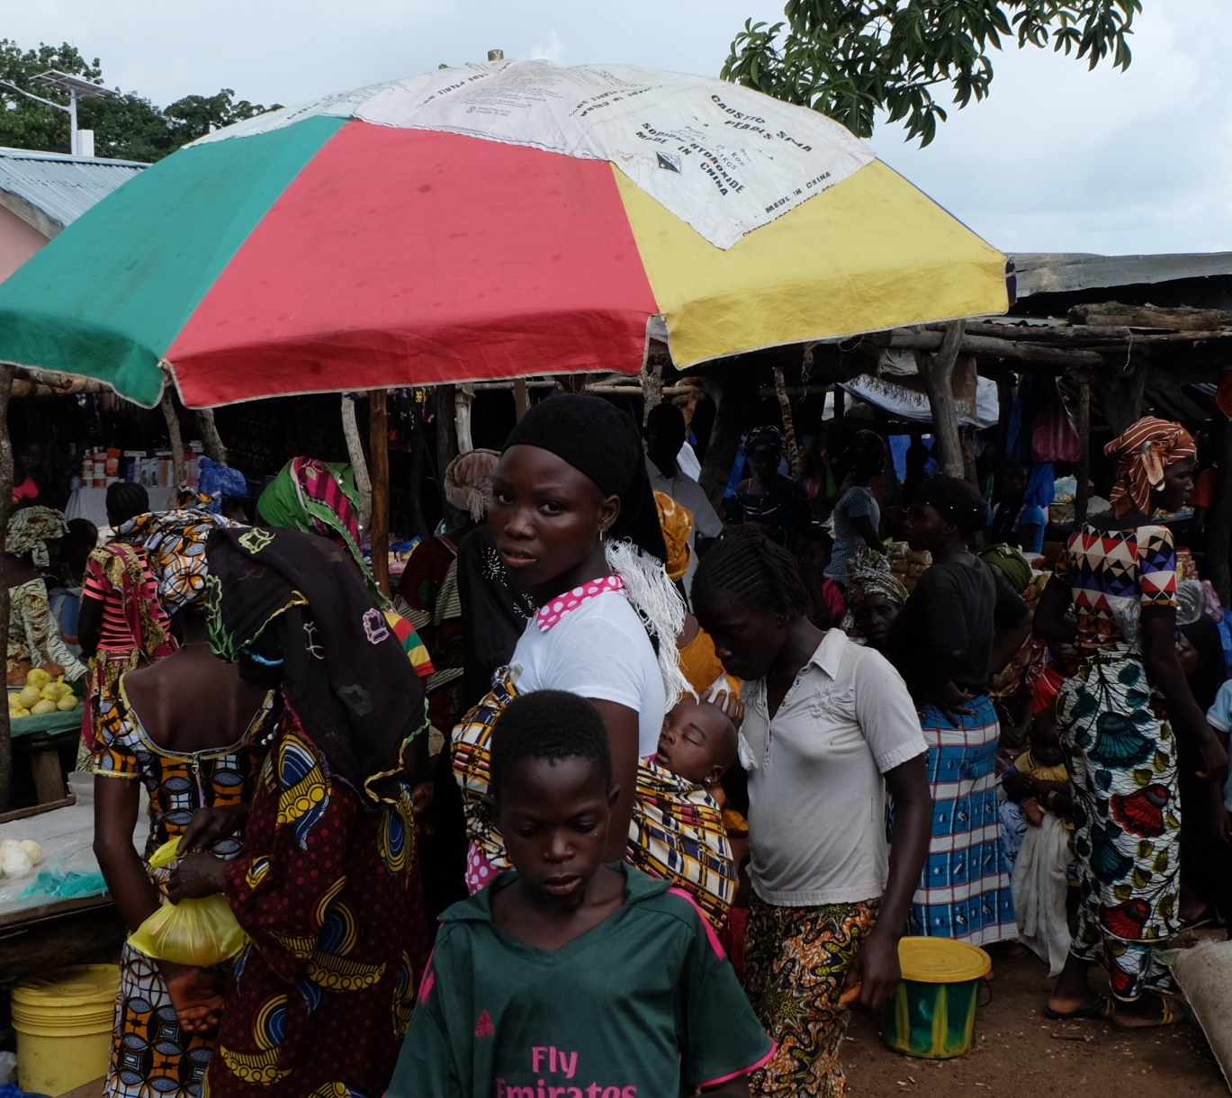
The Enabling Environment
Food market environment
Natural resources environment
Health, water, and sanitation
Nutrition/health knowledge and norms
Photo: Sarah Hogan, SPRING

Slide 29
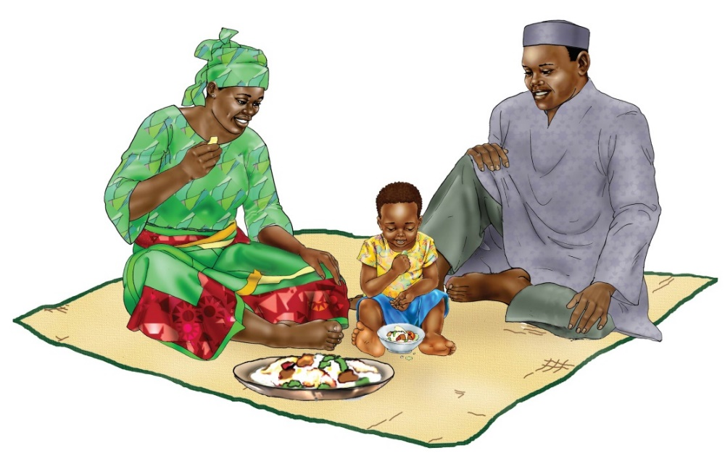
Caution: Go Beyond the Production of Nutrient-Rich Commodities
A value chain activity is not necessarily contributing to nutrition just because it produces a nutrient-rich crop or promotes an animal source food.
It must ensure that some of the crop or animal source food is consumed in the household or is in local markets for purchase.
Credit: USAID Advancing Nutrition and UNICEF IYCF Image Bank

Slide 30
Key Terms
Nutrition-specific
Nutrition-sensitive
Food market environment
Nutrient-rich value chain
Activity outcome
Strategy
Practice
Intervention
Output indicator
Outcome indicator
Photo: Steve Goertz, Feed the Future

