Slide 1
STEP 1:
Prioritize Nutrition-Sensitive Agriculture Outcomes for Your Activity
DECK 2

Slide 2
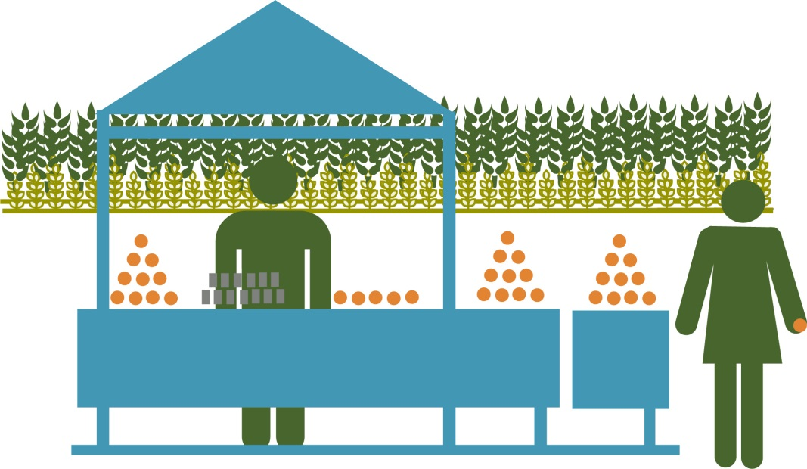
What is the Purpose of Your Activity?
Agriculture activities commonly aim to—
Improve production of target commodities (crops and livestock/poultry).
Increase income.
Sustain, protect, or enhance productive natural resources.
Engage women and youth to secure their livelihoods.

Slide 3
Example: West Africa Activity
What | How | Who
Increase production of pumpkin, fish, cowpeas. and rice | Promote good farming practices Introduce new technologies | Small farmers, co-ops, agricultural extension agents Agricultural extension agents, small farmers, co-ops, researchers
Increase income | Improve rice storage to sell at higher prices Add value to fresh fish using drying technology Increase access to agricultural financing | Small farmers, co-ops, input suppliers, buyers Fisherfolk, WorldFish, research staff Microfinance institutions, cooperatives, small farmer groups, women’s groups

Slide 4
Describe Your Agricultural Market Systems Development Activity
What | How | Who

Slide 5
Describe Your Agricultural Market Systems Development Activity
Goal: Agree on the agriculture/market systems components of your activity.
Describe WHAT: the big-picture results or outcomes.
Describe HOW your activity will achieve these results.
Describe WHO will benefit and WHO will participate.

Slide 6
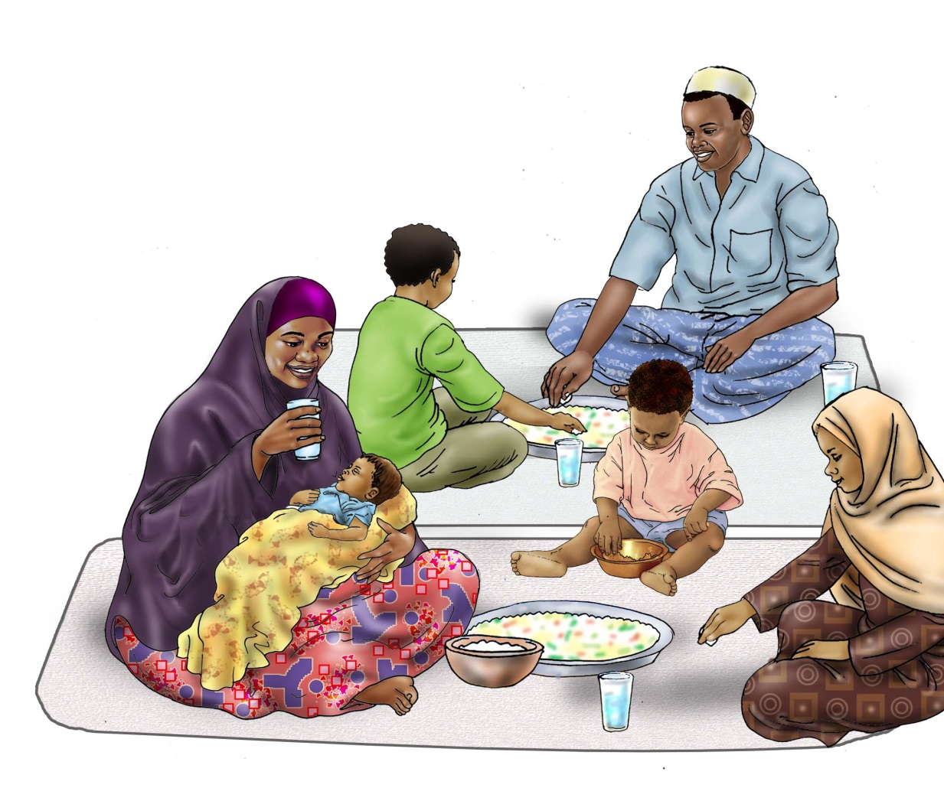
Nutrition Connection
What are the key contributors to malnutrition in your implementation area?
Credit: USAID Advancing Nutrition and UNICEF IYCF Image Bank

Slide 7
Identifying Nutrition-Sensitive Agriculture Outcomes
Improved availability of diverse, nutrient-rich foods in local markets
Improved affordability of diverse, nutrient-rich foods in local markets
Improved desirability of diverse, nutrient-rich foods among consumers
Improved environmental and food safety
Increased income control by women and equitable opportunities
Increased time and energy savings for women

Slide 8
Identify Nutrition-Sensitive Agriculture Outcomes
Nutrition-Sensitive Agriculture Outcome | Implementation Strategy | Practice | Intervention | Indicator
Outcome 1
Outcome 2

Slide 9
Identify Nutrition-Sensitive Agriculture Outcomes
Goal: Identify nutrition-sensitive agriculture outcomes your activity will be able to achieve
Based on WHAT your activity is striving to achieve and the key nutritional problems in your target area, think about which of the six nutrition-sensitive agriculture outcomes might be possible. Use Handout 5.
Insert these into the first column of your activity design matrix. We recommend no more than three.

Slide 10
STEP 2:
Prioritize Nutrition-Sensitive Agriculture Strategies

Slide 11
Key Terms
Strategy: The means or broad approach by which an activity may achieve a stated purpose or desired outcome.
Intervention: A deliberate involvement in a process intended to influence events and/or consequences. The term may refer to single activities but often refers to sets of activities organized within a project. In our context, we can think of an intervention as an action that, combined with other actions, will accomplish the nutrition-sensitive agriculture strategies.

Slide 12
Recap
What
How
Who

Slide 13
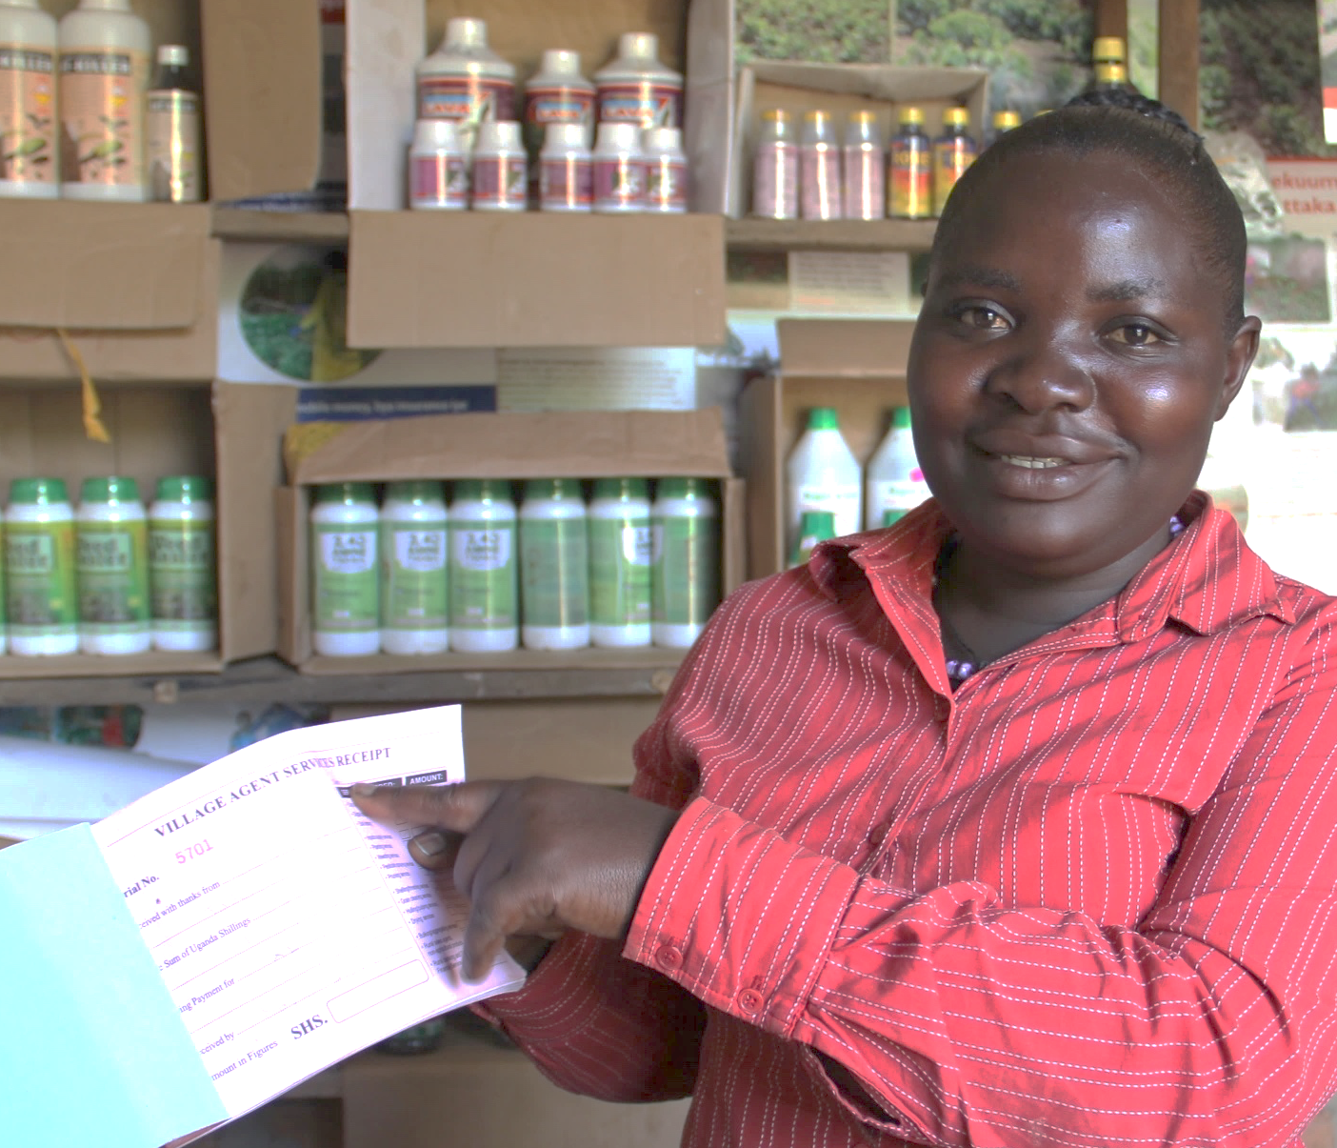
Developing Nutrition-Sensitive Agriculture Strategies
Photo: Michelle Byamugisha, Chemonics

Slide 14
Nutrition-Sensitive Agriculture Strategies Criteria and Examples
Outcome: Improved availability of diverse, nutrient-rich foods in local markets
Criteria: Increase the supply of nutrient-rich food in local markets
Example strategy: Link dairy farmers to milk collection centers
Example strategy: Promote inter-cropping and other practices to diversify home production
Criteria: Extend the time period a nutrient-rich food is available in local markets
Example strategy: Use hermetically sealed bags for cowpea storage
Example strategy: Promote community warehouse system to safely store commodities closer to market for longer periods of time

Slide 15
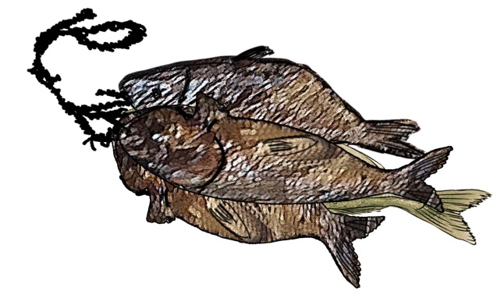
Some Strategies May ALREADY be Nutrition-Sensitive
Strategy: Add value to fresh fish using drying technology
This is already nutrition-sensitive because it may—
Increase the supply in local markets.
Extend shelf life.
Improve safety.
Credit: USAID Advancing Nutrition and UNICEF IYCF Image Bank

Slide 16
Some Strategies Can be ADAPTED to be Nutrition-Sensitive
Agriculture strategies:
Promote good farming practices.
Introduce new productions technologies.
Adapted strategy: Strengthen capacity of cooperative members and farmer groups in appropriate storage practices for cowpeas and rice.

Slide 17
Some New Nutrition-Sensitive Strategies May Need to be ADDED
New strategy: Facilitate marketing to build consumer demand for fish and cowpeas.
Review Handout 10 for criteria for nutrition-sensitive agriculture strategies and examples!
Credit: USAID Advancing Nutrition and UNICEF IYCF Image Bank

Slide 18
Partnering as a Strategy
Consider key linkages, partnerships, and advocacy needs:
What target groups are others reaching?
To improve adoption of what practices?
How can you adjust your strategies to more cost-effectively achieve results through partnerships?
Photo: SPRING/Kyrgyz Republic

Slide 19
Identify Nutrition-Sensitive Agriculture Strategies
Nutrition-Sensitive Agriculture Outcome | Implementation Strategy | Practice | Intervention | Indicator
Outcome 1 | Strategy 1.1 Strategy 1.2
Outcome 2 | Strategy 2.1 Strategy 2.2

Slide 20
Identify Nutrition-Sensitive Agriculture Strategies
Goal: Identify nutrition-sensitive strategies that your activity will be able to achieve.
Start your HOW column from Step 1 and determine what strategies are already nutrition-sensitive or could be made nutrition-sensitive. Use the criteria on Handout 11.
Consider the nutrition challenges in your target area and the scope of your activity and add any nutrition-sensitive strategies that you identify.
Make sure that each strategy you identify during this step indicates the nutrition-sensitive outcome it supports.

Slide 21
Recap
Strategies that your agriculture activity ADAPTED to make them more nutrition-sensitive
Strategies that your agriculture activity included that were ALREADY nutrition-sensitive
Strategies that your agriculture activity ADDED to better achieve nutrition-sensitive outcomes

Slide 22
Checking the Feasibility of Your Nutrition-Sensitive Agriculture Strategies
Sustainability and potential for impact
Funding available
Time available
Staff capacity and experience
Organization’s competitive advantage/expertise
Alignment with government priorities
Alignment with USAID (donor) priorities
Complementarity with other investments in activity area
Opportunity to leverage private-sector investment

Slide 23
Presenting Your Strategies—Check Your Work!
A representative from each small group will present the strategies identified in Step 2. Be sure to include—
how these strategies considered the original activity design and scope
the nutrition issues in the activity implementation area
how the strategies work toward the identified nutrition-sensitive agriculture outcome.

Slide 24
STEP 3:
Identify Practices and Develop Interventions

Slide 25
Key Terms
Practice—A concrete action that a specific person or group does at a specific time and place. You can think of it as an evidence-based behavior that you would hope to see an actor start doing, stop doing, or do differently. A practice is an action that someone could sustain beyond the duration of your activity.
Intervention—A deliberate involvement in a process intended to influence events and/or consequences. The term may refer to single activities but often refers to sets of activities organized within a project. In our context, we can think of an intervention as an action that, combined with other actions, will accomplish the nutrition-sensitive agriculture strategies.

Slide 26
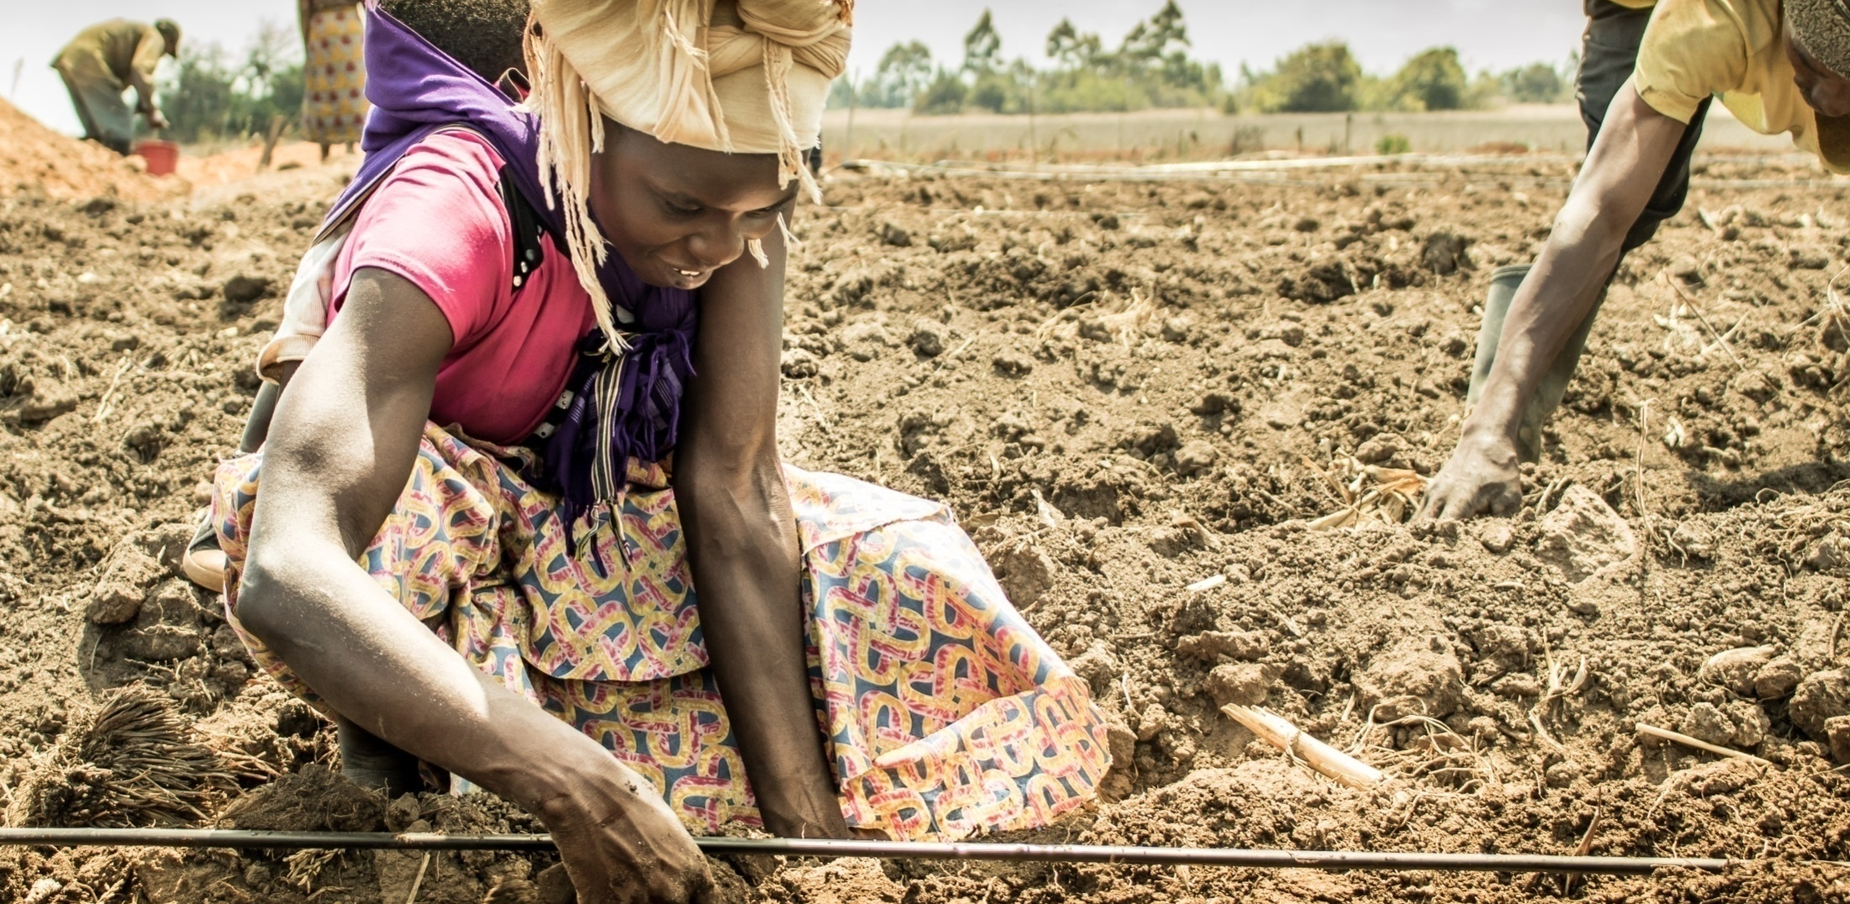
Adapting Good Agricultural Practices to Support Nutrition
Photo: Fintrac, Inc.

Slide 27
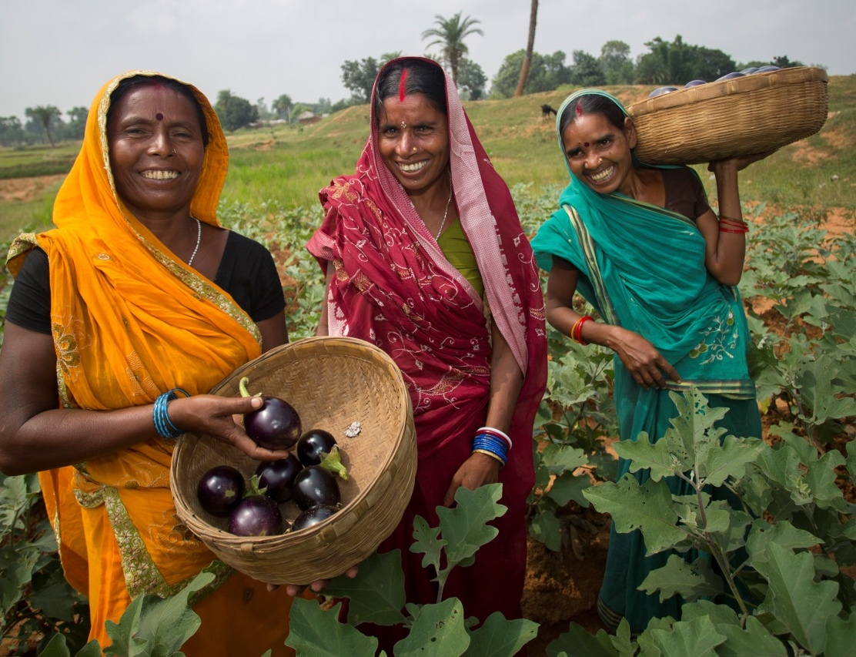
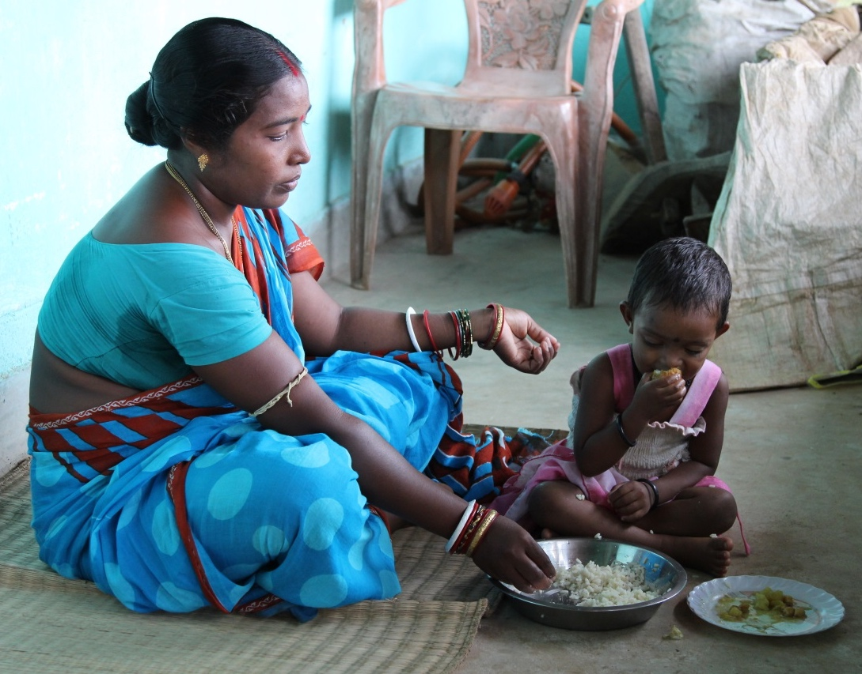
Targeting: Agriculture vs. Nutrition
Photo: (left) Jake Lyell, Lutheran World Relief, (right) SPRING

Slide 28
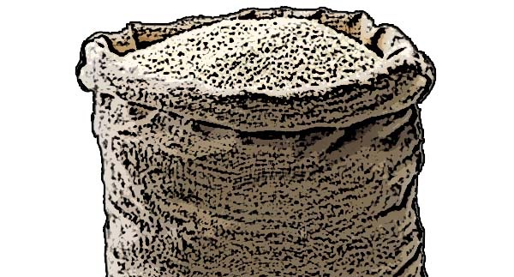
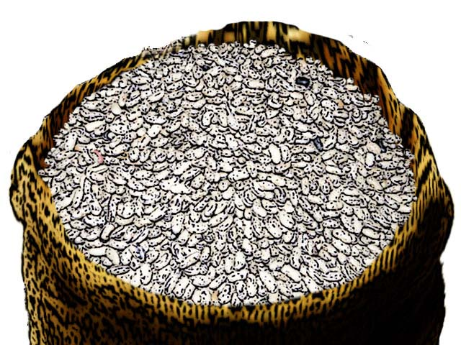
Identify Practices: West Africa Activity Example
Strategy: Strengthen capacity of cooperative members and farmer groups in appropriate post-harvest handling and storage practices for both cowpeas and rice.
Practices:
Dry to appropriate moisture level.
Recognize damaged or spoiled cowpea seed.
Sort and remove damaged seeds/grains.
Test moisture level before storage.
Credit: USAID Advancing Nutrition and UNICEF IYCF Image Bank

Slide 29
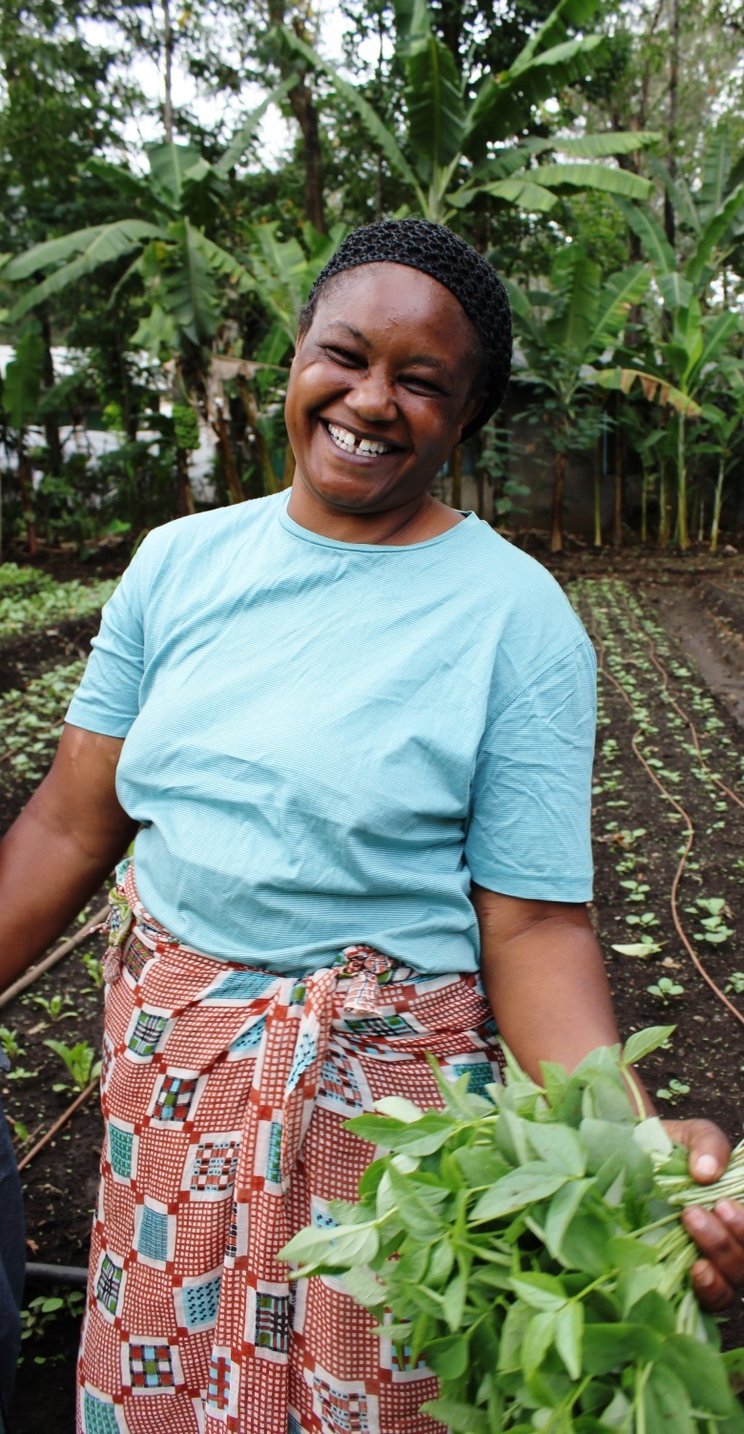
Develop Interventions: West Africa Activity Example
Interventions:
Train cowpea growers in good sorting, drying, and moisture testing practices before storage.
Train rice growers in good drying and moisture testing practices before storage.
Train agricultural extension agents to train others in good sorting, drying, and moisture testing practices before storage.
Develop pictorial guidance to assist cooperatives, farmers, and agricultural extension agents in continuing to use good sorting, drying, and moisture testing practices before storage.
Photo: Fintrac, Inc.

Slide 30
Exercise: Identify Practices and Develop Interventions
Nutrition-Sensitive Agriculture Outcome | Implementation Strategy | Practice | Intervention | Indicator
Outcome 1 | Strategy 1.1 Strategy 1.2 | Practice 1.1 Practice 1.2 | Intervention 1.1 Intervention 1.2
Outcome 2 | Strategy 2.1 Strategy 2.2 | Practice 2.1 Practice 2.2 | Intervention 2.1 Intervention 2.2

Slide 31
Identify Nutrition-Sensitive Agriculture Practices and Develop Interventions
Goal: Operationalize prioritized strategies
Groups should review each strategy in column 3 of the activity design matrix, discuss the practices that are desired for each, and develop interventions that will ensure use of those practices.
Use Handout 12. Its contents have been organized by nutrition-sensitive agriculture outcome and are provided only as examples to help your team start brainstorming.
Agree upon nutrition-sensitive agriculture interventions that the team has the budget, staff, and timeframe to undertake.

Slide 32
Presenting Your Practices and Interventions—Check Your Work!
At this time, each small group is asked to present its practices and interventions to the full team. As you do this make sure to include—
how these interventions lead to the practice
how the practice supports the strategy
how the strategies work toward the identified nutrition-sensitive agriculture outcome.

Slide 33
STEP 4:
Define Monitoring Indicators

Slide 34
Good Monitoring
Undertake regular data collection activities to track implementation progress:
Monitor the quantity, quality, and timeliness of activity outputs.
Monitor achievement of activity outcomes.
Ensure the quality of performance monitoring data collected.
Data collection typically entails the following tasks:
Review performance indicator data and monitoring reports.
Conduct or participate in data quality assessments.
Conduct site visits.
Examine technical reports and deliverables.
Meet with implementing staff and other stakeholders.

Slide 35
Process Monitoring
Process monitoring focuses on the implementation process and informs questions like—
Are practitioners completing the detailed implementation steps as planned?
Does implementation vary across activity target areas?
Did the activity reach the intended people?
Use process monitoring to determine if you need to adjust activities to achieve desired outcomes.

Slide 36
Process Monitoring Example
An activity includes an intervention intended to increase joint decision making in households.
The implementation approach has several steps, starting with training project staff to facilitate conversations that promote 1–2 key practices per meeting with 5–8 households, requiring attendance of 2–3 decision makers from each household each month for six months.
The activity has also determined that each trained facilitator should reach out to each household grouping of decision makers at least once between facilitated discussion sessions.
How might the activity team use the information collected through process monitoring?

Slide 37
Quality Monitoring
Quality monitoring allays concerns about how implementers conduct planned activities and requires the collection and use of data to—
Identify gaps between current performance and expectations/requirements to achieve desired results.
Introduce modifications, perhaps in response to findings from process monitoring.
Assess the effect of modifications on performance.
How does quality monitoring differ from process monitoring?

Slide 38
Key Terms
Indicator—a variable that measures one aspect of a program or project
Output indicator—a unit of measure to assess the quality and implementation of resulting products, goods, or services at the end of an intervention
Outcome indicator—measures short- to medium-term effects of the combined outputs from an activity’s interventions.

Slide 39
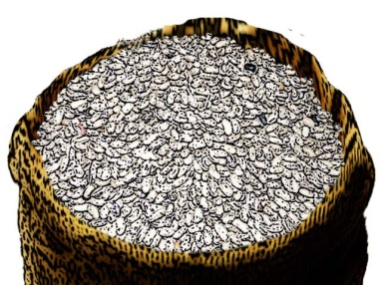
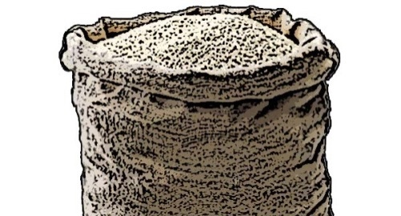
Develop Output Indicators: West Africa Activity Example
Number of rice/cowpea growers using improved drying technology
Number of rice/cowpea growers measuring moisture levels for their commodity prior to storage
Number of fish processors meeting food safety standards
Number of agricultural extension agents trained in appropriate post-harvest handling and storage practices for rice and cowpeas
Percentage of agricultural extension agents completing all planned farmer group visits
Credit: USAID Advancing Nutrition and UNICEF IYCF Image Bank

Slide 40
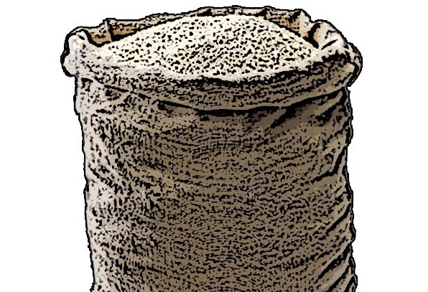
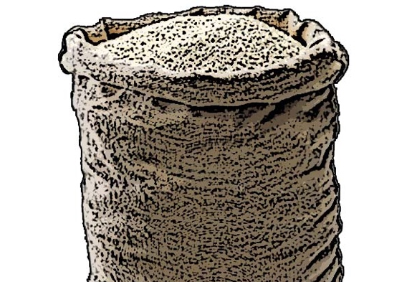
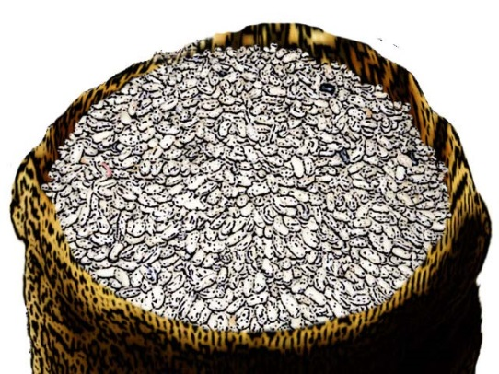
Develop Outcome Indicators: West Africa Activity Example (continued)
Strategy: Add value (drying) to fresh fish to extend the time period over which households might be able to both find fish to purchase in local markets and/or store at home for consumption.
Outcome indicator: Percent increase in volume of dried, packaged fish in local markets.
Credit: USAID Advancing Nutrition and UNICEF IYCF Image Bank

Slide 41
Define Indicators
Nutrition-Sensitive Agriculture Outcome | Implementation Strategy | Practice | Intervention | Indicator
Outcome 1 | Strategy 1.1 Strategy 1.2 | Practice 1.1 Practice 1.2 | Intervention 1.1 Intervention 1.2 | Outcome Indicator 1 Output 1.1 Output 1.2
Outcome 2 | Strategy 2.1 Strategy 2.2 | Practice 2.1 Practice 2.2 | Intervention 2.1 Intervention 2.2 | Outcome Indicator 2 Output 2.1 Output 2.2

Slide 42
Define Monitoring Indicators
Goal: Establish indicators
Each group will work on one outcome or one row of the activity design matrix.
Each group should develop 1 or 2 outcome indicators as well as output indicators for the interventions most critical to achieving the outcomes assigned to them.
Begin by determining what short- to medium-term outcome indicator(s) best measure the planned strategy and intended outcome. It might be helpful to refer back to Handout 5, which also provides a range of sample outcomes.

Slide 43
Pulling It All Together: Completed Matrix!
Nutrition-Sensitive Agriculture Outcome | Implementation Strategy | Practice | Intervention | Indicator
Outcome 1 | Strategy 1.1 Strategy 1.2 | Practice 1.1 Practice 1.2 | Intervention 1.1 Intervention 1.2 | Outcome Indicator 1 Output 1.1 Output 1.2
Outcome 2 | Strategy 2.1 Strategy 2.2 | Practice 2.1 Practice 2.2 | Intervention 2.1 Intervention 2.2 | Outcome Indicator 2 Output 2.1 Output 2.2

Slide 44
Next Steps
Map your matrix to work plan, results framework, and performance management plan.
Manage approvals to activity adjustments.
Contact partners, government, or other stakeholders.
Other tasks

Slide 45
Outline Post-Workshop Action Items
Task | Person Responsible | Deadline

Slide 46
Outline Post-Workshop Action Items
Goal: Outline next steps to ensure integration of new outcomes and indicators into activity work plan and monitoring systems.
Discuss how you plan to incorporate the work you did during this workshop into your results framework, work plan, PMP, and/or other activity documents. Define additional tasks including ideas about other stakeholders and partners to contact.
Identify specific follow-up tasks and the name of a person (or small group) who will be responsible for conducting each task. We also recommend committing to a timeframe for completing each task.

