Slide 1
Small-Quantity Lipid-Based Nutrient Supplements: What to Communicate to Program Participants
Annex I. Counseling Cards for Adaptation
Photo credit: Abdourahamane Balla and Halima Diadié for JSI
USAID ADVANCING NUTRITION

Slide 2
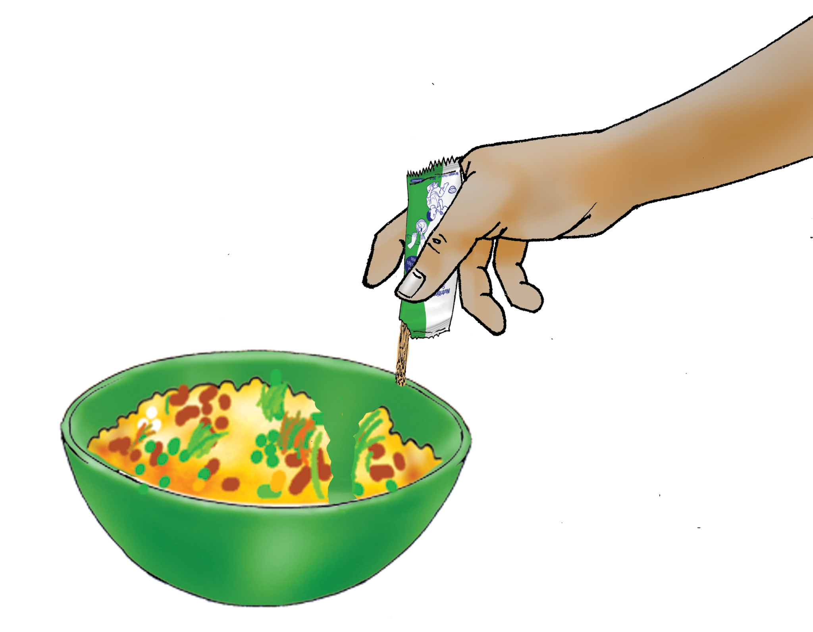
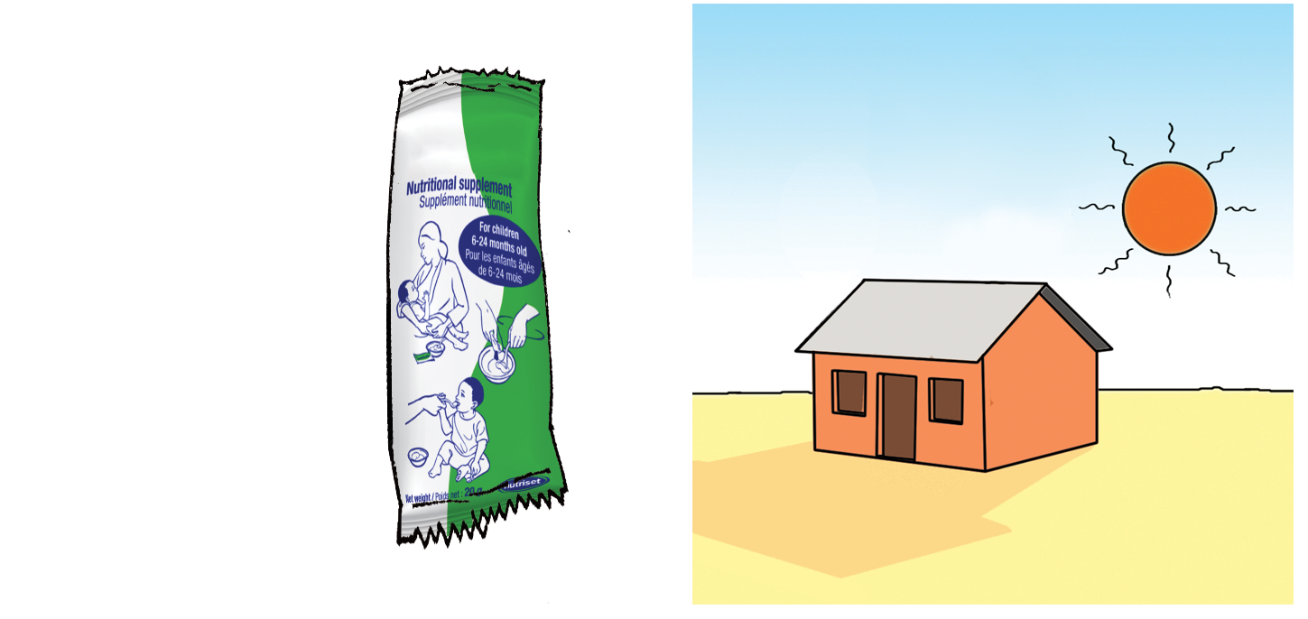
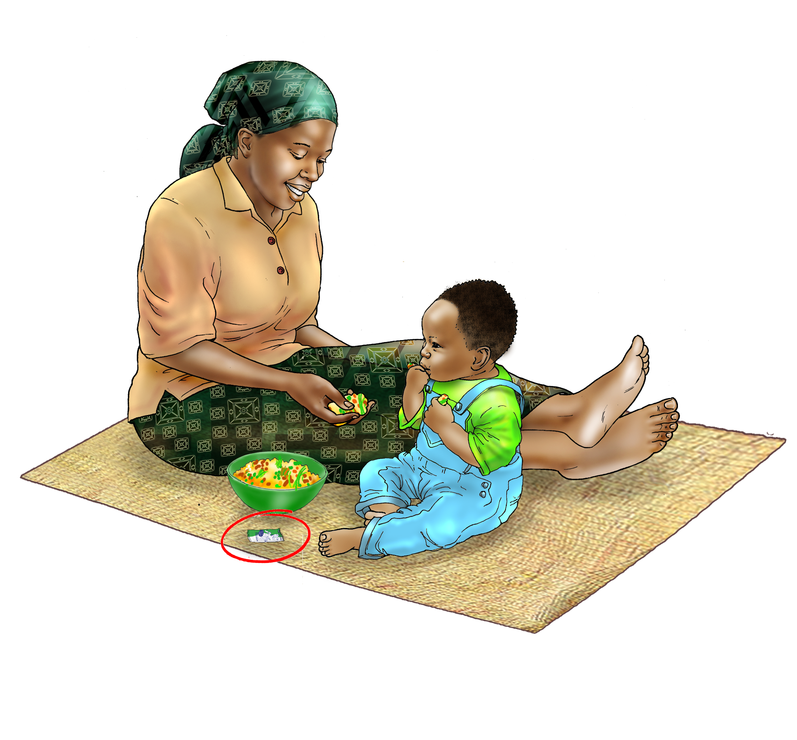
[SQ-LNS] help your child grow healthy

Slide 3
[SQ-LNS] help your child grow healthy
[Local name of SQ-LNS] help your child grow healthy.
You can give [local name] directly from the sachet or mix [local name] with food.
[Local name] are only for children 6 months to 24 months of age.
Feed one sachet only of [local name] per day to your child.
After your child eats [local name], his or her stool might change in color or consistency for the first few days; if you are concerned about this, consult a health worker.
If your child develops rashes or experiences difficulty breathing after eating [local name], immediately stop feeding the product and consult a health worker.

Slide 4
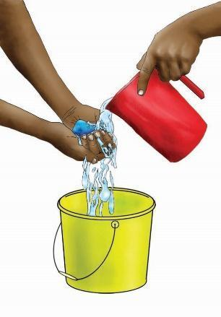
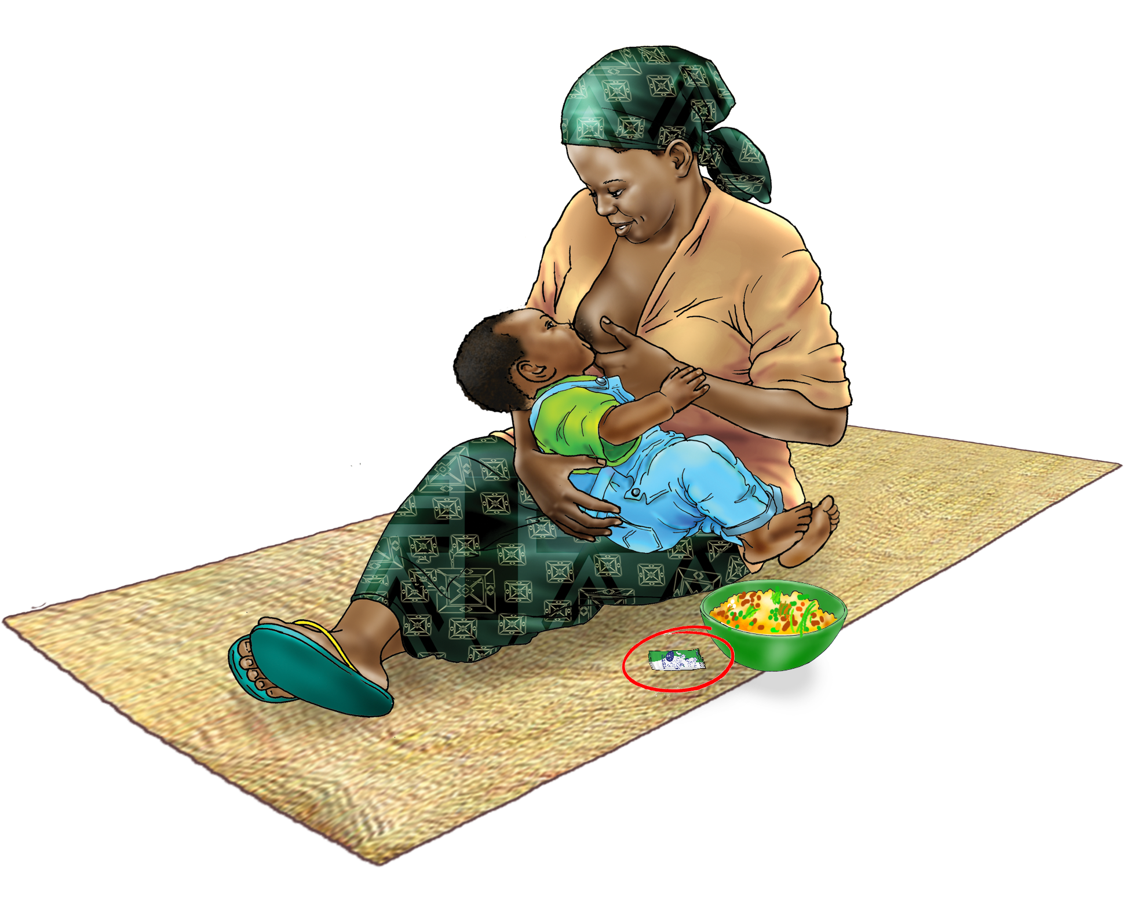
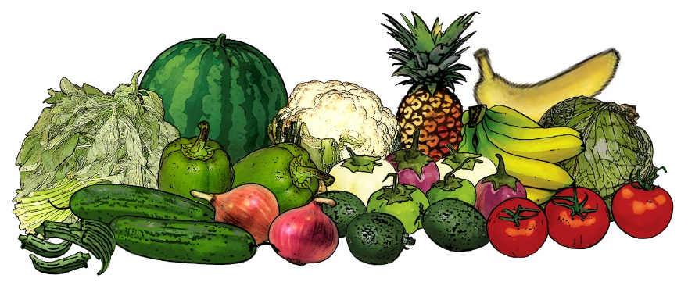
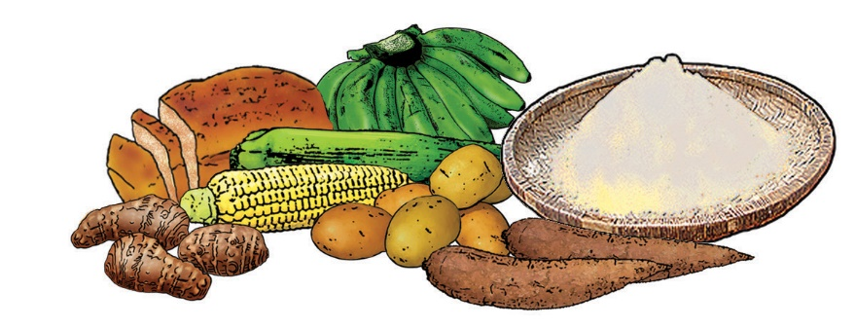
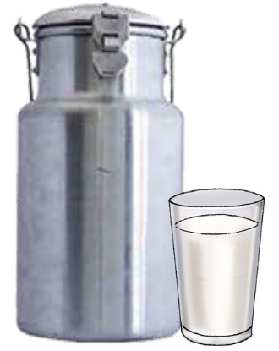
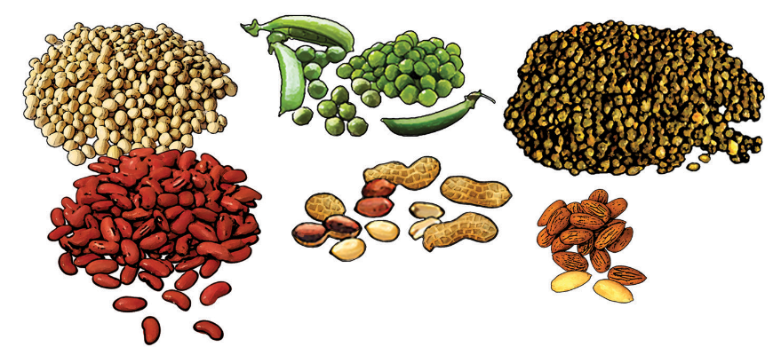
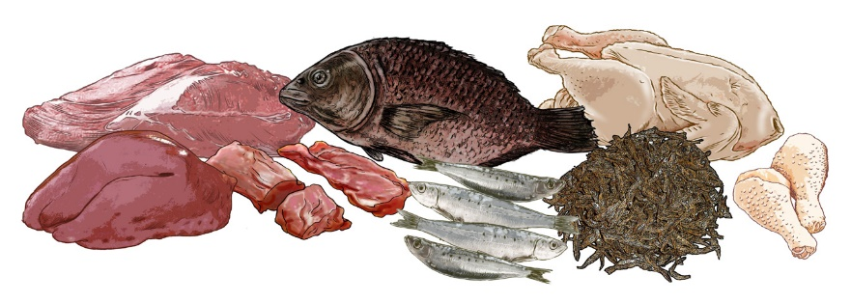
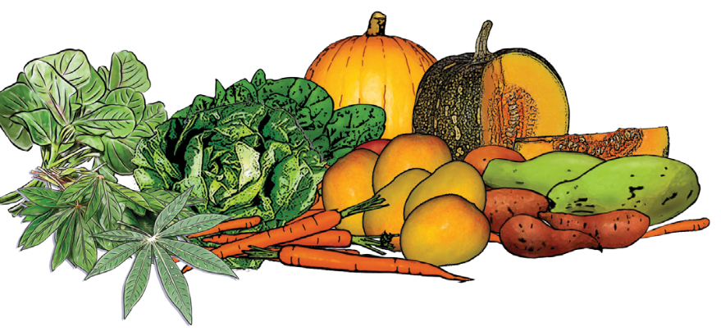
How to feed [SQ-LNS] with your child’s diet

Slide 5
How to feed [SQ-LNS] with your child’s diet
While feeding [local name] to your child, continue to breastfeed and give your child a variety of nutritious foods.
Wash your hands with soap and water before feeding your child [local name] and other food.
Wash your child’s hands with soap and water before giving you child [local name] or other food to eat.

Slide 6
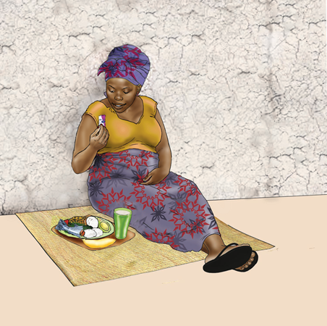
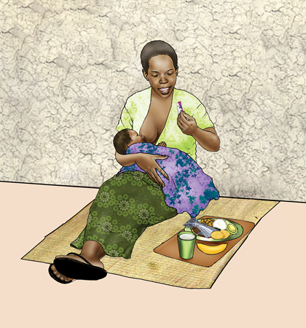
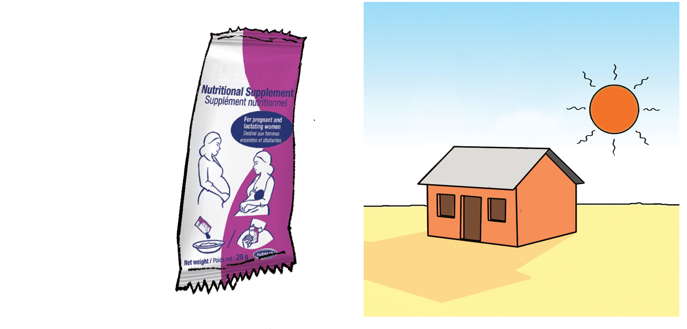
[SQ-LNS] for the pregnant or breastfeeding woman

Slide 7
[SQ-LNS] for the pregnant or breastfeeding woman
[Local name] are for pregnant women and women who are breastfeeding children up to six months of age. Say this to women taking SQ-LNS:
When you eat [local name] during pregnancy, they will help your child grow healthy.
When you eat [local name] while breastfeeding, they will support your health.
You can eat [local name] directly from the sachet or mix [local name] with food.
While eating [local name], remember to continue eating nutritious foods.
Eat one sachet only of [local name] per day.
If you experience any side effects such as rashes or difficulty breathing, after eating [local name], immediately stop eating the product and consult a health worker.

Slide 8
End Slide
USAID ADVANCING NUTRITION
IMPLEMENTED BY:
JSI Research & Training Institute, Inc.
2733 Crystal Drive
4th Floor
Arlington, VA 22202
Phone: 703–528–7474
Email: info@advancingnutrition.orginfo@advancingnutrition.org
Internet: advancingnutrition.orgadvancingnutrition.org
USAID Advancing Nutrition is the Agency's flagship multi-sectoral nutrition project, addressing the root causes of malnutrition to save lives and enhance long-term health and development.
This presentation is made possible by the generous support of the American people through the U.S. Agency for International Development. It was prepared under the terms of contract 7200AA18C00070 awarded to JSI Research & Training Institute, Inc. The contents are the responsibility of JSI and do not necessarily reflect the views of USAID or the U.S. Government.
USAID ADVANCING NUTRITION

