Slide 1
Facility-Based Mentorship for Strengthening Breastfeeding Counselling in Kenya
Photo credit: Allan Gichigi/MCSP
Illustrative Slides for Inception Meetings
*Find additional slides with more background information on breastfeeding, breastfeeding counseling, BFHI, and the design of the mentorship program in the sensitisation meeting slides,if needed.

Slide 2
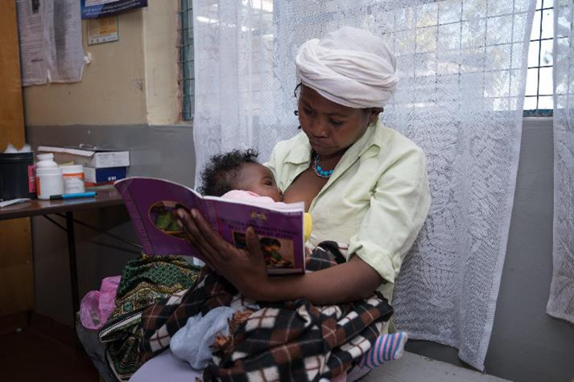
Meeting Agenda
Purpose of the Meeting
Breastfeeding Counselling Mentorship Program:
Goals and Objectives
Implementation Process
Roles and Responsibilities of Program Leadership
Implementing the Program
Program Materials
Next Steps
Summary
Photo credit: Allan Gichigi/MCSP

Slide 3
Purpose of the Meeting

Slide 4
Meeting Goal and Objectives
The goal of this meeting is to sensitise key stakeholders on the facility-based breastfeeding counselling mentorship program and the Baby-Friendly Hospital Initiative (BFHI) before the start of implementation.
By the end of the meeting, participants will be able to—
Summarise the definition of competencies and performance indicators and how they relate to the mentorship program.
Identify the actions for implementation of the mentorship program.
Describe the roles and responsibilities of health facility leadership in implementation of the mentorship program.
Summarise the materials required for implementation of the mentorship program.
Take action on the next steps to implement the mentorship program.

Slide 5
Breastfeeding Counselling Mentorship Program

Slide 6
Goals and Objectives

Slide 7
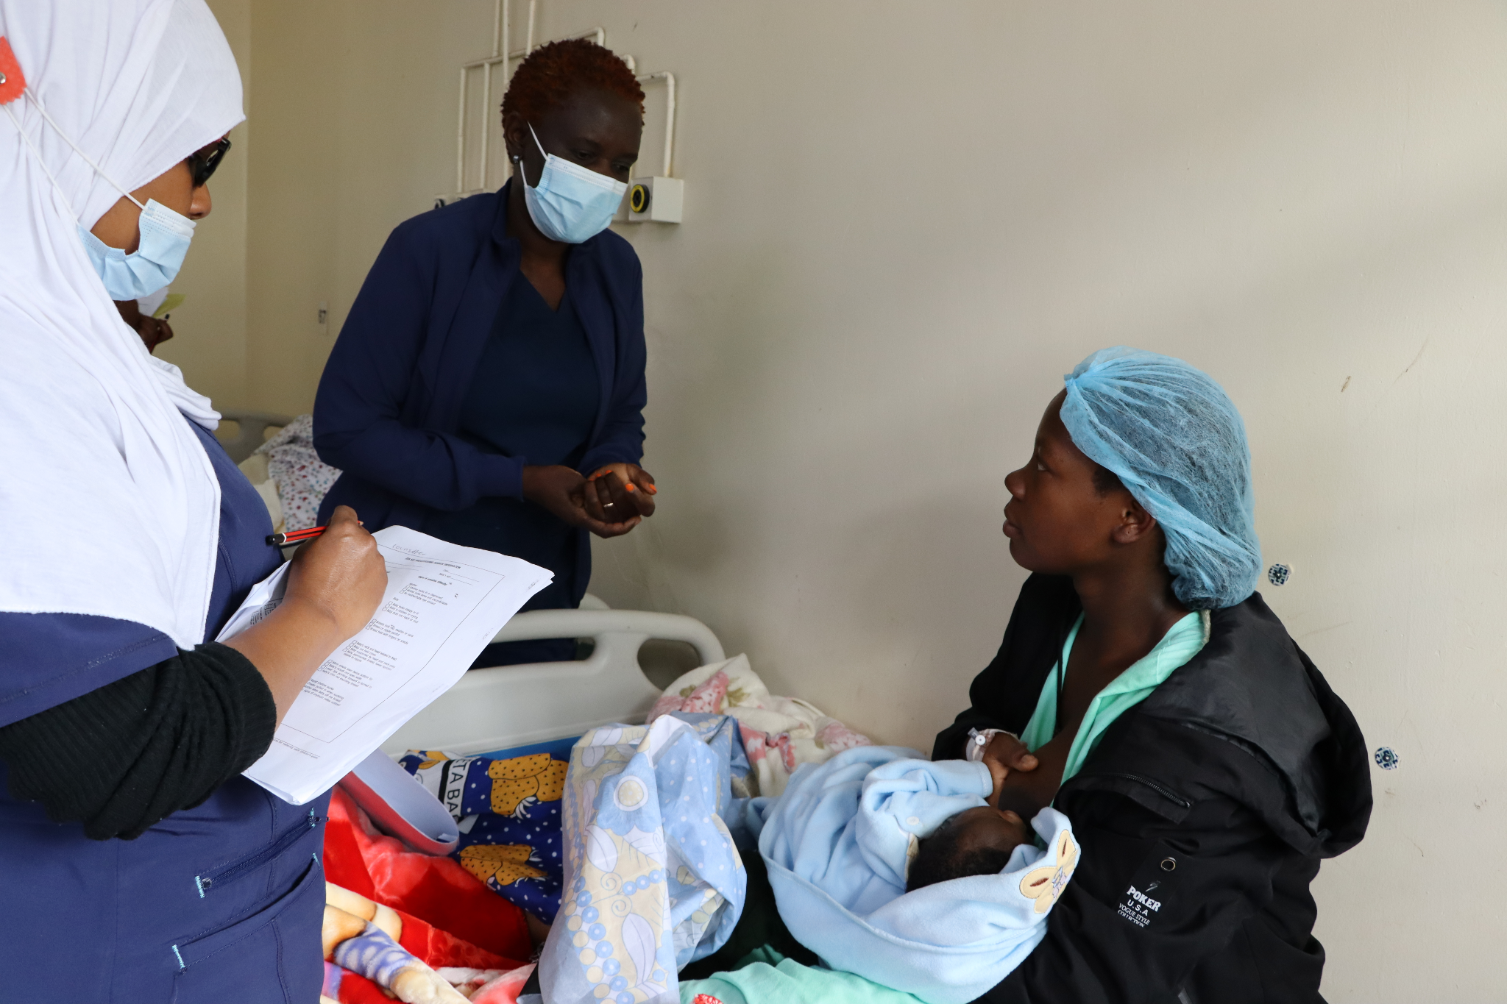
Goals and Objectives of the Mentorship Program
The overarching goal is to improve the quality of breastfeeding counselling provided by health workers.
The specific objectives of the program are to—
Reinforce and strengthen 7 of the 16 breastfeeding counselling competencies needed for implementation of BFHI.
Support mentees to apply skills learned in the BFHI Training Course for Maternity Staff (WHO and UNICEF 2020a) during counselling sessions with clients.
Cultivate a skilled team of on-site mentors who can champion and support quality breastfeeding counselling and serve as a resource for mentees.
Create an enabling environment for providing quality breastfeeding counselling at all relevant service delivery points.
Photo credit: Fridah Bwari/Save the Children

Slide 8
Competencies and Performance Indicators
The mentorship program is based on achieving a set of competencies, which are measured by performance indicators.
Both the competencies and performance indicators of focus for the breastfeeding counselling mentorship program are taken from the Competency Verification Toolkit (WHO and UNICEF 2020b).
Definitions:
Competency: The capability to use a set of related knowledge, skills, and behaviours to successfully perform identified jobs, roles, or responsibilities (WHO 2015, 15).
Performance indicator: Help to document that a mentee has acquired necessary competencies and are measurable (WHO and UNICEF 2020b, 6). A mentor verifies each of the performance indicators address knowledge, skills, or attitudes by observation.

Slide 9
Competencies Prioritised for the Mentorship Program
Use listening and learning skills whenever engaging in a conversation with a mother.
Engage in antenatal conversation about breastfeeding.
Facilitate breastfeeding within the first hour, according to cues.
Discuss with a mother how breastfeeding works.
Assist mother getting her baby to attach to the breast.
Help a mother to breastfeed a small or sick baby.
Ensure seamless transition after discharge.

Slide 10
Performance Indicators of Focus by Competency (1)
Competency | Performance Indicator
3. Use listening and learning skills whenever engaging in a conversation with a mother | 11. Demonstrate at least three aspects of listening and learning skills when talking with a mother.
5. Engage in antenatal conversation about breastfeeding | 15. Engage in a conversation with a pregnant woman on three aspects of the importance of breastfeeding.
 | 16. Assess at least three aspects of a pregnant woman’s knowledge about breastfeeding in order to fill the gaps and correct inaccuracies.
 | 17. Engage in a conversation with a pregnant woman about at least four care practices a mother/infant dyad will experience at the birthing facility that will support breastfeeding.
Source: WHO and UNICEF 2020b

Slide 11
Performance Indicators of Focus by Competency (2)
Competency | Performance Indicator
7. Facilitate breastfeeding within the first hour, according to cues | 25. Engage in a conversation with a mother including at least three reasons why suckling at the breast in the first hour is important, when the baby is ready.
 | 27. Describe to a mother at least three pre-feeding behaviours babies show before actively sucking at the breast.
8. Discuss with a mother how breastfeeding works | 29. Engage in a conversation with a mother regarding at least three reasons why effective exclusive breastfeeding is important.
 | 30. Engage in a conversation with a mother regarding two elements related to infant feeding patterns in the first 36 hours of life.
 | 31. Describe to a mother at least four signs of adequate transfer of milk in the first few days.
Source: WHO and UNICEF 2020b

Slide 12
Performance Indicators of Focus by Competency (3)
Competency | Performance Indicator
9. Assist mother getting her baby to attach to the breast | 32. Evaluate a full breastfeeding session observing at least five points.
12. Help a mother to breastfeed a small or sick baby | 43. Help a mother achieve a comfortable and safe position for breastfeeding with her small or sick infant at the breast, noting at least four points.
 | 44. Engage in a conversation with a mother of a small or sick infant not sucking effectively at the breast, including at least five points
 | 46. Engage in a conversation with a mother of a small or sick or vulnerable infant (including multiple births) regarding the importance of observing at least two subtle signs and behavioural state shifts to determine when it is appropriate to breastfeed.
Source: WHO and UNICEF 2020b

Slide 13
Performance Indicators of Focus by Competency (4)
Competency | Performance Indicator
16. Ensure seamless transition after discharge | 62. Develop individualized discharge feeding plans with a mother that includes at least six points.
 | 63. Describe to a mother at least four warning signs of infant undernourishment or dehydration for a mother to contact a health care professional after discharge.
 | 64. Describe at least three warning signs for a mother to contact a health care professional after discharge.
Source: WHO and UNICEF 2020b

Slide 14
Description of the Implementation Process

Slide 15
Establishing the Program
Sensitise facility management about BFHI and the mentorship program. ✅
Identify breastfeeding counselling mentorship program leadership. ✅
Conduct a BFHI health facility self-assessment. ✅
Conduct an inception meeting.
Acquire resources.

Slide 16
Implementation Process
The implementation process includes 10 actions:
Train health facility staff in the BFHI Training Course for Maternity Staff.
Identify and prioritise service delivery points.
Select and train mentors.
Select mentees.
Pair mentors and mentees.
Orient mentors and mentees.
Conduct mentoring.
Conduct monthly meetings.
Assess competencies for graduation.
Monitor the program.
There are also several steps before implementation to establish the mentorship program at a facility including—
Sensitise facility management.
Identify program leadership.
Conduct a BFHI health facility self-assessment.
Conduct an inception meeting.
Acquire resources.

Slide 17
Implementation Process (2)
When a health facility is implementing the mentorship program for the first time, the entire process, from establishing the program structure at the health facility to graduation of the first cohort of mentees could take between 8–10 months to complete.
The mentorship program can become a continuous activity at a health facility to strengthen breastfeeding counselling competencies of health workers working in maternal, newborn, and child care, by selecting new cohorts of mentees to become part of the mentorship program and graduating others.
The figure on the following slide depicts the ten implementation actions and pre-steps and the estimated time that each of the actions may take.

Slide 18
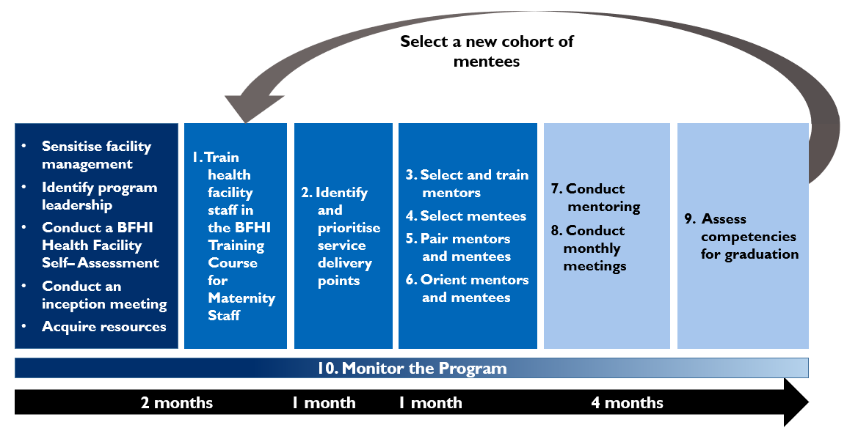
Actions in Implementing the Breastfeeding Counselling Mentorship Program at a Health Facility

Slide 19
Roles and Responsibilities of Program Leadership

Slide 20
Roles and Responsibilities of BFHI Facility Coordinator
Oversee the mentorship program.
Convene the BFHI Facility Implementation team meetings, as needed, but at least once every two months.
Organise an inception meeting for the health facility management team (HFMT) and heads of departments (HODs).
Organise orientation meetings with mentors and mentees.
Organise the BFHI trainings for mentors and mentees and the Core Concepts in Mentorship Training course for mentors.
Ensure that mentors and mentees have the necessary resources for implementation of the program.
Organise and plan the agenda for monthly meetings with mentors and mentees.
Collect the “Mentor Feedback Form” from mentees.
Convene and coordinate other related trainings, as needed.
Offer support and guidance to mentors and mentees throughout implementation of the program.

Slide 21
Roles and Responsibilities of the BFHI Facility Implementation Team (1)
Ensure the mentorship program is implemented as planned.
Participate in BFHI Facility Implementation Team meetings.
Support the BFHI facility coordinator to organise—
an inception meeting for the HFMT and HODs
orientation meetings with mentors and mentees
the BFHI training and the Core Concepts in Mentorship Training
monthly meetings.
Identify and select mentor and mentees, based on the selection criteria.
Determine the best ratio for mentor-to-mentee and the mentoring approach(es).

Slide 22
Roles and Responsibilities of the BFHI Facility Implementation Team (2)
Pair mentors to mentees, in collaboration with mentors.
Support mentors and mentees working in their service delivery point.
Engage the mentors and mentees in continuous quality improvement (CQI) activities in their respective service delivery points.
Update the HFMT on progress of the mentorship program.
Update the Sub-County Health Management Team and County Health Management Team on progress of the mentorship program, as required.
Conduct selected BFHI implementation activities, such as facility self-assessments.
Monitor the breastfeeding counselling mentorship program indicators.

Slide 23
Implementing the Program

Slide 24
Acquire Resources
Those involved in the mentorship program—mentors, mentees, administrators—must have sufficient time to engage in the mentorship program for it to be successful.
Implementing the mentorship program requires the following resources:
visualisation boards for tracking key indicators
job aids (i.e., counselling checklists, mentoring reminders) and mentorship program tools (i.e., observation tools, progress tracking logs) for mentors and mentees (Annex 4a and 4b)
information, education, and communication (IEC) materials for BHFI for the mother being counselled (i.e., counselling cards, pamphlets, posters, videos)
secure place to store mentoring tools and logs (i.e., binders, folders, cabinets)
certificates of completion of the mentorship program.

Slide 25
Action 1: Train Health Facility Staff
The mentorship program requires mentors and mentees to participate in the BFHI Training Course for Maternity Staff before the start of the mentorship program.
Based on the findings of the facility self-assessment, the BFHI Facility Implementation Team selects participants.
The BFHI facility coordinator arranges for master trainers to conduct the training to equip them with the knowledge and skills to support and protect breastfeeding.
These trainings should be completed as close as possible to the start of mentoring, ideally two weeks before but not more than one month before the start of mentoring.
The BFHI facility coordinator should organise training on BFHI at the health facility at least every two years, or more frequently if time and resources allow.

Slide 26
Action 1: Train Health Facility Staff (2)
Topics include—
BFHI
benefits of breastfeeding
counselling skills
how breastfeeding works
impact of birth practices
postnatal practices
assessing a breastfeed
breast and nipple conditions
milk supply challenges
challenges to feeding at the breast and alternative methods of feeding
medical indications for supplementary feeding
maternal health
antenatal preparation for breastfeeding
discharge
the International Code of Marketing of Breastmilk Substitutes
clinical practice sessions.

Slide 27
Action 2: Identify and Prioritise Service Delivery Points
Based on findings from the facility self-assessment, complementary assessment activities, and relevant priorities of the facility’s CQI team, the BFHI Facility Implementation Team, in consultation with the HFMT, will prioritise on one or more service delivery points for the focus of the mentorship program. Depending on the service delivery point(s) prioritised, the mentorship program will focus on different competencies.
Service Delivery Points
Antenatal care services: Inpatient antenatal care ward Outpatient antenatal care clinic Outpatient Prevention of Mother to Child Transmission (PMTCT) of HIV clinic
Labour and childbirth services: Inpatient labour and delivery ward
Postnatal care services: Inpatient postnatal care ward Outpatient postnatal care clinic
Newborn care services: Inpatient newborn ward Inpatient Neonatal Intensive Care Unit Inpatient Kangaroo Mother Care (KMC) ward Outpatient neonatal clinic
Paediatric care services: Inpatient paediatric ward Outpatient sick baby clinic Outpatient well baby clinic

Slide 28
Action 3: Select and Train Mentors
Mentors are selected by the BFHI Facility Implementation Team according to a set of criteria.
Mentors are selected on the basis of minimum requirements and additional considerations.

Slide 29
Minimum Requirements for Mentors
Completed the BFHI training
Provides direct care to clients in one of the prioritised service delivery point(s)
Has met all qualifications to work as a doctor, nurse, nutritionist, clinical officer, or midwife
Has a minimum of two years of experience providing maternal and newborn care, but five or more years is preferred
Demonstrates a high level of competency (i.e., knowledge, skills, and attitudes) in providing breastfeeding counselling, observing breastfeeding counselling, and accurately assessing breastfeeding counselling competencies
Senior management is supportive and agrees to allow staff to serve as a mentor
Conversant with the Breast Milk Substitutes (BMS) Act of 2012, the International Code of Marketing of BMS, and the subsidiary BMS regulations of 2021
Avoids conflicts of interest particularly with companies that produce BMS designated products, or from their parent or subsidiary companies, or political leaders. This is imperative to ensure direct care providers protect families from commercial pressure. All mentors must sign a code of conduct indicating adherence to this.

Slide 30
Roles and Responsibilities of Mentors
Provide mentoring, supporting the mentee(s) on all aspects of breastfeeding counselling, strengthening the mentees’ knowledge, skills, and attitudes.
Demonstrate and model breastfeeding counselling competencies.
Observe mentee(s) providing breastfeeding counselling, using the appropriate Observation Tool for the service delivery point.
Focus on observing counselling interactions and providing feedback to the mentee(s)—both affirming and corrective.
Facilitate professional growth in a non-punitive way.
Encourage learning and improvement in breastfeeding counselling competencies.
Build a rapport with mentee(s).
Plan and conduct weekly check-ins with their assigned mentee(s) to review documentation and action points from the previous meetings.
Be available to answer mentees’ questions and provide support to mentee(s).
Make use of job aids and tools.
Fill out monitoring and reporting forms.
Participate in monthly mentoring meetings.

Slide 31
Additional Considerations for Mentors
Availability
Other responsibilities
Reliability
Level of professional expertise
Experience being in a supervisory role
Experience with mentoring and pre-service professional education
Ability to be a leader and influence people
Knowledge about maternity care and infant feeding practices within the BFHI context to accurately detect both correct and incorrect knowledge, skills, and attitudes (behaviours)
Communication and organisational skills
Critical thinking and problem-solving skills
Resilience and adaptability
Supportive and positive attitude in approach to work
Attention to detail
Commitment to improving the quality of care for patients
Willingness to learn new skills
Willingness to commit to participating in the mentorship activities for the duration of the mentorship program

Slide 32
Training Mentors
All mentors who participate in the breastfeeding counselling mentorship program need to participate in a two-day Core Concepts in Mentorship Training course.
The BFHI Facility Implementation Team will need to identify facilitators to train mentors. These could be maternal, infant, and young child nutrition master trainers or some other practitioner who is qualified to teach this content, as agreed upon by the BFHI Facility Implementation Team.
Conduct this shortly after the BFHI training and, once again, as close as possible to the start of mentoring, ideally two weeks before but not more than one month before the start of mentoring.
Topics include: A brief orientation to the mentorship program, principles of mentorship, relationship building, effective communication and feedback skills, and clinical teaching skills. Participants review and discuss several case studies during the training.

Slide 33
Action 4: Select Mentees
The BFHI Facility Implementation Team, in consultation with mentors, selects mentees according to a set of criteria.
Mentees are selected on the basis of minimum requirements and additional considerations.

Slide 34
Minimum Requirements for Mentees
Completed the BFHI training
Provides direct care to clients in one of the prioritised service delivery point(s)
Has met all qualifications to work as a doctor, nurse, nutritionist, clinical officer, midwife, or breastfeeding peer supporter
Senior management is supportive and agrees to allow staff to participate as a mentee
Avoids conflicts of interest particularly with companies that produce BMS designated products, or from their parent or subsidiary companies, or political leaders. This is imperative to ensure direct care providers protect families from commercial pressure. All mentors must sign a code of conduct indicating adherence to this.

Slide 35
Roles and Responsibilities of Mentees
Actively participate in mentorship activities for the duration of the program.
Apply new learning on breastfeeding counselling in their daily work.
Practise the skills focused on during mentoring observations.
Participate in weekly check-ins and monthly mentorship meetings.
Complete the reporting forms.
Make use of job aids.

Slide 36
Additional Considerations for Mentees
Availability
Other responsibilities
Reliability
Willingness to learn new skills
Positive attitude in approach to work
Commitment to improving the quality of care for patients
Open to receiving feedback and guidance from their mentor
Willingness to commit to participating in the mentorship activities for the duration of the mentorship program

Slide 37
Action 5: Pair Mentors and Mentees
The BFHI Facility Implementation Team determines the best ratio for mentor-to-mentee (i.e., one-to-one, one mentor to three mentees)
They will consult mentors during the pairing process.
Considerations for pairing:
cadre of the mentor and mentee
mentor-to-mentee ratio chosen
unit where the mentor and mentee work
skill level of mentees
roles of mentors and mentees in the facility
personality
age and experience.

Slide 38
Action 6: Orient Mentors and Mentees
Approximately two weeks, but not more than four weeks, after completing the BFHI training and the Core Concepts in Mentorship Training course, the BFHI facility coordinator plans and facilitates orientation meetings with the mentors and mentees to provide a detailed overview of the program before mentoring begins.
Following the selection and pairing, there will be two orientation meetings, each serving a different purpose:
mentor-only orientation meeting
mentor and mentee orientation meeting.

Slide 39
Mentor-Only Orientation Meeting
We will discuss the following topics:
review of the description of the program
expectations of mentors (roles and responsibilities)
how to start mentoring and review of mentoring approaches
review of mentor-mentee pairing selections
explanation of program reference materials, job aids, monitoring and reporting forms, and IEC materials and how to use them
start and end dates and length of the mentorship program
schedule of monthly mentoring meetings
outstanding questions.

Slide 40
Mentor and Mentee Orientation Meeting
This meeting should cover all of the same information in addition to the following:
brief overview of clinical mentoring
minimum requirements for selecting mentors and mentees
additional considerations for selecting mentors and mentees
expectations of mentees (roles and responsibilities)
explanation of the process of pairing of mentees to mentors
mentees complete the “Mentee Self-Evaluation Form.”

Slide 41
Action 7: Conduct Mentoring
Mentoring involves demonstrating, observing, debriefing, and checking in.
The success of mentoring rests on the mentor providing timely, appropriate, and supportive feedback to the mentee.
While mentoring is primarily the responsibility of mentors and mentees, the BFHI facility coordinator and the BFHI Facility Implementation Team will offer support and guidance throughout the mentoring process.

Slide 42
Goal Setting
Before mentoring begins, the mentor and mentee(s) will meet to establish the mentees’ goals for the program. This helps to start to build trust, review individual goals, and discuss anything sensitive or confidential without other mentees present.
Mentee goals should be—
based on strengths and gaps identified by completing the “Mentee Self-Evaluation Form”
tailored to the needs of the mentee
agreed upon between the mentor/mentee
selected from the list of focus competencies of the mentorship program
achievable within the duration of the mentorship program (i.e., the mentee can make progress on these goals within the four-month duration)
documented on the “Mentee Goals and Progress Log.”

Slide 43
Demonstration, Observation, Debrief, Check-In
Takes place one to three times per week:
Demonstration: Mentees observe mentors providing breastfeeding counselling, demonstrating the competencies, and modelling best practices.
Observation:
Mentors observe mentees providing breastfeeding counselling.
Mentors perform competency assessments of mentees.
Debrief: Mentors provide feedback to mentees.
Takes place once every one or two weeks:
Check-in: Debrief counselling sessions observed, provide feedback, conduct clinical teaching, etc.

Slide 44
Demonstration by Mentors
Initially, mentees will observe mentors demonstrating the competency(ies). The mentee can ask questions and learn by observing their mentor.
Mentors leverage demonstrations to teach critical tasks related to performance indicators associated with the focus competencies.
Mentors may use clinical teaching or side-by-side mentoring to facilitate learning.
Mentors will demonstrate breastfeeding counselling competencies, as needed, throughout implementation of the mentorship program and consistently model good counselling skills.
When mentees are ready, they can demonstrate their breastfeeding counselling skills while mentors observe.

Slide 45
Observation of Mentees by Mentors
Mentors observe mentees providing breastfeeding counselling between one and three times per week, initially more frequently, throughout implementation of the mentorship program.
During observations, the mentee practises the competencies that she/he prioritised.
If, when the mentor is observing a mentee, the mentee omits crucial information or gives incorrect information, the mentor may gently step in and clarify the information during the counselling interaction.
Mentors assess mentees’ competencies using the performance indicators corresponding with the competencies that the mentees prioritised.
When observing breastfeeding counselling sessions, mentors will use the “Observation Tool” to help the mentor notice specific actions or skills related to priority performance indicators. They can also be reviewed during monthly meetings to assess progress against established goals.

Slide 46
Debrief
After any demonstration and observation, mentors and mentees should debrief.
After mentees observe a mentor demonstrating breastfeeding counselling competencies, mentees will discuss what they observed, provide feedback, and ask questions.
During the debrief, mentors will give supportive, constructive feedback and suggestions for improvement to the mentee.
If a mentor uses the mentor-led small group approach to mentoring, the mentor will provide feedback to all of the mentees in a group, so that mentees can learn from each other.

Slide 47
Check-In
The mentor should check in with mentee(s) every one or two weeks, depending on need and availability. More frequent mentoring check-ins are useful, particularly at the start of the program, if work schedules allow.
Check-ins should last for 60–90 minutes each, and they can be conducted one-on-one (mentor and mentee) or as a group (mentor and several mentees).
In cases where mentor-led small groups are the norm, the mentor should still plan to check in with each mentee one-to-one to discuss individual goals and any sensitive or confidential information that the mentee does not want to share with other mentees.

Slide 48
Action 8: Conduct Monthly Meetings
The BFHI facility coordinator will take the lead on organising and facilitating monthly mentor meetings for peer-to-peer experience sharing and review of case presentations.
Monthly meetings may include—
sharing challenges and successes on how mentoring is going (i.e., feedback on frequency of observations, frequency of check-ins, mentoring approaches used, and the use of mentorship program tools)
discussing common breastfeeding scenarios, challenges, and solutions and real-life examples through case presentations
reviewing feedback from mentees, referencing mentee responses on the “Mentor Feedback Form”, if used
identifying ways and make plans to improve the program
exploring suggestions for sustainability and expansion (opportunity for mentees to become mentors).

Slide 49
Action 9: Assess Competencies for Graduation
Mentees graduate from the mentorship program when they have demonstrated competence in the focus competencies.
Graduation from the mentorship program includes a combination of—
mentees confidence to perform breastfeeding counselling competencies
mentors’ assessment of the mentee’s ability to perform breastfeeding counselling competencies.
This is designed to be accomplished within four months of regular, ongoing mentorship (but it may take more or less time).
If the mentee meets these requirements, he/she will receive a certificate of completion of the breastfeeding counselling mentorship program by the BFHI Facility Implementation Team and will be eligible for serving as a mentor in that service delivery point in the future.
If the mentee fails to meet the requirements of graduation, the BFHI Facility Implementation Team and the mentee will meet to discuss the reasons and agree on next steps, which may include continuing in the program to graduate.

Slide 50
Action 10: Monitor the Program
The BFHI Facility Implementation Team, led by the BFHI facility coordinator, will monitor program indicators and other related indicators.
Over the course of the mentorship program, mentors will record breastfeeding counselling and breastfeeding counselling mentorship activities.
The BFHI facility coordinator will convene monthly mentor-mentee meetings to review the progress of the mentorship program, share successes, discuss challenges, and identify solutions.
Ideally, the BFHI Facility Management Team would take steps to collect and report on outcomes related to breastfeeding counselling provided, breastfeeding practices, and health status.

Slide 51
Facility Self-Assessment Upon Completion of Program
Upon completion of all of the 10 actions, the BFHI Facility Implementation Team will conduct another BFHI health facility self-assessment at the end of one cycle of mentorship (typically four months) or on a bi-annual basis.
Photo credit:: Allan Gichigi/MCSP

Slide 52
Program Materials

Slide 53
Mentorship Program Package
The breastfeeding counselling mentorship program package includes—
Implementation Guidance for a Facility-Based Breastfeeding Counselling Mentorship Program
Core Concepts in Mentorship Training: Mentor Training for the Breastfeeding Counselling Mentorship Program
Facilitator’s Guide
Participant’s Manual
Slide deck.
The mentorship package complements—
BFHI Training Course for Maternity Staff.

Slide 54
Implementation Guidance
Implementation guidance was developed for the program through a co-creation process with several stakeholders in Kenya, including the Ministry of Health.
The implementation guidance draws on tools and resources from the BFHI Training and the Competency Verification Toolkit.
Key document that health facilities will use when establishing and implementing the mentorship program at their facility:
includes actions for implementing the mentorship program at the facility level
describes the program structure, management, implementation, and monitoring.
Includes:
Mentor and mentee job aids, mentorship program tools, and IEC materials
Slide decks to use during orientation and inception meetings.

Slide 55
Mentor and Mentee Resources
The implementation guidance includes these. You will need to print these prior to the start of the mentorship program so they are available during the orientation meetings.
The annexes include the purpose of each resource and instructions for use.
In some cases, you will need to print more than one copy of a resource; the instructions indicate when this may be the case.

Slide 56
Mentor Training
The Core Concepts in Mentorship Training course orients mentors to the mentorship program and train them prior to the program start.
Contains:
Facilitator’s Guide
Participant’s Manual
Slide deck.

Slide 57
Consensus Building and Discussion on Key Next Steps for Implementation

Slide 58
Key Discussion Points
Results of the BFHI health facility self-assessment
This should inform the planning of the BFHI training(s) and selection of mentors and mentees.
Planning, organising, and facilitating BFHI training(s)
For example, number of potential participants, number of training sessions, identifying facilitators, timeline, resources, etc.
Process of selecting mentors
For example, organizing a meeting to discuss mentor selection, etc.
Resources needed for the mentorship program.
Notes:
*Note: Prior to this inception meeting, update this slide with the discussion points that should be reviewed during this meeting. There may also be additional slides that would be helpful to add.

Slide 59
Next Steps

Slide 60
Next Steps
Organise BFHI Training(s).
Select mentors.
Organise mentor training for mentor.
Select mentees and pair with mentors.
Organise a mentor-only orientation meeting.
Organise a mentor-mentee orientation meeting.
Kick-off mentoring!
Notes:
*Note: Prior to this inception meeting, this slide may require updating.

Slide 61
Summary

Slide 62
Summary
There are seven competencies that are the focus of the breastfeeding counselling mentorship program. These are measured by performance indicators.
There are ten actions to implement the mentorship program at a facility.
The immediate next steps are to organise and conduct the BFHI training(s) and select mentors.
Notes:
*Note: Prior to this inception meeting, this slide may require updating.

Slide 63
References
WHO (World Health Organization). 2015. Roles and Responsibilities of Government Chief Nursing and Midwifery Officers: A Capacity-Building Manual. Geneva: WHO. https://apps.who.int/iris/handle/10665/351684.
WHO (World Health Organization) and UNICEF (United Nations Children's Fund). 2020a. Baby Friendly Hospital Initiative (BFHI) Training Course for Maternity Staff: Director’s Guide. Geneva: WHO. https://apps.who.int/iris/bitstream/handle/10665/333674/9789240008939-eng.pdf
WHO (World Health Organization) and UNICEF (United Nations Children's Fund). 2020b. Competency Verification Toolkit: Ensuring Competency of Direct Care Providers to Implement the Baby-Friendly Hospital Initiative. Geneva: WHO. https://www.who.int/publications/i/item/9789240008854.

Slide 64
USAID ADVANCING NUTRITION

