Slide 1
Facility-Based Mentorship for Strengthening Breastfeeding Counselling in Kenya
Photo credit: Allan Gichigi/MCSP
Illustrative Slides for Orientation Meeting with Mentees and Mentors

Slide 2
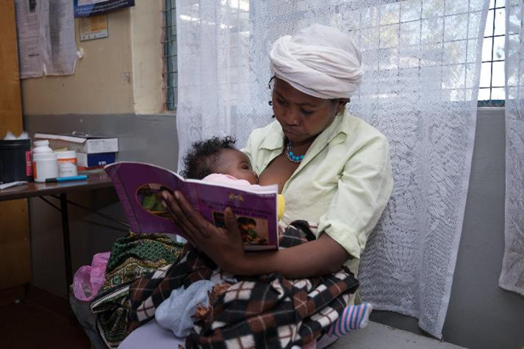
Meeting Agenda
Purpose of the Meeting
Brief overview of clinical mentoring
Structure of the Breastfeeding Counselling Mentorship Program and Implementation Process
Selection of mentors and mentees and roles and responsibilities
Process of pairing mentees to mentors
Mentoring, monthly meetings, and graduation criteria
Program Resources
Timelines and Schedules
Next Steps
Summary
Complete the “Part 1: Confidence Self-Evaluation” Form
Photo credit: Allan Gichigi/MCSP

Slide 3
Purpose of the Meeting

Slide 4
Meeting Goal and Objectives
The goal of this meeting is to orient mentors to the facility-based breastfeeding counselling mentorship program before the start of mentoring.
By the end of the meeting, particiaptns will be able to—
Define clinical mentoring.
Describe the structure of the mentorship program.
Describe the roles and responsibilities and expectations of mentors and mentees.
Explain the process of mentoring.
Use program resources to document engagement in the mentorship program.
Describe the timeline and scheduling for the mentorship program.

Slide 5
Clinical Mentoring

Slide 6
Clinical Mentoring: Definition
A sustained, collaborative relationship in which a highly experienced health care provider guides improvement in the quality of care delivered by other providers and the health care systems in which they work

Slide 7
What is a Mentor and a Mentee?
Mentor:
An experienced and empathetic person, proficient in her/his content area, who teaches and coaches another individual (mentee) or a group of individuals (mentees) in-person and/or virtually to ensure competent workplace performance and provide ongoing professional development.
Selected for the program in collaboration with the health facility management team based on the selection criteria.
Mentee:
A direct care provider who delivers breastfeeding counselling to clients. She/he is a dedicated skilled health provider who seeks to grow and develop personally and professionally to successfully achieve her/his goals to strengthen her/his breastfeeding counselling competencies with the support of a mentor.
Selected for the program in collaboration with the health facility management team, the Baby-Friendly Hospital Initiative (BFHI) implementation team, and mentors, using the selection criteria.

Slide 8
What Breastfeeding Counselling Mentors Do
Build relationships.
Strengthen confidence through positive feedback.
Identify areas for improvement.
Provide responsive coaching and model best practices.
Collect and report on data as part of the mentorship program.

Slide 9
Why Clinical Mentoring for Breastfeeding Support?
Quality counselling and support results in a 90 percent increase in exclusive breastfeeding rates for infants aged 0–5 months (Haroon et. al 2013).
Health workers are key to giving support, and counselling skills are complex.
Training alone is limited in providing opportunities for practicing skills learned during training.
Mentorship is a flexible learning and teaching approach that is effective in improving clinical competence (Feyissa et al. 2019).

Slide 10
Characteristics of Effective Mentoring Relationships
Warm, safe, respectful, trustful
Both mentor and mentee want to be involved
Mentor uses active and reflective listening
Mentor/mentee able to work through misunderstandings
Continuity of the relationship over time
Power is shared
Learning is two-way: mentor interested in mentee’s ideas

Slide 11
Structure of the Breastfeeding Counselling Mentorship Program

Slide 12
Description of the Mentorship Program
This is an in-house, facility-based mentorship program whereby mentors and mentees are based at the same facility.
We designed it for use at three levels of health facilities: level 3B, level 4, and level 5.
Facilities can implement it at several service delivery points, including antenatal care services, labour and childbirth services, postnatal care services, newborn care services, and paediatric services.
Mentors and mentees are trained in the BFHI Training Course for Maternity Staff (WHO and UNICEF 2020a).
When mentoring starts, mentees receive regular feedback and support from their mentors as they practice the skills taught in the BFHI maternity training in their day-to-day work.
Mentors and mentees engage in quality improvement activities at the health facility.
Typically takes four months for a mentee to acquire focus competencies.

Slide 13
Implementation Process
The implementation process includes 10 actions:
Train health facility staff in the BFHI Training Course for Maternity Staff.
Identify and prioritise service delivery points.
Select and train mentors.
Select mentees.
Pair mentors and mentees.
Orient mentors and mentees.
Conduct mentoring.
Conduct monthly meetings.
Assess competencies for graduation.
Monitor the program.
There are also several steps before implementation to establish the mentorship program at a facility including—
Sensitise facility management.
Identify program leadership.
Conduct a BFHI health facility self-assessment.
Conduct an inception meeting.
Acquire resources.

Slide 14
Program Leadership:
Roles and Responsibilities of BFHI Facility Coordinator
Oversee the mentorship program.
Convene the BFHI Facility Implementation team meetings, as needed, but at least once every two months.
Organise an inception meeting for the health facility management team (HFMT) and heads of departments (HODs).
Organise orientation meetings with mentors and mentees.
Organise the BFHI trainings for mentors and mentees and the Core Concepts in Mentorship Training course for mentors.
Ensure that mentors and mentees have the necessary resources for implementation of the program.
Organise and plan the agenda for monthly meetings with mentors and mentees.
Collect the “Mentor Feedback Form” from mentees.
Convene and coordinate other related trainings, as needed.
Offer support and guidance to mentors and mentees throughout implementation of the program.

Slide 15
Program Leadership: Roles and Responsibilities of the BFHI Facility Implementation Team (1)
Ensure the mentorship program is implemented as planned.
Participate in BFHI Facility Implementation Team meetings.
Support the BFHI facility coordinator to organise—
an inception meeting for the HFMT and HODs
orientation meetings with mentors and mentees
the BFHI training and the Core Concepts in Mentorship Training
monthly meetings.
Identify and select mentor and mentees, based on the selection criteria.
Determine the best ratio for mentor-to-mentee and the mentoring approach(es).

Slide 16
Program Leadership: Roles and Responsibilities of the BFHI Facility Implementation Team (2)
Pair mentors to mentees, in collaboration with mentors.
Support mentors and mentees working in their service delivery point.
Engage the mentors and mentees in continuous quality improvement activities in their respective service delivery points.
Update the HFMT on progress of the mentorship program.
Update the Sub-County Health Management Team and County Health Management Team on progress of the mentorship program, as required.
Conduct selected BFHI implementation activities, such as facility self-assessments.
Monitor the breastfeeding counselling mentorship program indicators.

Slide 17
Mentorship Program Package
The breastfeeding counselling mentorship program package includes—
Implementation Guidance for a Facility-Based Breastfeeding Counselling Mentorship Program
Core Concepts in Mentorship Training: Mentor Training for the Breastfeeding Counselling Mentorship Program
Facilitator’s Guide
Participant’s Manual
Slide deck.
The mentorship package complements—
BFHI Training Course for Maternity Staff.

Slide 18
Implementation Guidance
Implementation guidance was developed for the program through a co-creation process with several stakeholders in Kenya, including the Ministry of Health.
The implementation guidance draws on tools and resources from the BFHI Training and the Competency Verification Toolkit.
Key document that health facilities will use when establishing and implementing the mentorship program at their facility:
includes actions for implementing the mentorship program at the facility level
describes the program structure, management, implementation, and monitoring.
Includes:
Mentor and mentee job aids, mentorship program tools, and information, education, and communication materials
Slide decks to use during orientation and inception meetings.

Slide 19
Goals and Objectives

Slide 20
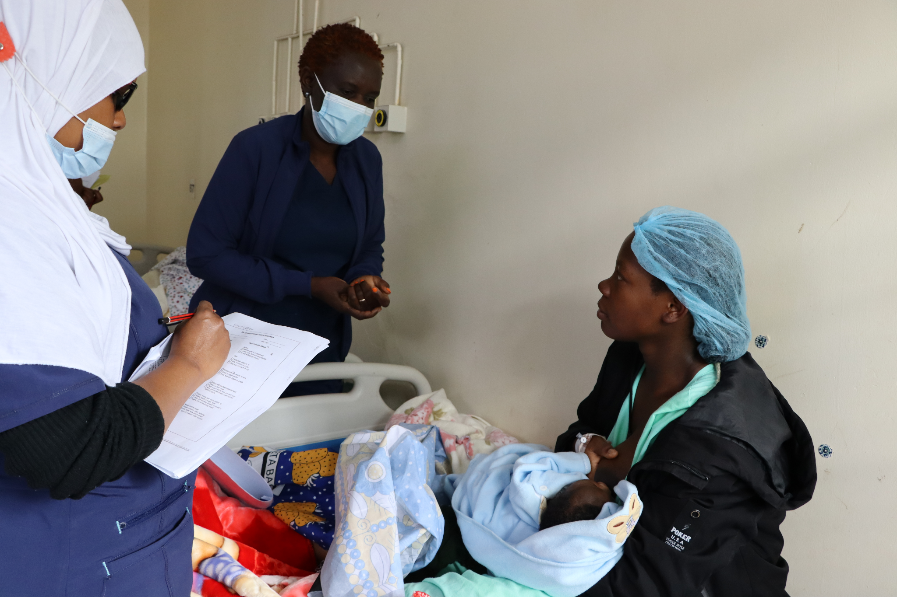
Goals and Objectives of the Mentorship Program
The overarching goal is to improve the quality of breastfeeding counselling provided by health workers.
The specific objectives of the program are to—
Reinforce and strengthen 7 of the 16 breastfeeding counselling competencies needed for implementation of BFHI.
Support mentees to apply skills learned in the BFHI Training Course for Maternity Staff (WHO and UNICEF 2020a) during counselling sessions with clients.
Cultivate a skilled team of on-site mentors who can champion and support quality breastfeeding counselling and serve as a resource for mentees.
Create an enabling environment for providing quality breastfeeding counselling at all relevant service delivery points.
Photo credit: Fridah Bwari/Save the Children

Slide 21
Competencies and Performance Indicators
The mentorship program is based on achieving a set of competencies, which are measured by performance indicators.
Both the competencies and performance indicators of focus for the breastfeeding counselling mentorship program are taken from the Competency Verification Toolkit (WHO and UNICEF 2020b).
Definitions:
Competency: The capability to use a set of related knowledge, skills, and behaviours to successfully perform identified jobs, roles, or responsibilities (WHO 2015, 15).
Performance indicator: Help to document that a mentee has acquired necessary competencies and are measurable (WHO and UNICEF 2020b, 6). A mentor verifies each of the performance indicators address knowledge, skills, or attitudes by observation.

Slide 22
Competencies Prioritised for the Mentorship Program
Use listening and learning skills whenever engaging in a conversation with a mother.
Engage in antenatal conversation about breastfeeding.
Facilitate breastfeeding within the first hour, according to cues.
Discuss with a mother how breastfeeding works.
Assist mother getting her baby to attach to the breast.
Help a mother to breastfeed a small or sick baby.
Ensure seamless transition after discharge.
Notes:
*Note: Prior to this orientation meeting update this slide to remove any competencies that will NOT be covered as part of the mentorship program at this health facility.

Slide 23
Performance Indicators of Focus by Competency (1)
Competency | Performance Indicator
3. Use listening and learning skills whenever engaging in a conversation with a mother | 11. Demonstrate at least three aspects of listening and learning skills when talking with a mother.
5. Engage in antenatal conversation about breastfeeding | 15. Engage in a conversation with a pregnant woman on three aspects of the importance of breastfeeding.
 | 16. Assess at least three aspects of a pregnant woman’s knowledge about breastfeeding in order to fill the gaps and correct inaccuracies.
 | 17. Engage in a conversation with a pregnant woman about at least four care practices a mother/infant dyad will experience at the birthing facility that will support breastfeeding.
Source: WHO and UNICEF 2020b
Notes:
*Note: Prior to this orientation meeting update this slide to remove any competencies and performance indicators that will NOT be covered as part of the mentorship program at this health facility.

Slide 24
Performance Indicators of Focus by Competency (2)
Competency | Performance Indicator
7. Facilitate breastfeeding within the first hour, according to cues | 25. Engage in a conversation with a mother including at least three reasons why suckling at the breast in the first hour is important, when the baby is ready.
 | 27. Describe to a mother at least three pre-feeding behaviours babies show before actively sucking at the breast.
8. Discuss with a mother how breastfeeding works | 29. Engage in a conversation with a mother regarding at least three reasons why effective exclusive breastfeeding is important.
 | 30. Engage in a conversation with a mother regarding two elements related to infant feeding patterns in the first 36 hours of life.
 | 31. Describe to a mother at least four signs of adequate transfer of milk in the first few days.
Source: WHO and UNICEF 2020b
Notes:
*Note: Prior to this orientation meeting update this slide to remove any competencies and performance indicators that will NOT be covered as part of the mentorship program at this health facility.

Slide 25
Performance Indicators of Focus by Competency (3)
Competency | Performance Indicator
9. Assist mother getting her baby to attach to the breast | 32. Evaluate a full breastfeeding session observing at least five points.
12. Help a mother to breastfeed a small or sick baby | 43. Help a mother achieve a comfortable and safe position for breastfeeding with her small or sick infant at the breast, noting at least four points.
 | 44. Engage in a conversation with a mother of a small or sick infant not sucking effectively at the breast, including at least five points
 | 46. Engage in a conversation with a mother of a small or sick or vulnerable infant (including multiple births) regarding the importance of observing at least two subtle signs and behavioural state shifts to determine when it is appropriate to breastfeed.
Source: WHO and UNICEF 2020b
Notes:
*Note: Prior to this orientation meeting update this slide to remove any competencies and performance indicators that will NOT be covered as part of the mentorship program at this health facility.

Slide 26
Performance Indicators of Focus by Competency (4)
Competency | Performance Indicator
16. Ensure seamless transition after discharge | 62. Develop individualized discharge feeding plans with a mother that includes at least six points.
 | 63. Describe to a mother at least four warning signs of infant undernourishment or dehydration for a mother to contact a health care professional after discharge.
 | 64. Describe at least three warning signs for a mother to contact a health care professional after discharge.
Source: WHO and UNICEF 2020b
Notes:
*Note: Prior to this orientation meeting update this slide to remove any competencies and performance indicators that will NOT be covered as part of the mentorship program at this health facility.

Slide 27
Selecting Mentors and Mentees and Roles and Responsibilities

Slide 28
Minimum Requirements for Mentors
Completed the BFHI training
Provides direct care to clients in one of the prioritised service delivery point(s)
Has met all qualifications to work as a doctor, nurse, nutritionist, clinical officer, or midwife
Has a minimum of two years of experience providing maternal and newborn care, but five or more years is preferred
Demonstrates a high level of competency (i.e., knowledge, skills, and attitudes) in providing breastfeeding counselling, observing breastfeeding counselling, and accurately assessing breastfeeding counselling competencies
Senior management is supportive and agrees to allow staff to serve as a mentor
Conversant with the Breast Milk Substitutes (BMS) Act of 2012, the International Code of Marketing of BMS, and the subsidiary BMS regulations of 2021
Avoids conflicts of interest particularly with companies that produce BMS designated products, or from their parent or subsidiary companies, or political leaders. This is imperative to ensure direct care providers protect families from commercial pressure. All mentors must sign a code of conduct indicating adherence to this.

Slide 29
Roles and Responsibilities of Mentors
Provide mentoring, supporting the mentee(s) on all aspects of breastfeeding counselling, strengthening the mentees’ knowledge, skills, and attitudes.
Demonstrate and model breastfeeding counselling competencies.
Observe mentee(s) providing breastfeeding counselling, using the appropriate Observation Tool for the service delivery point.
Focus on observing counselling interactions and providing feedback to the mentee(s)—both affirming and corrective.
Facilitate professional growth in a non-punitive way.
Encourage learning and improvement in breastfeeding counselling competencies.
Build a rapport with mentee(s).
Plan and conduct weekly check-ins with their assigned mentee(s) to review documentation and action points from the previous meetings.
Be available to answer mentees’ questions and provide support to mentee(s).
Make use of job aids and tools.
Fill out monitoring and reporting forms.
Participate in monthly mentoring meetings.

Slide 30
Additional Considerations for Mentors
Availability
Other responsibilities
Reliability
Level of professional expertise
Experience being in a supervisory role
Experience with mentoring and pre-service professional education
Ability to be a leader and influence people
Knowledge about maternity care and infant feeding practices within the BFHI context to accurately detect both correct and incorrect knowledge, skills, and attitudes (behaviours)
Communication and organisational skills
Critical thinking and problem-solving skills
Resilience and adaptability
Supportive and positive attitude in approach to work
Attention to detail
Commitment to improving the quality of care for patients
Willingness to learn new skills
Willingness to commit to participating in the mentorship activities for the duration of the mentorship program

Slide 31
Minimum Requirements for Mentees
Completed the BFHI training
Provides direct care to clients in one of the prioritised service delivery point(s)
Has met all qualifications to work as a doctor, nurse, nutritionist, clinical officer, midwife, or breastfeeding peer supporter
Senior management is supportive and agrees to allow staff to participate as a mentee
Avoids conflicts of interest particularly with companies that produce BMS designated products, or from their parent or subsidiary companies, or political leaders. This is imperative to ensure direct care providers protect families from commercial pressure. All mentors must sign a code of conduct indicating adherence to this.

Slide 32
Roles and Responsibilities of Mentees
Actively participate in mentorship activities for the duration of the program.
Apply new learning on breastfeeding counselling in their daily work.
Practise the skills focused on during mentoring observations.
Participate in weekly check-ins and monthly mentorship meetings.
Complete the reporting forms.
Make use of job aids.

Slide 33
Additional Considerations for Mentees
Availability
Other responsibilities
Reliability
Willingness to learn new skills
Positive attitude in approach to work
Commitment to improving the quality of care for patients
Open to receiving feedback and guidance from their mentor
Willingness to commit to participating in the mentorship activities for the duration of the mentorship program

Slide 34
Process of Pairing Mentors and Mentees

Slide 35
Pair Mentors and Mentees
The BFHI Facility Implementation Team determines the best ratio for mentor-to-mentee (i.e., one-to-one, one mentor to three mentees)
Mentors were consulted during the pairing process.
Considerations for pairing:
cadre of the mentor and mentee
mentor-to-mentee ratio chosen
unit where the mentor and mentee work
skill level of mentees
roles of mentors and mentees in the facility
personality
age and experience.
Notes:
*Note: Prior to this orientation meeting update this slide to add any additional criteria or considerations used when pairing.

Slide 36
Review of the Implementation Process, including Actions Completed

Slide 37
Implementation Process
The implementation process includes 10 actions:
Train health facility staff in the BFHI Training Course for Maternity Staff. ✅
Identify and prioritise service delivery points. ✅
Select and train mentors. ✅
Select mentees. ✅
Pair mentors and mentees. ✅
Orient mentors and mentees.
Conduct mentoring.
Conduct monthly meetings.
Assess competencies for graduation.
Monitor the program.
Notes:
*Note: For actions which have already been completed, add a check mark to indicate that they are completed.

Slide 38
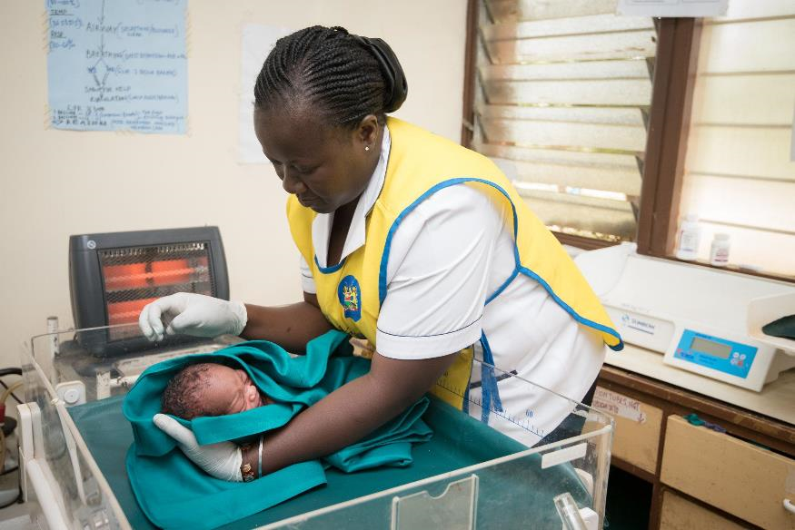
Service Delivery Points Chosen
We will implement the mentorship program in the following service delivery points:
[TO BE ADDED]
[TO BE ADDED]
Photo credit: Allan Gichigi/MCSP
Notes:
*Note: Prior to this orientation meeting update this slide with the service delivery point(s) selected for the mentorship program at this health facility.

Slide 39
Mentees Selected
We selected the following health workers to participate in the mentorship program:
[TO BE ADDED]
[TO BE ADDED]
Notes:
*Note: Prior to this orientation meeting update this slide with the names of the health workers selected as mentees for the mentorship program at this health facility.

Slide 40
Pairing of Mentors and Mentees
The following mentors and mentees have been paired for the mentorship program:
[TO BE ADDED]
[TO BE ADDED]
Notes:
*Note: Prior to this orientation meeting update this slide with the names of pairing of mentors and mentees for the mentorship program at this health facility. If the pairing has not yet been done and/or if the pairing will be done as part of this orientation meeting, update the slides to indicate this.

Slide 41
Mentoring, Monthly Meetings, and Graduation Criteria

Slide 42
Mentoring

Slide 43
What is Mentoring?
Mentoring involves demonstrating, observing, debriefing, and checking in.
The success of mentoring rests on the mentor providing timely, appropriate, and supportive feedback to the mentee.
While mentoring is primarily the responsibility of mentors and mentees, the BFHI facility coordinator and the BFHI Facility Implementation Team will offer support and guidance throughout the mentoring process.

Slide 44
Goal Setting
Before mentoring begins, the mentor and mentee(s) will meet to establish the mentees’ goals for the program. This helps to start to build trust, review individual goals, and discuss anything sensitive or confidential without other mentees present.
Mentee goals should be—
based on strengths and gaps identified by completing the “Mentee Self-Evaluation Form”
tailored to the needs of the mentee
agreed upon between the mentor/mentee
selected from the list of focus competencies of the mentorship program
achievable within the duration of the mentorship program (i.e., the mentee can make progress on these goals within the four-month duration)
documented on the “Mentee Goals and Progress Log” (will review later).

Slide 45
Summary: Demonstration, Observation, Debrief, and Check-In
Takes place one to three times per week:
Demonstration: Mentees observe mentors providing breastfeeding counselling, demonstrating the competencies, and modelling best practices.
Observation:
Mentors observe mentees providing breastfeeding counselling.
Mentors perform competency assessments of mentees.
Debrief: Mentors provide feedback to mentees.
Takes place once every one or two weeks:
Check-in: Debrief counselling sessions observed, provide feedback, conduct clinical teaching, etc.

Slide 46
Demonstration by Mentors
Initially, mentees will observe mentors demonstrating the competency(ies). The mentee can ask questions and learn by observing their mentor. Mentors leverage demonstrations to teach critical tasks related to performance indicators associated with the focus competencies. Mentors may use clinical teaching or side-by-side mentoring to facilitate learning.
Mentors will demonstrate breastfeeding counselling competencies, as needed, throughout implementation of the mentorship program and consistently model good counselling skills.
When mentees are ready, they can demonstrate their breastfeeding counselling skills while mentors observe.

Slide 47
Observation of Mentees by Mentors
Mentors observe mentees providing breastfeeding counselling between one and three times per week, initially more frequently, throughout implementation of the mentorship program.
During observations, the mentee practises the competencies that she/he prioritised.
If, when the mentor is observing a mentee, the mentee omits crucial information or gives incorrect information, the mentor may gently step in and clarify the information during the counselling interaction.
Mentors assess mentees’ competencies using the performance indicators corresponding with the competencies that the mentees prioritised.
When observing breastfeeding counselling sessions, mentors will use the “Observation Tool” to help the mentor notice specific actions or skills related to priority performance indicators. They can also be reviewed during monthly meetings to assess progress against established goals.

Slide 48
Observation Tools

Slide 49
Debrief
After any demonstration and observation, mentors and mentees should debrief.
After mentees observe a mentor demonstrating breastfeeding counselling competencies, mentees will discuss what they observed, provide feedback, and ask questions.
After mentors observe mentees, mentors will give supportive, constructive feedback and suggestions for improvement to the mentee.
If a mentor uses the mentor-led small group approach to mentoring, the mentor will provide feedback to all of the mentees in a group, so mentees can learn from each other.

Slide 50
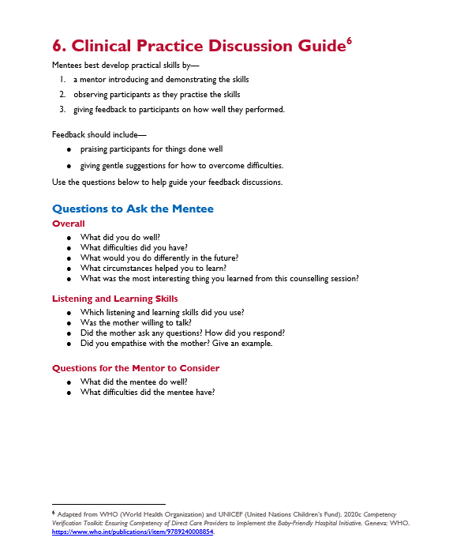
Clinical Practice Discussion Guide
Mentors will use this to guide the discussion during debriefs and check-ins with mentees.

Slide 51
Check-In
The mentor should check in with mentee(s) every one or two weeks, depending on need and availability. More frequent mentoring check-ins are useful, particularly at the start of the program, if work schedules allow for this.
Check-ins should last for 60–90 minutes each, and they can be conducted one-on-one (mentor and mentee) or as a group (mentor and several mentees).
In cases where mentor-led small groups are the norm, the mentor should still plan to check in with each mentee one-to-one to discuss individual goals and any sensitive or confidential information that the mentee does not want to share with other mentees.

Slide 52
Program Materials: Mentee Resources

Slide 53
Mentee Resources
Mentee Job Aids:
Topics to Cover during Breastfeeding Counselling
Checklist for Observing a Breastfeeding Session
Breastfeeding Counselling Log
Information, Education, and Communication Materials:
Expressing Breast Milk Counselling Card
Mentorship Program Tools:
Schedule of Mentoring Meetings and Resources to Use
Focus Competencies and Performance Indicators
Mentor Feedback Form
Mentee Goals and Progress Log.

Slide 54
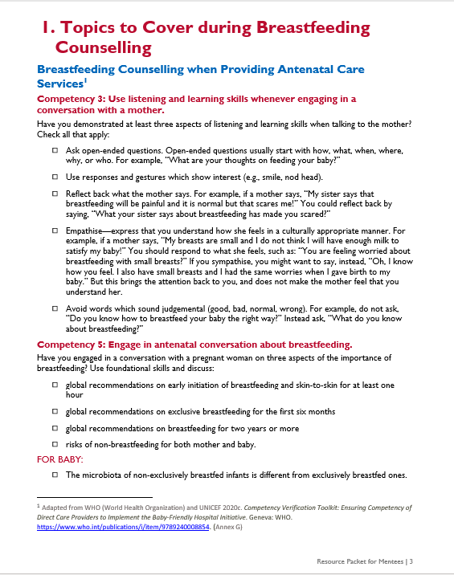
Topics to Cover during Breastfeeding Counselling
Mentees reference these guides when conducting a counselling visit in each of the service delivery points/areas.
The topics focus on the competencies and performance indicators of the mentorship program.
Mentees should review the checklist before a counselling visit and make a check mark in the box during counselling visits.
Use a pencil to fill out this checklist so you can reuse it, or print multiple copies.

Slide 55
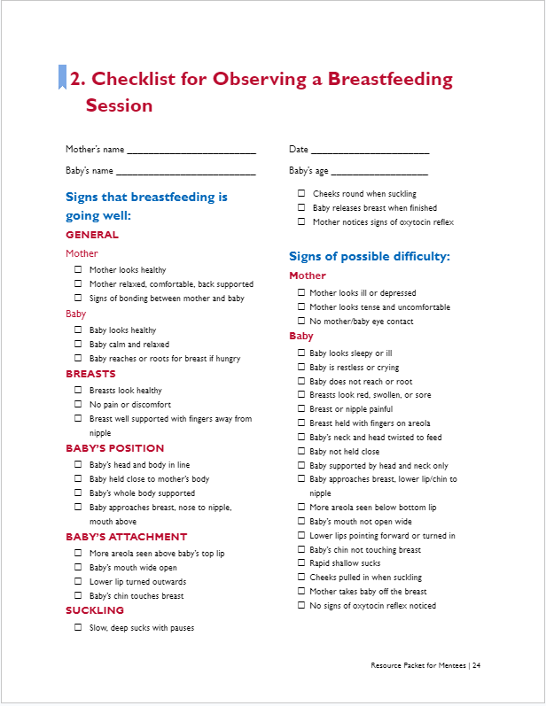
Checklist for Observing a Breastfeeding Session
Use this checklist to help you remember what to observe when assessing a breastfeed.
The left-hand column shows breastfeeding is going well. The right-hand column indicates a possible difficulty.
Make a check mark in the box based on observations.
If you do not observe an action, do not add a mark.
After completing the form, review the check marks on the left-hand side of the form.
If the majority are in this column, breastfeeding is most likely going well.
If there are some check marks in the right-hand column, then breastfeeding may not be going well. This means that this mother may have challenges and will need help.
Use a pencil to fill out this checklist so you can reuse it, or print multiple copies.

Slide 56
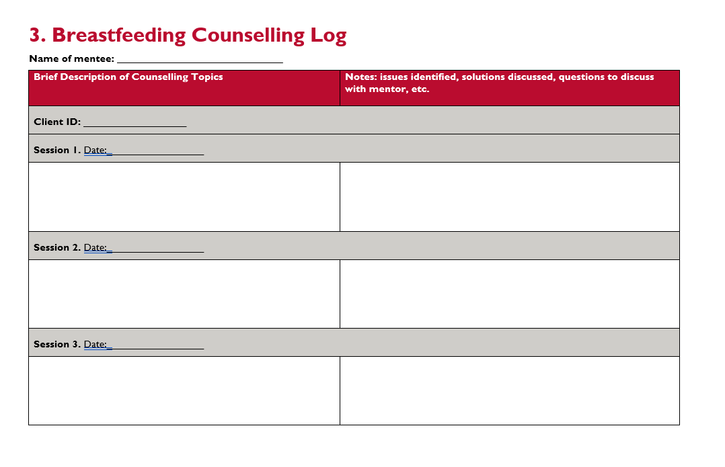
Breastfeeding Counselling Log
This resource tracks breastfeeding counselling and support provided, including issues identified and solutions proposed.
Use it to track the breastfeeding counselling provided over time to a specific client and to remind yourself of the cases you have seen to discuss them with your mentor during check-ins.
Take brief notes of the breastfeeding counselling topics that you have discussed with a client.
Write down the issues identified, solutions proposed, and any questions you have for your mentor to discuss during your next check-in.
You will need to print multiple copies of this log.

Slide 57
Expressing Breast Milk Counselling Card
Use this counselling card to counsel mothers and caregivers on expressing breast milk.
You could print and distribute it to mothers and caregivers.

Slide 58
Schedule of Mentoring Meetings and Resources to Use
This resource serves as a reminder for the mentor and mentee of the ideal schedule for mentoring interactions, including check-ins, and meetings, as well as the resources to use.

Slide 59
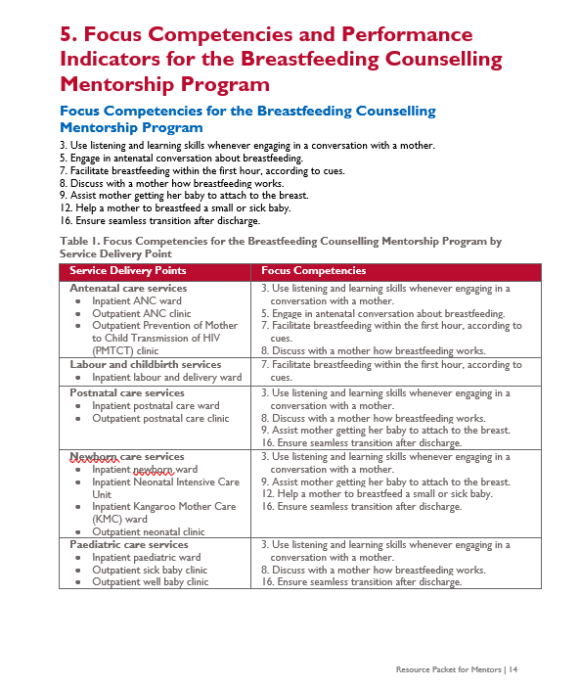
Focus Competencies and Performance Indicators for the Breastfeeding Counselling Mentorship Program
Use this resource when reviewing your mentees’ competencies and progress toward achieving their goals.
It is a list of the focus competencies for the breastfeeding counselling mentorship program, which are then presented by the relevant service delivery points.
It also includes the performance indicators used to measure each focus competency.

Slide 60
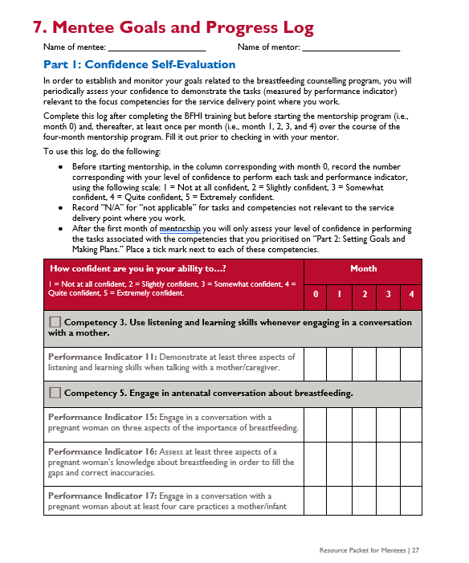
Mentee Goals and Progress Log: Purpose
This log is an opportunity for mentees to reflect on your self confidence in applying knowledge and skills learned during the BFHI Training Course for Maternity Staff when providing breastfeeding counselling.
This is not a performance evaluation, but rather a guide you can use to set goals for the mentorship program and evaluate your own progress.
It is a place to document your goals for the mentorship program and reflect on them throughout the mentorship program.

Slide 61
Mentee Goals and Progress Log—
Part 1: Confidence Self-Evaluation
In order to establish and monitor your goals related to the breastfeeding counselling program, you will periodically assess your confidence to demonstrate the tasks (measured by performance indicator) relevant to the focus competencies for the service delivery point where you work.
We will complete Part 1 of this log today.
Thereafter, you will complete this log at least once per month (i.e., month 1, 2, 3, and 4) over the course of the four-month mentorship program.
After the first month of mentorship you will only assess your level of confidence in performing the tasks associated with the competencies that you prioritised on “Part 2: Setting Goals and Making Plans.” Place a tick mark next to each of these competencies.
Fill it out prior to checking in with your mentor.

Slide 62
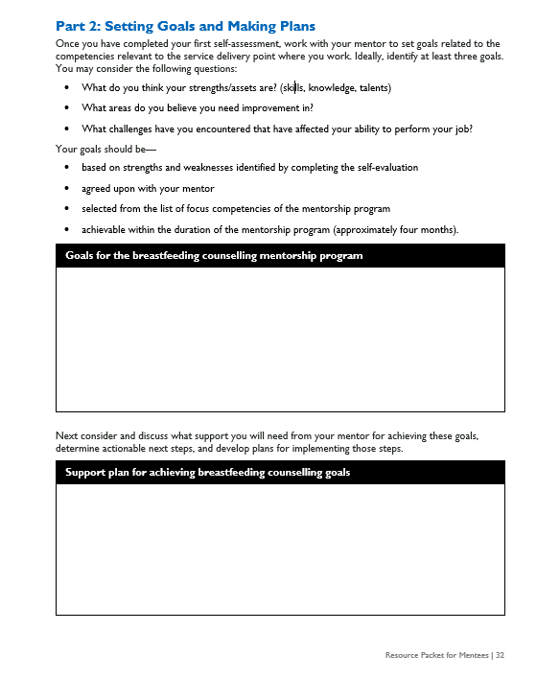
Mentee Goals and Progress Log—
Part 2: Setting Goals and Making Plans
Once you have completed your first self-assessment, you will work with your mentor to set goals related to the competencies relevant to the service delivery point where you work.
Ideally, identify at least three goals.
You may consider the following questions:
What do you think your strengths/assets are? (skills, knowledge, talents)
What areas do you believe you need improvement in?
What challenges have you encountered that have affected your ability to perform your job?

Slide 63
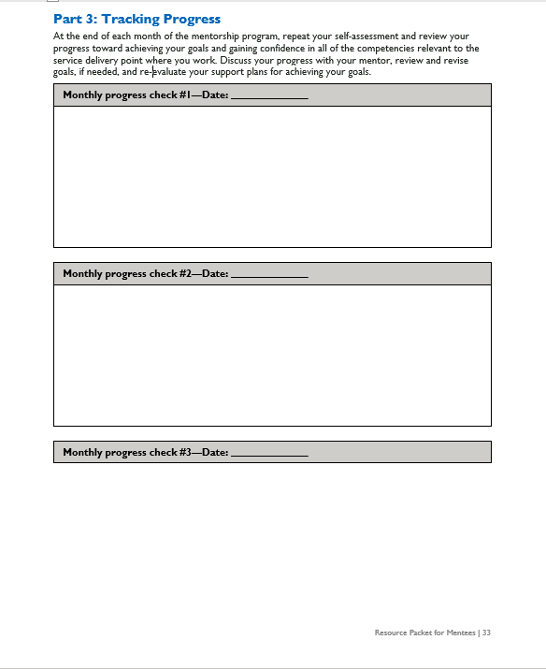
Mentee Goals and Progress Log—
Part 3: Tracking Progress
At the end of each month of the mentorship program, repeat your self-assessment and review your progress toward achieving your goals and gaining confidence in all of the competencies relevant to the service delivery point where you work.
Discuss your progress with your mentor, review and revise goals, if needed, and reevaluate your support plans for achieving your goals.

Slide 64
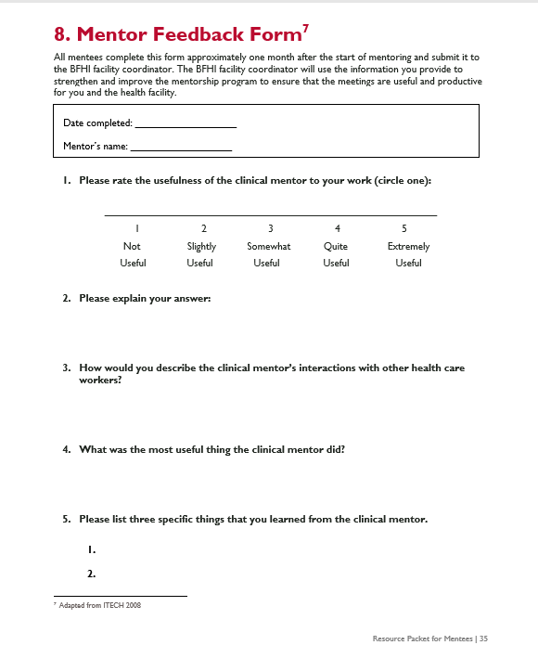
Mentor Feedback Form
The purpose of this form is to enable you to provide feedback on the usefulness of the support provided by your mentor as part of the breastfeeding counselling mentorship program.
Information collected will strengthen and improve the system to ensure that the meetings are useful and productive for you and the health facility.
Complete this form approximately one month after the start of the mentorship program and submit it to the BFHI facility coordinator.

Slide 65
Program Materials: Mentor Resources

Slide 66
Mentor Resources
These resources are for mentors and have already been reviewed with them.
Mentor Job Aids:
Building a Relationship with a Mentee
Basic Principles of Giving Feedback
Five Steps of Clinical Teaching
Schedule of Mentoring Meetings and Resources to Use
Focus Competencies and Performance Indicators
Clinical Practice Discussion Guide
Mentorship Program Tools:
Observation Tools
Mentee Progress Log

Slide 67
Monthly Meetings

Slide 68
Monthly Meetings
The BFHI facility coordinator will organise and facilitate monthly mentor meetings for peer-to-peer experience sharing and review of case presentations.
Monthly meetings may include—
Sharing challenges and successes on how mentoring is going (i.e., feedback on frequency of observations, frequency of check-ins, mentoring approaches used, and the use of mentorship program tools).
Discussing common breastfeeding scenarios, challenges, and solutions and real-life examples through case presentations.
Reviewing feedback from mentees, referencing mentee responses on the “Mentor Feedback Form”, if used.
Identifying ways and make plans to improve the program.
Exploring suggestions for sustainability and expansion (opportunity for mentees to become mentors).

Slide 69
Graduation

Slide 70
Assess Competencies for Graduation (1)
Mentees graduate from the mentorship program when they have demonstrated competence in the focus competencies relevant to the service delivery point where the mentee provides breastfeeding counselling services.
This is designed to be accomplished within four months of regular, ongoing mentorship (but it may take more or less time).
If the mentee meets the requirements of graduation, he/she will receive a certificate of completion from the breastfeeding counselling mentorship program for the service delivery point where the mentee provides breastfeeding counselling services by the BFHI Facility Implementation Team.
Mentees who graduate will be eligible for serving as a mentor in that service delivery point in the future.
If the mentee fails to meet the requirements of graduation, the BFHI Facility Implementation Team and the mentee will meet to discuss the reasons and agree on next steps, which may include continuing in the program to achieve graduation.

Slide 71
Assess Competencies for Graduation (2)
Criteria for graduation:
The mentee must be “quite confident” or “extremely confident” demonstrating each task (measured by performance indicator) relevant to the focus competencies for the service delivery point where the mentee provides breastfeeding counselling services, based on the “Mentee Goals and Progress Log”.
The mentor must be “quite confident” or “extremely confident” in the mentee’s ability to demonstrate each task (measured by performance indicator) relevant to the focus for the service delivery point where the mentee provides breastfeeding counselling services, based on the “Mentee Progress Log”.
This means that the “Part 1: Mentor Confidence Assessment” of the “Mentee Progress Log” AND “Part 1: Confidence Self-Evaluation” of the “Mentee Goals and Progress Log” have only 4s and 5s for all of the focus competencies in the service delivery point where the mentee provides breastfeeding counselling services by the end of the mentorship program.

Slide 72
Timeline and Schedules

Slide 73
Timeline and Schedules
Mentoring will begin on [XXX].
You and your mentor should schedule your first meeting no later than [XXX].
Expect to meet with your mentor several times per week in the beginning of the program.
The first monthly meeting is planned for [XXX].
Notes:
*Note: Prior to this orientation meeting update this slide with actual timelines.

Slide 74
Next Steps

Slide 75
Next Steps
First meeting of mentors and mentees.
Kick-off mentoring!
Notes:
*Note: Prior to this orientation meeting update this slide with any additional next steps.

Slide 76
Summary

Slide 77
Summary
The breastfeeding counselling mentorship program is facility-based; can take place at several service delivery points across maternal, newborn, and paediatric services; is designed to take four months; and is structured in a way that mentors teach and coach mentees to ensure competency in breastfeeding counselling.
Mentors are expected to support the mentees on all aspects of breastfeeding counselling to strengthening the mentees’ knowledge, skills, and attitudes; to demonstrate and model breastfeeding counselling competencies; and to focus on observing counselling interactions and providing feedback to the mentees.
Mentoring involves demonstrating, observing, debriefing, and checking in; there are several tools and job aids used during each of these interactions.

Slide 78
Complete the “Part 1: Confidence Self-Evaluation” form

Slide 79
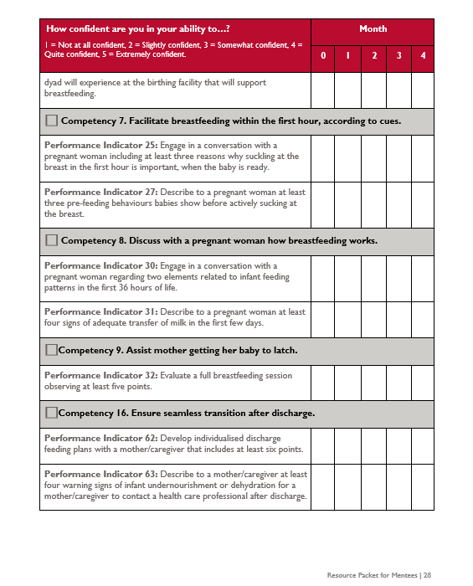
Mentee Goals and Progress Log—
Part 1: Confidence Self-Evaluation
In the column corresponding with month 0, record the number corresponding with your level of confidence to perform each task and performance indicator, using the following scale:
1 = Not at all confident
2 = Slightly confident
3 = Somewhat confident
4 = Quite confident
5 = Extremely confident
Record “N/A” (not applicable) for tasks and competencies not relevant to the service delivery point where you work.
After the first month of mentorship you will only assess your level of confidence in performing the tasks associated with the competencies that you will prioritise on “Part 2: Setting Goals and Making Plans.”

Slide 80
References
Feyissa, G.T., D. Balabanova, M. Woldie. 2019. “How Effective are Mentoring Programs for Improving Health Worker Competence and Institutional Performance in Africa? A Systematic Review of Quantitative Evidence.” Journal of Multidisciplinary Healthcare 12(5): 989–1005. https://doi.org/10.2147/JMDH.S228951.
Haroon, S., J.K. Das, R.A. Salam, A. Imdad, & Z.A. Bhutta. 2013. “Breastfeeding Promotion Interventions and Breastfeeding Practices: A Systematic Review”. BMC Public Health, 13 (Suppl 3): S20. https://doi.org/10.1186/1471-2458-13-S3-S20
WHO (World Health Organization) and UNICEF (United Nations Children's Fund). 2020a. Baby Friendly Hospital Initiative (BFHI) Training Course for Maternity Staff: Director’s Guide. Geneva: WHO. https://apps.who.int/iris/bitstream/handle/10665/333674/9789240008939-eng.pdf
WHO (World Health Organization) and UNICEF (United Nations Children's Fund). 2020b. Competency Verification Toolkit: Ensuring Competency of Direct Care Providers to Implement the Baby-Friendly Hospital Initiative. Geneva: WHO. https://www.who.int/publications/i/item/9789240008854.

Slide 81
USAID ADVANCING NUTRITION

