Slide 1
Facility-Based Mentorship for Strengthening Breastfeeding Counselling in Kenya
Photo credit: Allan Gichigi/MCSP
Illustrative Slides for Orientation Meeting with Mentors

Slide 2
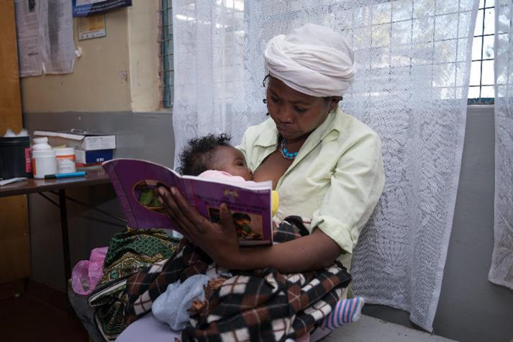
Meeting Agenda
Purpose of the Meeting
Review Structure of the Breastfeeding Counselling Mentorship Program and Implementation Process
Expectations of Mentors
Mentoring
Program Resources
Timelines and Schedules
Next Steps
Summary
Photo credit: Allan Gichigi/MCSP

Slide 3
Purpose of the Meeting

Slide 4
Meeting Goal and Objectives
The goal of this meeting is to orient mentors to the facility-based breastfeeding counselling mentorship program before the start of mentoring.
By the end of the meeting, participants will be able to—
Describe the structure of the mentorship program.
Describe the expectations of mentors.
Explain the process of mentoring.
Use program resources to mentor health workers on breastfeeding counselling.
Describe the timeline and scheduling for the mentorship program.

Slide 5
Structure of the Breastfeeding Counselling Mentorship Program

Slide 6
Review: Structure of the Mentorship Program
This is an in-house, facility-based mentorship program; mentors and mentees are based at the same facility.
We designed it for use at three levels of health facilities: level 3B, level 4, and level 5.
Facilities can implement it at several service delivery points, including antenatal care services, labour and childbirth services, postnatal care services, newborn care services, and paediatric services.
Mentors and mentees are trained in the Baby-Friendly Hospital Initiative (BFHI) Training Course for Maternity Staff (WHO and UNICEF 2020a).
When mentoring starts, mentees receive regular feedback and support from their mentors as they practice the skills taught in the BFHI maternity training in their day-to-day work.
Mentors and mentees engage in quality improvement activities at the health facility.
Typically takes four months for a mentee to acquire focus competencies.

Slide 7
Review: What is a Mentor and a Mentee?
Mentor:
An experienced and empathetic person, proficient in her/his content area, who teaches and coaches another individual (mentee) or a group of individuals (mentees) in-person and/or virtually to ensure competent workplace performance and provide ongoing professional development
Selected for the program in collaboration with the health facility management team based on the selection criteria.
Mentee:
A direct care provider who delivers breastfeeding counselling to clients. She/he is a dedicated skilled health provider who seeks to grow and develop personally and professionally to successfully achieve her/his goals to strengthen her/his breastfeeding counselling competencies with the support of a mentor.
Selected for the program in collaboration with the health facility management team, the BFHI implementation team, and mentors, using the selection criteria.

Slide 8
Program Leadership:
Roles and Responsibilities of BFHI Facility Coordinator
Oversee the mentorship program.
Convene the BFHI Facility Implementation team meetings, as needed, but at least once every two months.
Organise an inception meeting for the health facility management team (HFMT) and heads of departments (HODs).
Organise orientation meetings with mentors and mentees.
Organise the BFHI trainings for mentors and mentees and the Core Concepts in Mentorship Training course for mentors.
Ensure that mentors and mentees have the necessary resources for implementation of the program.
Organise and plan the agenda for monthly meetings with mentors and mentees.
Collect the “Mentor Feedback Form” from mentees.
Convene and coordinate other related trainings, as needed.
Offer support and guidance to mentors and mentees throughout implementation of the program.

Slide 9
Program Leadership: Roles and Responsibilities of the BFHI Facility Implementation Team (1)
Ensure the mentorship program is implemented as planned.
Participate in BFHI Facility Implementation Team meetings.
Support the BFHI facility coordinator to organise—
an inception meeting for the HFMT and HODs
orientation meetings with mentors and mentees
the BFHI training and the Core Concepts in Mentorship Training
monthly meetings.
Identify and select mentor and mentees, based on the selection criteria.
Determine the best ratio for mentor-to-mentee and the mentoring approach(es).

Slide 10
Program Leadership: Roles and Responsibilities of the BFHI Facility Implementation Team (2)
Pair mentors to mentees, in collaboration with mentors.
Support mentors and mentees working in their service delivery point.
Engage the mentors and mentees in continuous quality improvement activities in their respective service delivery points.
Update the HFMT on progress of the mentorship program.
Update the Sub-County Health Management Team and County Health Management Team on progress of the mentorship program, as required.
Conduct selected BFHI implementation activities, such as facility self-assessments.
Monitor the breastfeeding counselling mentorship program indicators.

Slide 11
Goals and Objectives

Slide 12
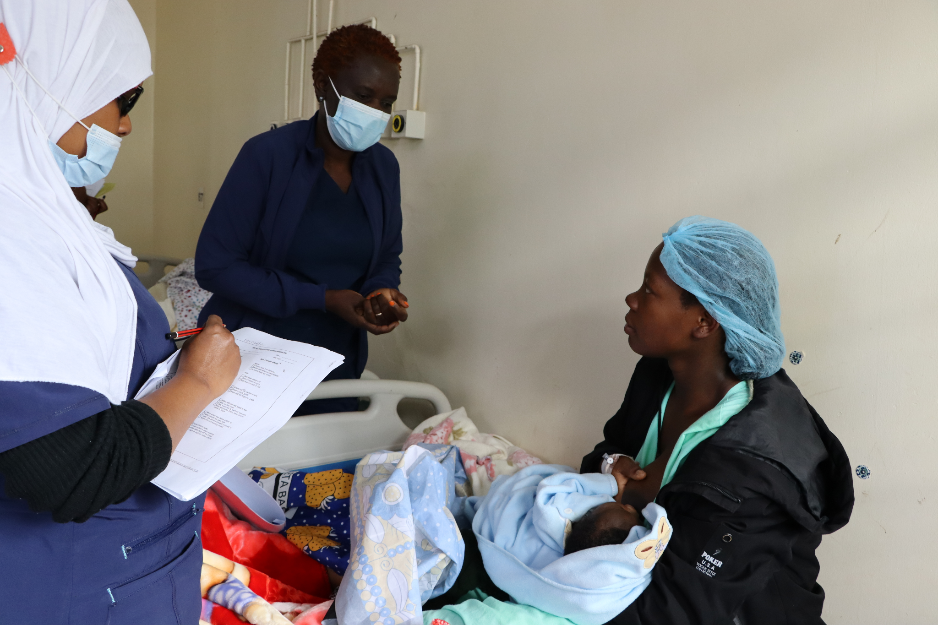
Goals and Objectives of the Mentorship Program
The overarching goal is to improve the quality of breastfeeding counselling provided by health workers.
The specific objectives of the program are to—
Reinforce and strengthen 7 of the 16 breastfeeding counselling competencies needed for implementation of BFHI.
Support mentees to apply skills learned in the BFHI Training Course for Maternity Staff (WHO and UNICEF 2020a) during counselling sessions with clients.
Cultivate a skilled team of on-site mentors who can champion and support quality breastfeeding counselling and serve as a resource for mentees.
Create an enabling environment for providing quality breastfeeding counselling at all relevant service delivery points.
Photo credit: Fridah Bwari/Save the Children

Slide 13
Review: Minimum Requirements for Mentors
Completed the BFHI training
Provides direct care to clients in one of the prioritised service delivery point(s)
Has met all qualifications to work as a doctor, nurse, nutritionist, clinical officer, or midwife
Has a minimum of two years of experience providing maternal and newborn care, but five or more years is preferred
Demonstrates a high level of competency (i.e., knowledge, skills, and attitudes) in providing breastfeeding counselling, observing breastfeeding counselling, and accurately assessing breastfeeding counselling competencies
Senior management is supportive and agrees to allow staff to serve as a mentor
Conversant with the Breast Milk Substitutes (BMS) Act of 2012, the International Code of Marketing of BMS, and the subsidiary BMS regulations of 2021
Avoids conflicts of interest particularly with companies that produce BMS designated products, or from their parent or subsidiary companies, or political leaders. This is imperative to ensure direct care providers protect families from commercial pressure. All mentors must sign a code of conduct indicating adherence to this.

Slide 14
Competencies and Performance Indicators
The mentorship program is based on achieving a set of competencies, which are measured by performance indicators.
Both the competencies and performance indicators of focus for the breastfeeding counselling mentorship program are taken from the Competency Verification Toolkit (WHO and UNICEF 2020b).
Definitions:
Competency: The capability to use a set of related knowledge, skills, and behaviours to successfully perform identified jobs, roles, or responsibilities (WHO 2015, 15).
Performance indicator: Help to document that a mentee has acquired necessary competencies and are measurable (WHO and UNICEF 2020b, 6). A mentor verifies each of the performance indicators address knowledge, skills, or attitudes by observation.

Slide 15
Competencies Prioritised for the Mentorship Program
Use listening and learning skills whenever engaging in a conversation with a mother.
Engage in antenatal conversation about breastfeeding.
Facilitate breastfeeding within the first hour, according to cues.
Discuss with a mother how breastfeeding works.
Assist mother getting her baby to attach to the breast.
Help a mother to breastfeed a small or sick baby.
Ensure seamless transition after discharge.
Notes:
*Note: Prior to this orientation meeting update this slide to remove any competencies that will NOT be covered as part of the mentorship program at this health facility.

Slide 16
Performance Indicators of Focus by Competency (1)
Competency | Performance Indicator
3. Use listening and learning skills whenever engaging in a conversation with a mother | 11. Demonstrate at least three aspects of listening and learning skills when talking with a mother.
5. Engage in antenatal conversation about breastfeeding | 15. Engage in a conversation with a pregnant woman on three aspects of the importance of breastfeeding.
 | 16. Assess at least three aspects of a pregnant woman’s knowledge about breastfeeding in order to fill the gaps and correct inaccuracies.
 | 17. Engage in a conversation with a pregnant woman about at least four care practices a mother/infant dyad will experience at the birthing facility that will support breastfeeding.
Source: WHO and UNICEF 2020b
Notes:
*Note: Prior to this orientation meeting update this slide to remove any competencies and performance indicators that will NOT be covered as part of the mentorship program at this health facility.

Slide 17
Performance Indicators of Focus by Competency (2)
Competency | Performance Indicator
7. Facilitate breastfeeding within the first hour, according to cues | 25. Engage in a conversation with a mother including at least three reasons why suckling at the breast in the first hour is important, when the baby is ready.
 | 27. Describe to a mother at least three pre-feeding behaviours babies show before actively sucking at the breast.
8. Discuss with a mother how breastfeeding works | 29. Engage in a conversation with a mother regarding at least three reasons why effective exclusive breastfeeding is important.
 | 30. Engage in a conversation with a mother regarding two elements related to infant feeding patterns in the first 36 hours of life.
 | 31. Describe to a mother at least four signs of adequate transfer of milk in the first few days.
Source: WHO and UNICEF 2020b
Notes:
*Note: Prior to this orientation meeting update this slide to remove any competencies and performance indicators that will NOT be covered as part of the mentorship program at this health facility.

Slide 18
Performance Indicators of Focus by Competency (3)
Competency | Performance Indicator
9. Assist mother getting her baby to attach to the breast | 32. Evaluate a full breastfeeding session observing at least five points.
12. Help a mother to breastfeed a small or sick baby | 43. Help a mother achieve a comfortable and safe position for breastfeeding with her small or sick infant at the breast, noting at least four points.
 | 44. Engage in a conversation with a mother of a small or sick infant not sucking effectively at the breast, including at least five points
 | 46. Engage in a conversation with a mother of a small or sick or vulnerable infant (including multiple births) regarding the importance of observing at least two subtle signs and behavioural state shifts to determine when it is appropriate to breastfeed.
Source: WHO and UNICEF 2020b
Notes:
*Note: Prior to this orientation meeting update this slide to remove any competencies and performance indicators that will NOT be covered as part of the mentorship program at this health facility.

Slide 19
Performance Indicators of Focus by Competency (4)
Competency | Performance Indicator
16. Ensure seamless transition after discharge | 62. Develop individualized discharge feeding plans with a mother that includes at least six points.
 | 63. Describe to a mother at least four warning signs of infant undernourishment or dehydration for a mother to contact a health care professional after discharge.
 | 64. Describe at least three warning signs for a mother to contact a health care professional after discharge.
Source: WHO 2020b
Notes:
*Note: Prior to this orientation meeting update this slide to remove any competencies and performance indicators that will NOT be covered as part of the mentorship program at this health facility.

Slide 20
Mentorship Program Package
The breastfeeding counselling mentorship program package includes—
Implementation Guidance for a Facility-Based Breastfeeding Counselling Mentorship Program
Core Concepts in Mentorship Training: Mentor Training for the Breastfeeding Counselling Mentorship Program
Facilitator’s Guide
Participant’s Manual
Slide deck.
The mentorship package complements—
BFHI Training Course for Maternity Staff.

Slide 21
Implementation Guidance
Implementation guidance was developed for the program through a co-creation process with several stakeholders in Kenya, including the Ministry of Health.
The implementation guidance draws on tools and resources from the BFHI Training and the Competency Verification Toolkit.
Key document that health facilities will use when establishing and implementing the mentorship program at their facility:
includes actions for implementing the mentorship program at the facility level
describes the program structure, management, implementation, and monitoring.
Includes:
Mentor and mentee job aids, mentorship program tools, and information, education, and communication materials
Slide decks to use during orientation and inception meetings.

Slide 22
Review of the Implementation Process, including Actions Completed

Slide 23
Implementation Process
The implementation process includes 10 actions:
Train health facility staff in the BFHI Training Course for Maternity Staff. ✅
Identify and prioritise service delivery points. ✅
Select and train mentors. ✅
Select mentees. ✅
Pair mentors and mentees. ✅
Orient mentors and mentees.
Conduct mentoring.
Conduct monthly meetings.
Assess competencies for graduation.
Monitor the program.
There are also several steps before implementation to establish the mentorship program at a facility including—
Sensitise facility management.
Identify program leadership.
Conduct a BFHI health facility self-assessment.
Conduct an inception meeting.
Acquire resources.
Notes:
*Note: For actions which have already been completed, add a check mark to indicate that they are completed.

Slide 24
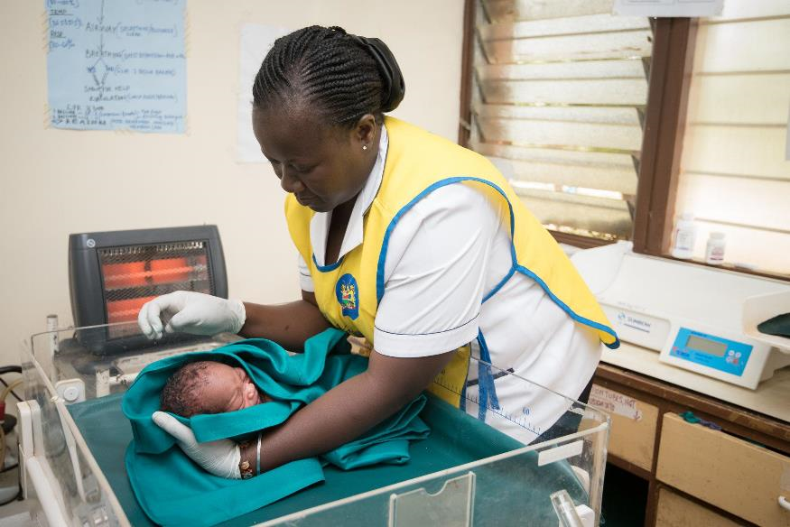
Service Delivery Points Chosen
We will implement the mentorship program in the following service delivery points:
[TO BE ADDED]
[TO BE ADDED]
Photo credit: Allan Gichigi/MCSP
Notes:
*Note: Prior to this orientation meeting update this slide with the service delivery point(s) selected for the mentorship program at this health facility.

Slide 25
Mentees Selected
We selected the following health workers to participate in the mentorship program:
[TO BE ADDED]
[TO BE ADDED]
Notes:
*Note: Prior to this orientation meeting update this slide with the names of the health workers selected as mentees for the mentorship program at this health facility.

Slide 26
Pairing of Mentors and Mentees
The following mentors and mentees have been paired for the mentorship program:
[TO BE ADDED]
[TO BE ADDED]
Notes:
*Note: Prior to this orientation meeting update this slide with the names of pairing of mentors and mentees for the mentorship program at this health facility. If the pairing has not yet been done and/or if the pairing will be done as part of this orientation meeting, update the slides to indicate this.

Slide 27
Expectations of Mentors

Slide 28
Roles and Responsibilities of Mentors (1)
Provide mentoring, supporting the mentee(s) on all aspects of breastfeeding counselling, strengthening the mentees’ knowledge, skills, and attitudes.
Demonstrate and model breastfeeding counselling competencies.
Observe mentee(s) providing breastfeeding counselling, using the appropriate Observation Tool for the service delivery point.
Focus on observing counselling interactions and providing feedback to the mentee(s)—both affirming and corrective.
Facilitate professional growth in a non-punitive way.
Encourage learning and improvement in breastfeeding counselling competencies.

Slide 29
Roles and Responsibilities of Mentors (2)
Build a rapport with mentee(s).
Plan and conduct weekly check-ins with their assigned mentee(s) to review documentation and action points from the previous meetings.
Be available to answer mentees’ questions and provide support to mentee(s).
Make use of job aids and tools.
Fill out monitoring and reporting forms.
Participate in monthly mentoring meetings.

Slide 30
Additional Considerations for Selecting Mentors (1)
Availability
Other responsibilities
Reliability
Level of professional expertise
Experience being in a supervisory role
Experience with mentoring and pre-service professional education
Ability to be a leader and influence people
Knowledge about maternity care and infant feeding practices within the BFHI context to accurately detect both correct and incorrect knowledge, skills, and attitudes (behaviours)

Slide 31
Additional Considerations for Selecting Mentors (2)
Communication and organisational skills
Critical thinking and problem-solving skills
Resilience and adaptability
Supportive and positive attitude in approach to work
Attention to detail
Commitment to improving the quality of care for patients
Willingness to learn new skills
Willingness to commit to participating in the mentorship activities for the duration of the mentorship program.

Slide 32
Implementation Process: Actions 6–10

Slide 33
Action 6: Orient Mentors and Mentees

Slide 34
Mentor and Mentee Orientation Meeting
Following this mentor-only orientation meeting, we will hold an orientation meeting with both mentors and mentees.
This meeting will include the same content as this orientation meeting but will also include the following:
brief overview of clinical mentoring
minimum requirements for selecting mentors and mentees
additional considerations for selecting mentors and mentees
expectations of mentees (roles and responsibilities)
explanation of the process of pairing of mentees to mentors
mentees complete the “Mentee Self-Evaluation Form.”

Slide 35
Action 7: Conduct Mentoring

Slide 36
What is Mentoring?
Mentoring involves demonstrating, observing, debriefing, and checking in.
The success of mentoring rests on the mentor providing timely, appropriate, and supportive feedback to the mentee.
While mentoring is primarily the responsibility of mentors and mentees, the BFHI facility coordinator and the BFHI Facility Implementation Team will offer support and guidance throughout the mentoring process.

Slide 37
Goal Setting with Your Mentee(s)
Before mentoring begins, the mentor and mentee(s) will meet to establish the mentees’ goals for the program. This helps to start to build trust, review individual goals, and discuss anything sensitive or confidential without other mentees present.
Mentee goals should be—
based on strengths and gaps identified by completing the “Mentee Self-Evaluation Form”
tailored to the needs of the mentee
agreed upon between the mentor/mentee
selected from the list of focus competencies of the mentorship program
achievable within the duration of the mentorship program (i.e., the mentee can make progress on these goals within the four-month duration)
documented on the “Mentee Goals and Progress Log” (will review later).

Slide 38
Summary: Demonstration, Observation, Debrief, and Check-In
Takes place one to three times per week:
Demonstration: Mentees observe mentors providing breastfeeding counselling, demonstrating the competencies, and modelling best practices.
Observation:
Mentors observe mentees providing breastfeeding counselling.
Mentors perform competency assessments of mentees.
Debrief: Mentors provide feedback to mentees.
Takes place once every one or two weeks:
Check-in: Debrief counselling sessions observed, provide feedback, conduct clinical teaching, etc.

Slide 39
Demonstration by Mentors
Initially, mentees will observe mentors demonstrating the competency(ies). The mentee can ask questions and learn by observing their mentor. Mentors leverage demonstrations to teach critical tasks related to performance indicators associated with the focus competencies. Mentors may use clinical teaching or side-by-side mentoring to facilitate learning.
Mentors will demonstrate breastfeeding counselling competencies, as needed, throughout implementation of the mentorship program and consistently model good counselling skills.
When mentees are ready, they can demonstrate their breastfeeding counselling skills while mentors observe.

Slide 40
Observation of Mentees by Mentors
Mentors observe mentees providing breastfeeding counselling between one and three times per week, initially more frequently, throughout implementation of the mentorship program.
During observations, the mentee practises the competencies that she/he prioritised.
If, when the mentor is observing a mentee, the mentee omits crucial information or gives incorrect information, the mentor may gently step in and clarify the information during the counselling interaction.
Mentors assess mentees’ competencies using the performance indicators corresponding with the competencies that the mentees prioritised.
When observing breastfeeding counselling sessions, mentors will use the “Observation Tool” (will review later) to help identify specific actions or skills related to priority performance indicators. You can also review these during monthly meetings to assess progress against established goals.

Slide 41
Debrief
After any demonstration and observation, mentors and mentees should debrief.
After mentees observe a mentor demonstrating breastfeeding counselling competencies, mentees will discuss what they observed, provide feedback, and ask questions.
After mentors observe mentees, mentors will give supportive, constructive feedback and suggestions for improvement to the mentee.
If a mentor uses the mentor-led small group approach to mentoring, the mentor will provide feedback to all of the mentees in a group, so mentees can learn from each other.

Slide 42
Check-In
Mentors should check in with mentee(s) every one or two weeks, depending on need and availability. More frequent mentoring check-ins are useful, particularly at the start of the program, if work schedules allow.
Check-ins should last for 60–90 minutes each, and they can be conducted one-on-one (mentor and mentee) or as a group (mentor and several mentees).
In cases where mentor-led small groups are the norm, mentors should plan to check in with each mentee one-to-one to discuss individual goals and any sensitive or confidential information that the mentee does not want to share with other mentees.

Slide 43
Program Materials: Mentor Resources

Slide 44
Mentor Resources
Mentor Job Aids:
Building a Relationship with a Mentee
Basic Principles of Giving Feedback
Six Steps of Clinical Teaching
Schedule of Mentoring Meetings and Resources to Use
Focus Competencies and Performance Indicators
Clinical Practice Discussion Guide
Mentorship Program Tools:
Observation Tools
Mentee Progress Log
Part 1: Mentor Confidence Assessment
Part 2: Mentee Progress Tracking

Slide 45
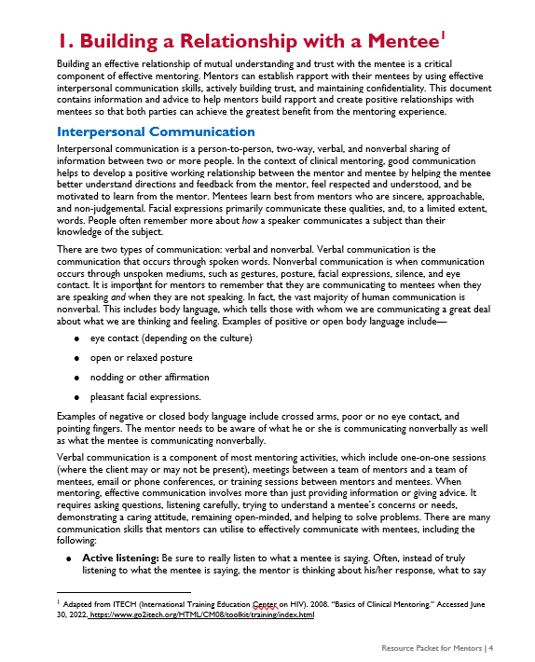
Building a Relationship with a Mentee
This resource contains information and guidance on strategies to use to build a relationship with a mentee.
Read this resource before the mentorship program begins and use the strategies in it throughout the program.
We provided this during the mentor training.

Slide 46
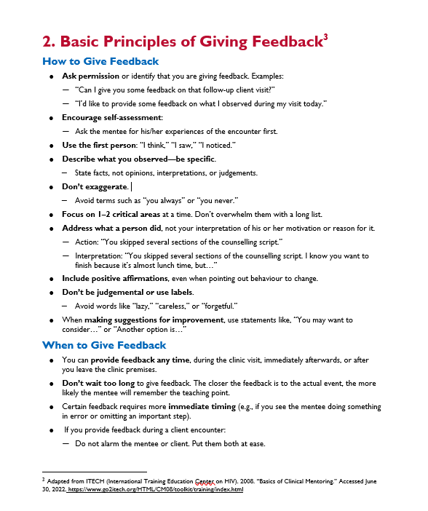
Basic Principles of Giving Feedback
This resource contains information and guidance on strategies to use to give feedback to the mentee.
Read this resource before the mentorship program begins and use the strategies in it throughout the program.
We provided this during the mentor training.

Slide 47
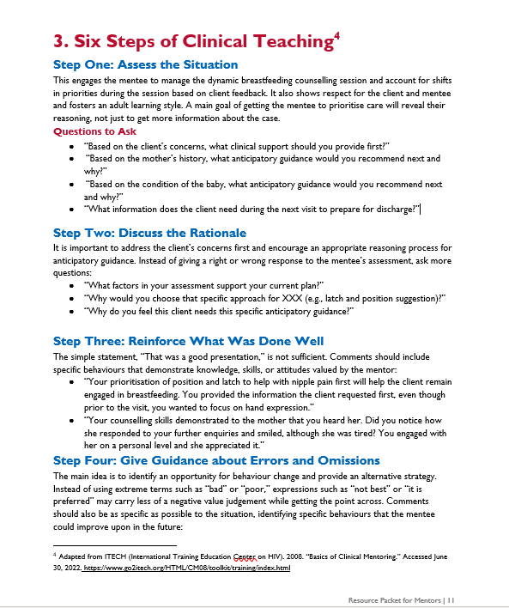
Six Steps of Clinical Teaching
This resource describes the five steps for clinical teaching.
Review this before or during a check-in or meeting with your mentee(s) to remember these steps.
We provided this during the mentor training.

Slide 48
Schedule of Mentoring Meetings and Resources to Use
This resource serves as a reminder for the mentor and mentee of the ideal schedule for mentoring interactions, including check-ins, and meetings, as well as the resources to use.

Slide 49
Focus Competencies and Performance Indicators for the Breastfeeding Counselling Mentorship Program
Use this resource when reviewing your mentees’ competencies and progress toward achieving their goals.
It lists the focus competencies for the breastfeeding counselling mentorship program, which are then presented by the relevant service delivery points.
It also includes the performance indicators used to measure each focus competency.

Slide 50
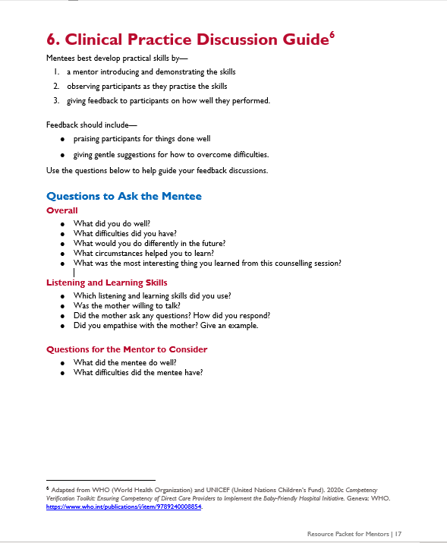
Clinical Practice Discussion Guide
Use this to guide the discussion during check-ins with your mentees.
After you observe the mentee, you will meet to debrief the counselling visit.
Use the questions in the checklist to guide and prompt discussion and feedback with your mentee.

Slide 51
Observation Tools: Purpose
Use these tools to observe mentees provide breastfeeding counselling and to objectively assess what a health worker does.
The tools help you notice the specific actions that define the performance indicators associated with the focus competencies of the breastfeeding counselling mentorship program.

Slide 52
Observation Tools: Instructions
If you have more than one mentee, you will need to print one copy of the observation tool for each mentee.
Use the tool associated with the service delivery point where your mentee works. (i.e., If the mentee works in the outpatient antenatal care clinic, use the “Observation Tool 1: Antenatal Care Services”).
Document observations of counselling interactions that you observe. As you observe, check the action as either—
yes, it has been observed as correct
no, it has not been observed as correct
unsure; it has been observed, but not sure if it is correct or not
not applicable.
Use a pencil to fill out this tool so that you can update and revise it week-to-week as your mentee makes progress towards achieving competencies throughout the duration of the mentorship program.

Slide 53
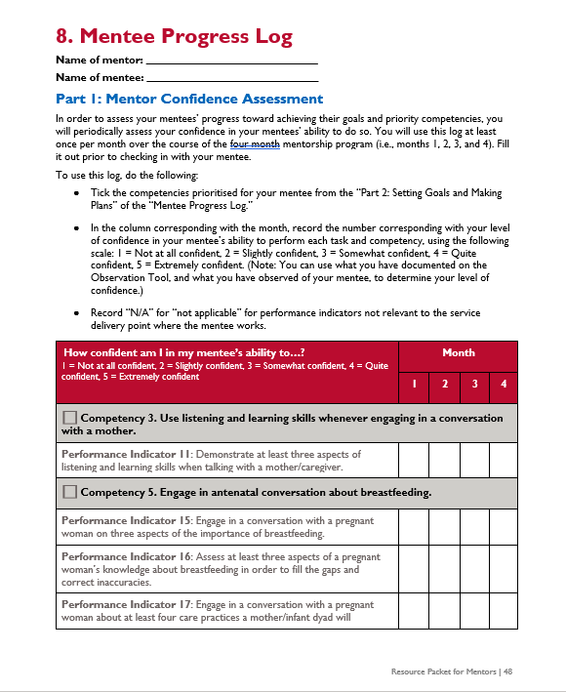
Mentee Progress Log: Purpose
This log provides an opportunity to reflect on your confidence in your mentee applying knowledge and skills learned during the BFHI training when providing breastfeeding counselling.
It is not a performance evaluation, but rather a guide that you can use to—
set goals with your mentee(s) for the mentorship program
evaluate your mentees’ progress
recommend whether your mentee has achieved graduation or not.
Use it during regular check-in meetings.

Slide 54
Mentee Progress Log—
Part 1: Mentor Confidence Assessment
Rate the level of confidence you have in your mentee demonstrating each of the performance indicators.
Use what you have documented on the Observation Tool, and what you have observed of your mentee, to determine your level of confidence.

Slide 55
Part 1: Mentor Confidence Assessment Instructions
Use this log at least once per month over the course of the four month mentorship program (i.e., months 1, 2, 3, and 4).
Fill it out prior to checking in with your mentee.
To use this log, do the following:
Tick the competencies prioritised for your mentee from the “Part 2: Setting Goals and Making Plans” of the “Mentee Progress Log.”
In the column corresponding with the month, record the number corresponding with your level of confidence in your mentee’s ability to perform each task and competency, using the following scale:
1 = Not at all confident • 2 = Slightly confident
3 = Somewhat confident • 4 = Quite confident
5 = Extremely confident.
Use what you have documented on the Observation Tool, and what you have observed of your mentee, to determine your level of confidence.
Record “N/A” (not applicable) for performance indicators not relevant to the service delivery point where the mentee works.

Slide 56
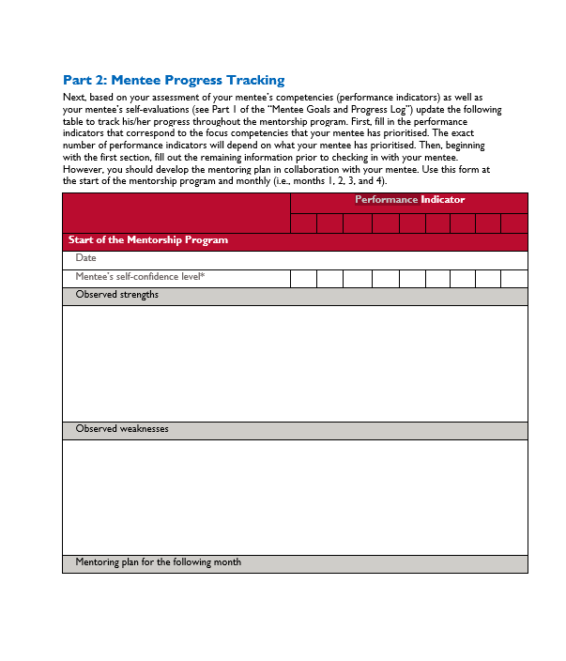
Mentee Progress Log—
Part 2: Mentee Progress Tracking
Track your mentee’s progress over the course of the mentorship program.
Summarises your mentee’s observed strengths and weaknesses, and develop a mentoring plan for the following month in collaboration with your mentee.

Slide 57
Part 2: Mentee Progress Tracking Instructions
Fill in the performance indicators that correspond to the focus competencies that your mentee has prioritised.
For each performance indicator, record the mentee’s self-confidence level score from their “Part 1: Confidence Self-Evaluation” log in the mentee resources.
Then, record your own evaluation of the mentee’s competence from the “Part 1: Mentor Confidence Assessment.”
Summarise the mentee’s observed strengths and weaknesses.
Develop a mentoring plan for the following month in collaboration with your mentee.
In the final month of mentorship, document recommendations for next steps for your mentee (e.g., graduating from the mentorship program, continuing in the mentorship program, focusing on new competencies).

Slide 58
Program Materials: Mentee Resources

Slide 59
Mentee Resources
We will review these during the mentor-mentee orientation meeting.
Mentee Job Aids:
Topics to Cover during Breastfeeding Counselling
Checklist for Observing a Breastfeeding Session
Breastfeeding Counselling Log
Schedule of Mentoring Meetings and Resources to Use
Information, Education, and Communication Materials:
Expressing Breast Milk Counselling Card
Mentorship Program Tools:
Focus Competencies and Performance Indicators
Mentor Feedback Form
Mentee Goals and Progress Log

Slide 60
Action 8: Conduct Monthly Meetings

Slide 61
Action 8: Conduct Monthly Meetings
The BFHI facility coordinator will organise and facilitate monthly mentor meetings for peer-to-peer experience sharing and review of case presentations.
Monthly meetings may include—
Sharing challenges and successes on how mentoring is going (i.e., feedback on frequency of observations, frequency of check-ins, mentoring approaches used, and the use of mentorship program tools).
Discussing common breastfeeding scenarios, challenges, and solutions and real-life examples through case presentations.
Reviewing feedback from mentees, referencing mentee responses on the “Mentor Feedback Form”, if used.
Identifying ways and make plans to improve the program.
Exploring suggestions for sustainability and expansion (opportunity for mentees to become mentors).

Slide 62
Action 9: Assess Competencies for Graduation

Slide 63
Action 9: Assess Competencies for Graduation (1)
Mentees graduate from the mentorship program when they have demonstrated competence in the focus competencies relevant to the service delivery point where the mentee provides breastfeeding counselling services.
This is designed to be accomplished within four months of regular, ongoing mentorship (but it may take more or less time).
If the mentee meets the requirements of graduation, he/she will receive a certificate of completion from the breastfeeding counselling mentorship program for the service delivery point where the mentee provides breastfeeding counselling services by the BFHI Facility Implementation Team.
Mentees who graduate will be eligible for serving as a mentor in that service delivery point in the future.
If the mentee fails to meet the requirements of graduation, the BFHI Facility Implementation Team and the mentee will meet to discuss the reasons and agree on next steps, which may include continuing in the program to achieve graduation.

Slide 64
Action 9: Assess Competencies for Graduation (2)
Criteria for graduation:
The mentee must be “quite confident” or “extremely confident” demonstrating each task (measured by performance indicator) relevant to the focus competencies for the service delivery point where the mentee provides breastfeeding counselling services, based on the “Mentee Goals and Progress Log”.
The mentor must be “quite confident” or “extremely confident” in the mentee’s ability to demonstrate each task (measured by performance indicator) relevant to the focus for the service delivery point where the mentee provides breastfeeding counselling services, based on the “Mentee Progress Log”.
This means “Part 1: Mentor Confidence Assessment” of the “Mentee Progress Log” AND “Part 1: Confidence Self-Evaluation” of the “Mentee Goals and Progress Log” have only 4s and 5s for all of the focus competencies in the service delivery point where the mentee provides breastfeeding counselling services by the end of the mentorship program.

Slide 65
Action 10: Monitor the Program

Slide 66
Action 10: Monitor the Program
The BFHI Facility Implementation Team, led by the BFHI facility coordinator, will monitor program indicators and other related indicators.
Over the course of the mentorship program, mentors will record breastfeeding counselling and breastfeeding counselling mentorship activities.
The BFHI facility coordinator will convene monthly mentor-mentee meetings to review the progress of the mentorship program, share successes, discuss challenges, and identify solutions.
Ideally, the BFHI Facility Management Team would take steps to collect and report on outcomes related to breastfeeding counselling provided, breastfeeding practices, and health status.

Slide 67
Timeline and Schedules

Slide 68
Timeline and Schedules
The mentor-mentee orientation meeting will take place on [XXX].
Mentoring will begin on [XXX].
You should schedule your first meeting with your mentee(s) no later than [XXX].
Expect to meet with your mentee(s) several times per week in the beginning of the program.
We have planned the first monthly meeting for [XXX].
Notes:
*Note: Prior to this orientation meeting update this slide with actual timelines.

Slide 69
Next Steps

Slide 70
Next Steps
Organise a mentor-mentee orientation meeting.
Kick-off mentoring!
Notes:
*Note: Prior to this orientation meeting update this slide with any additional next steps.

Slide 71
Summary

Slide 72
Summary
The breastfeeding counselling mentorship program is facility-based; can take place at several service delivery points across maternal, newborn, and paediatric services; is designed to take four months; and is structured in a way that mentors teach and coach mentees to ensure competency in breastfeeding counselling.
Mentors are expected to support the mentees on all aspects of breastfeeding counselling to strengthening the mentees’ knowledge, skills, and attitudes; to demonstrate and model breastfeeding counselling competencies; and to focus on observing counselling interactions and providing feedback to the mentees.
Mentoring involves demonstrating, observing, debriefing, and checking in; there are several tools and job aids used during each of these interactions.

Slide 73
References
WHO (World Health Organization). 2015. Roles and Responsibilities of Government Chief Nursing and Midwifery Officers: A Capacity-Building Manual. Geneva: WHO. https://apps.who.int/iris/handle/10665/351684.
WHO (World Health Organization) and UNICEF (United Nations Children's Fund). 2020a. Baby Friendly Hospital Initiative (BFHI) Training Course for Maternity Staff: Director’s Guide. Geneva: WHO. https://apps.who.int/iris/bitstream/handle/10665/333674/9789240008939-eng.pdf
WHO (World Health Organization) and UNICEF (United Nations Children's Fund). 2020b. Competency Verification Toolkit: Ensuring Competency of Direct Care Providers to Implement the Baby-Friendly Hospital Initiative. Geneva: WHO. https://www.who.int/publications/i/item/9789240008854.

Slide 74
USAID ADVANCING NUTRITION

