Slide 1
Facility-Based Mentorship for Strengthening Breastfeeding Counselling in Kenya
Photo credit: Allan Gichigi/MCSP
Illustrative Slides for Sensitisation Meetings

Slide 2
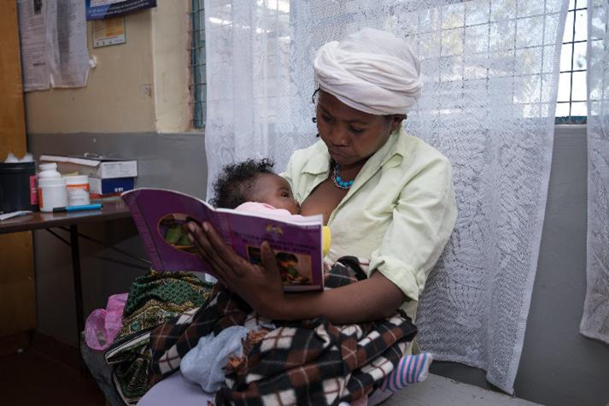
Meeting Agenda
Purpose of the Meeting
Importance of Breastfeeding and Overview of the Baby-Friendly Hospital Initiative (BFHI)
Current Context of Breastfeeding in Kenya
Importance of Breastfeeding Counselling
Description of the Breastfeeding Counselling Mentorship Program
Next Steps
Summary
Photo credit: Allan Gichigi/MCSP

Slide 3
Purpose of the Meeting

Slide 4
Meeting Goal and Objectives
The goal of this meeting is to sensitise key stakeholders on the facility-based breastfeeding counselling mentorship program and the BFHI before the start of implementation.
By the end of the meeting, participants will be able to—
Describe the importance of breastfeeding and breastfeeding counselling.
Identify the Ten Steps to Successful Breastfeeding.
Summarise the current context of breastfeeding in Kenya.
Describe the structure of the mentorship program.
Take action on the next steps to implement the mentorship program.

Slide 5
Importance of Breastfeeding and the Baby-Friendly Hospital Initiative

Slide 6
Importance of Breastfeeding

Slide 7
Importance of Breastfeeding
It is well accepted that breastfeeding has health, nutrition, and cognitive benefits for both children and mothers.
International recommendations include—
initiating breastfeeding within one hour of birth
exclusive breastfeeding for the first six months
continued breastfeeding with complementary feeding until two years of age and beyond.

Slide 8
Overview of the BFHI

Slide 9
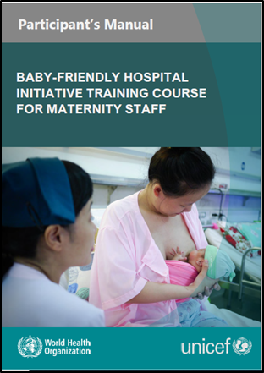
The Baby-Friendly Hospital Initiative
The World Health Organisation (WHO) and UNICEF released updated BFHI implementation guidance in 2018, including the first revision of the Ten Steps to Successful Breastfeeding since 1989.
Step 2 is to “ensure that staff have sufficient knowledge, competence, and skills to support breastfeeding.”
The Competency Verification Toolkit (WHO and UNICEF 2020b) provides guidance and tools for countries to assess staff competency in the knowledge, skills, and attitudes needed to implement the Ten Steps.

Slide 10
The 10 Steps to Successful Breastfeeding

Slide 11
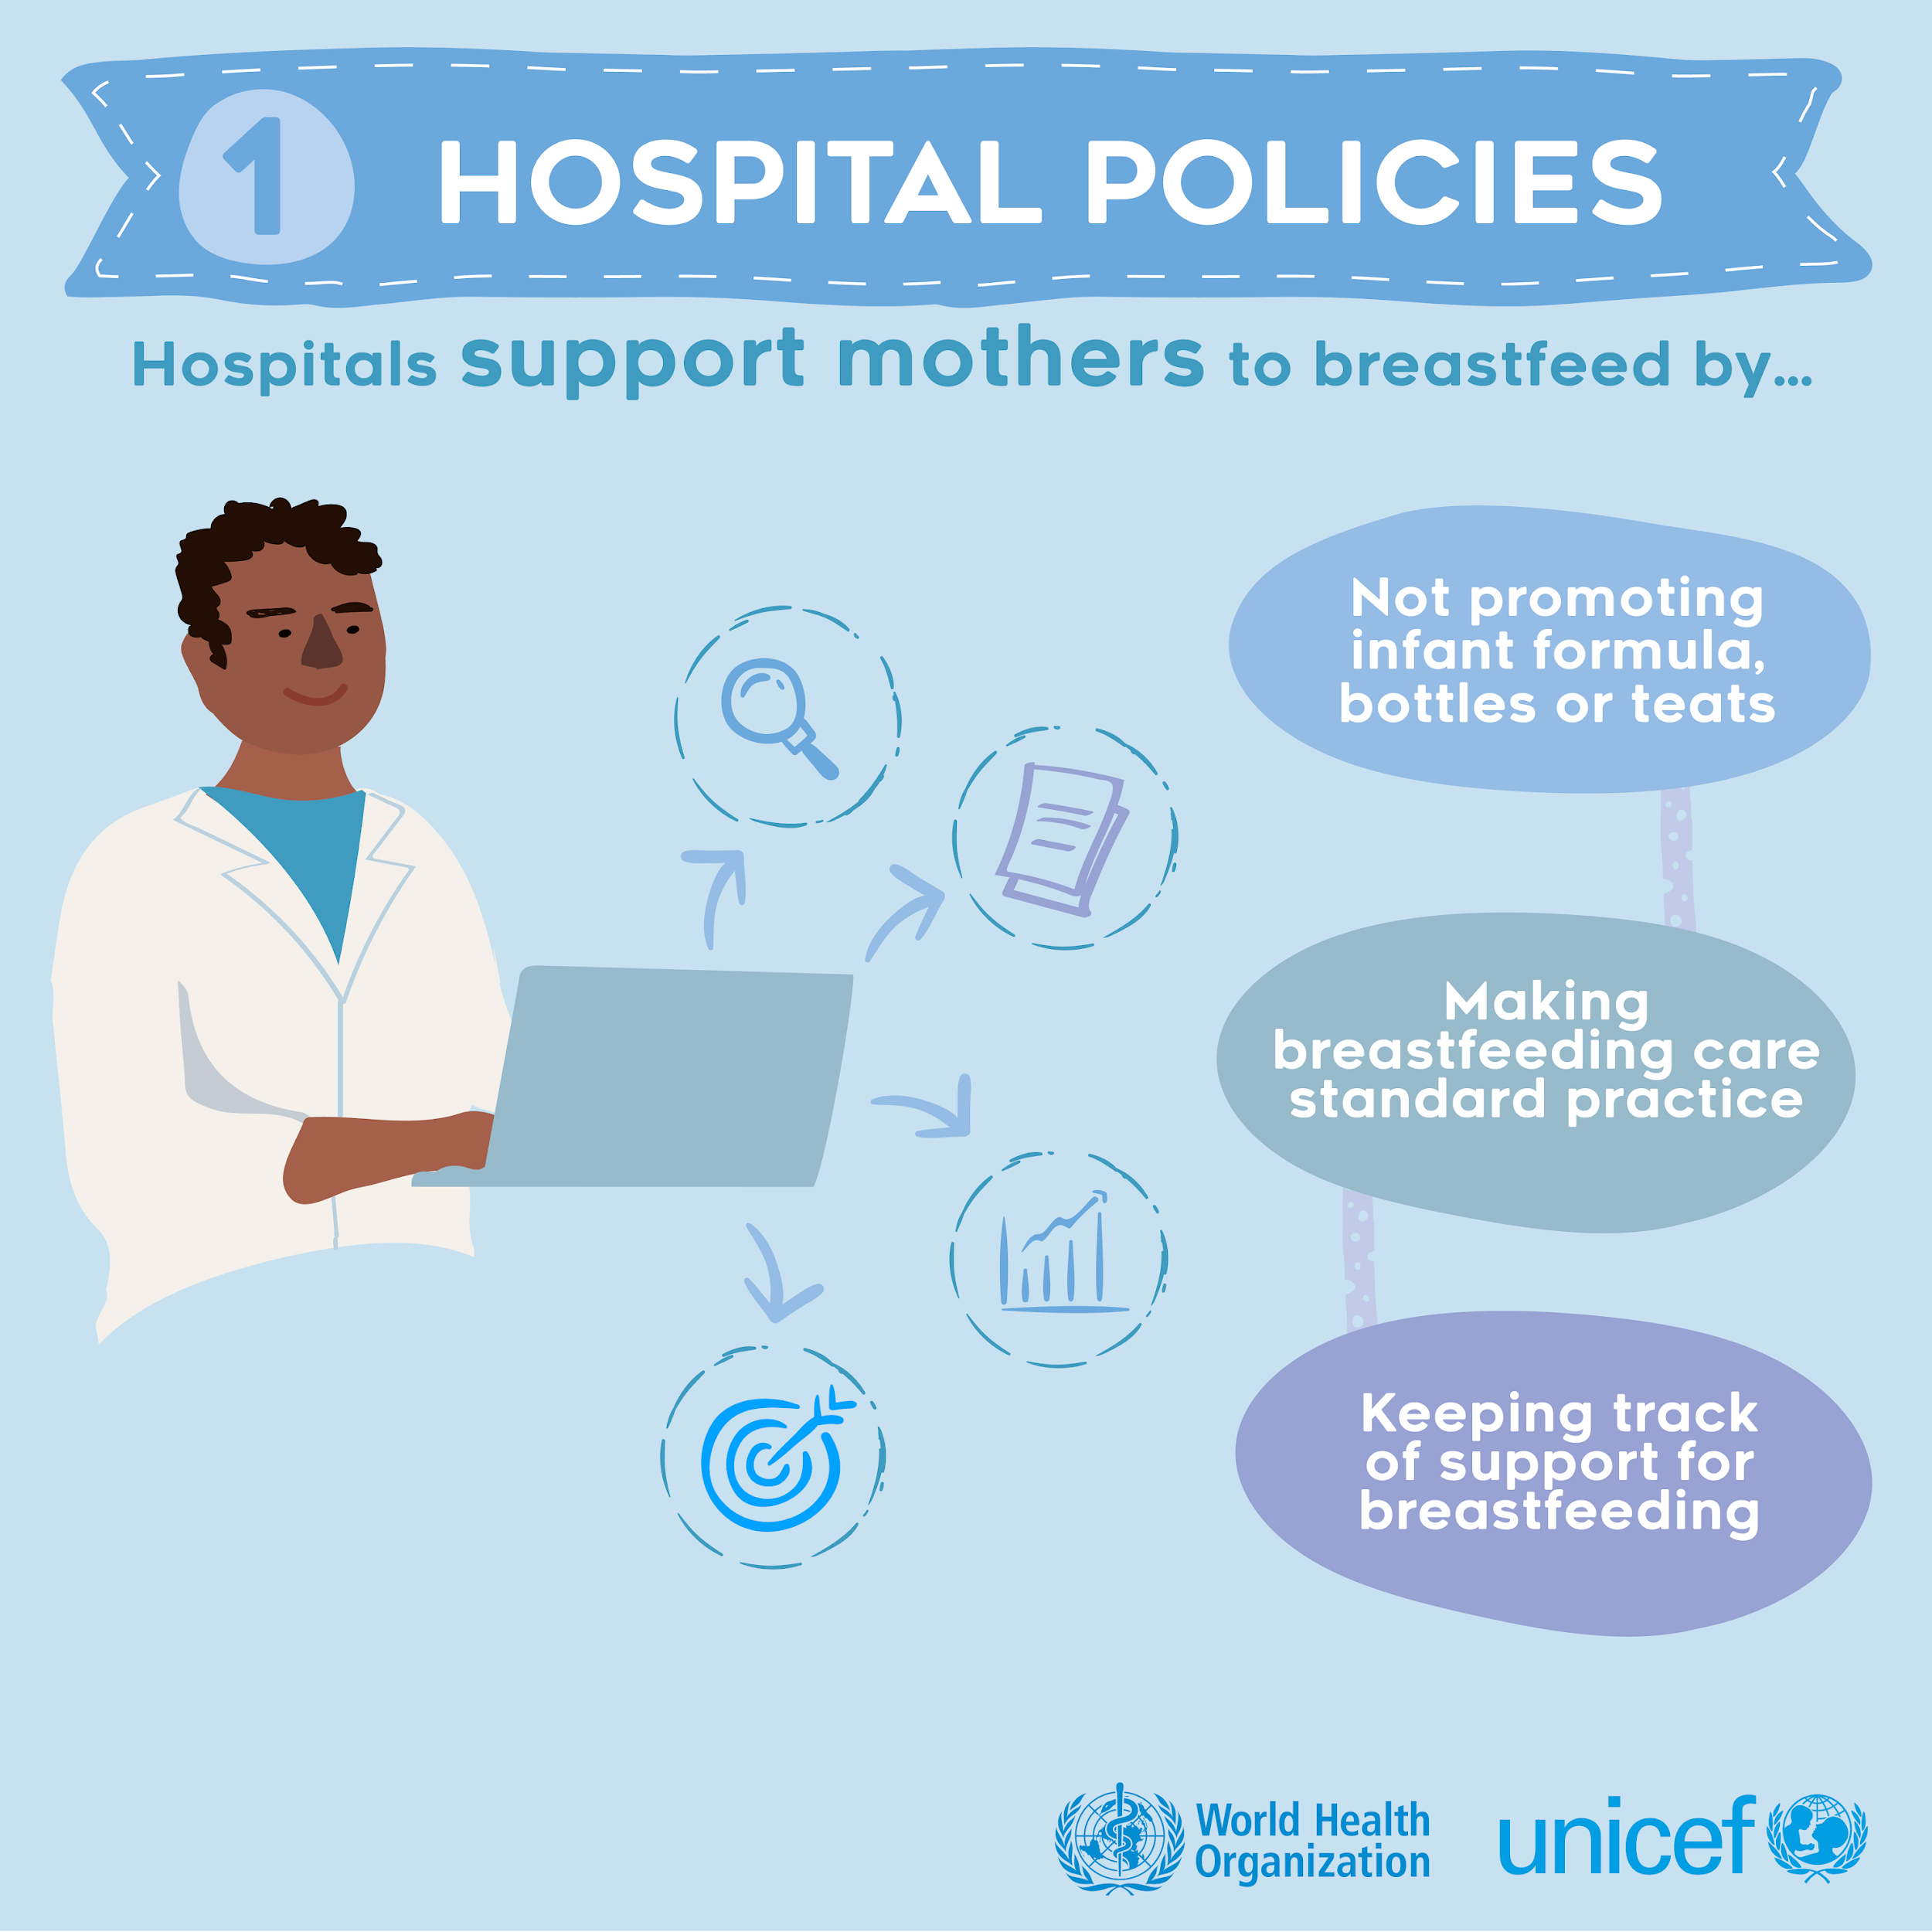
Step 1: Facility Policies
Hospital policies should support mothers to breastfeed.
Rationale:
Families are most vulnerable to the marketing of breast-milk substitutes (BMS) during the entire prenatal, perinatal and postnatal period when they are making decisions about infant feeding.
WHO has called upon health workers and health-care systems to comply with the International Code of Marketing of Breast-Milk Substitutes & BMS Regulations 2021.

Slide 12
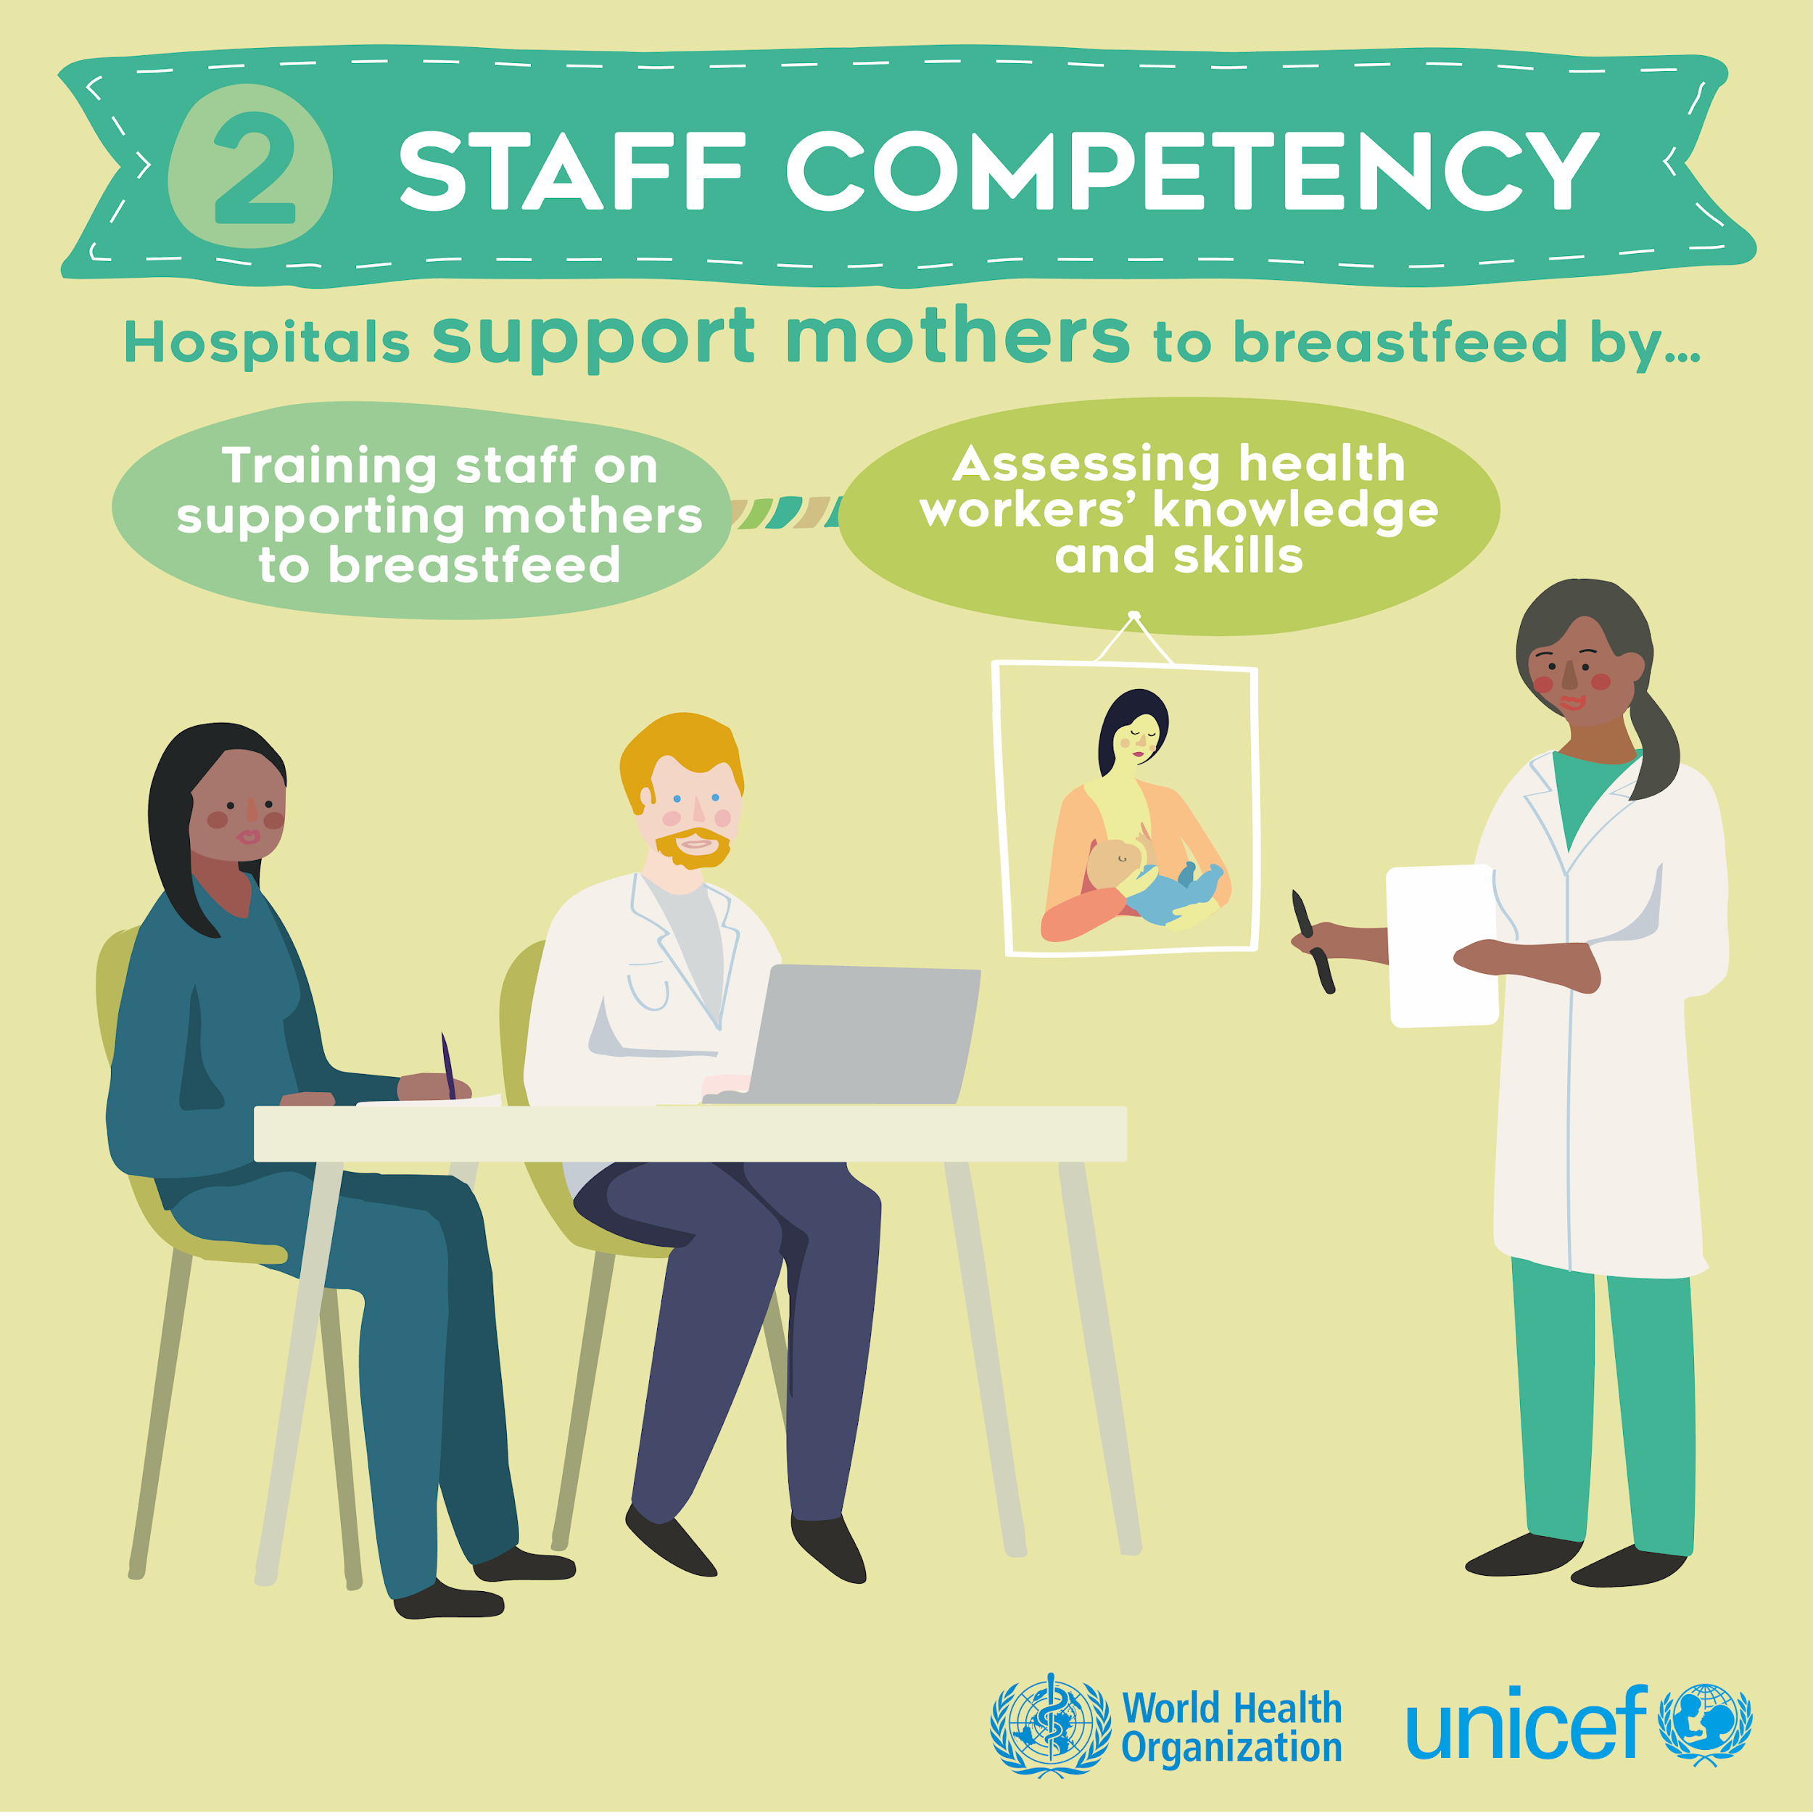
Step 2: Staff Competency
Hospitals need to train their staff and support continuous development of knowledge and skills to support mothers to breastfeed.
Rationale:
Timely and appropriate care for breastfeeding mothers can only be accomplished if staff have the knowledge, competence, and skills to carry it out.

Slide 13
Step 3: Antenatal Care
Discuss the importance and management of breastfeeding with pregnant women and their families.
Rationale:
Basic information about breastfeeding is critical for women and families to make informed decisions.
It’s an important time to increase their understanding of maternity practices that facilitate the establishment of breastfeeding.

Slide 14
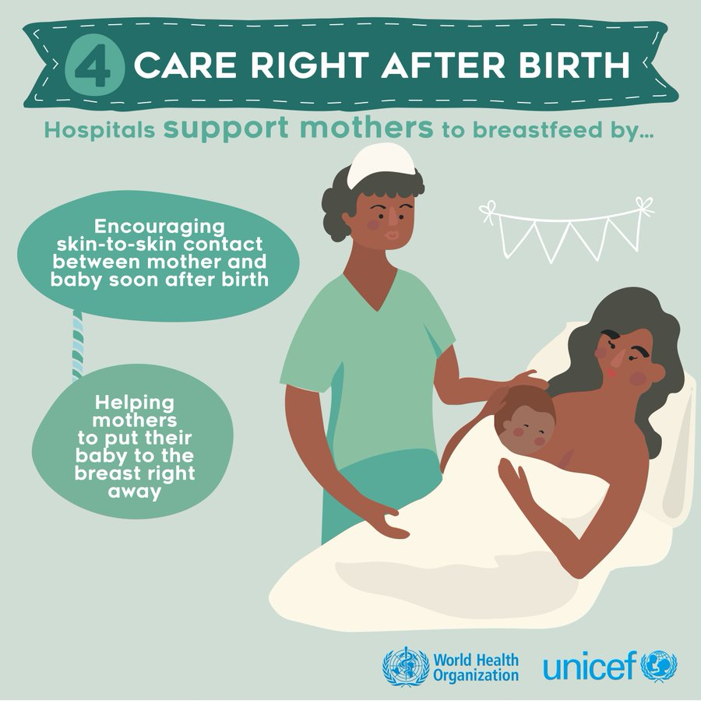
Step 4: Immediate Postnatal Care
Facilitate immediate and uninterrupted skin-to-skin contact and support mothers to initiate breastfeeding as soon as possible after birth.
Rationale:
Immediate skin-to-skin facilitates newborn’s natural rooting reflex, populates microbiome, and prevents hypothermia.
Early and frequent suckling or breastmilk expression triggers the production of breastmilk and accelerates lactogenesis.
Early initiation proven to reduce risk of infant mortality.

Slide 15
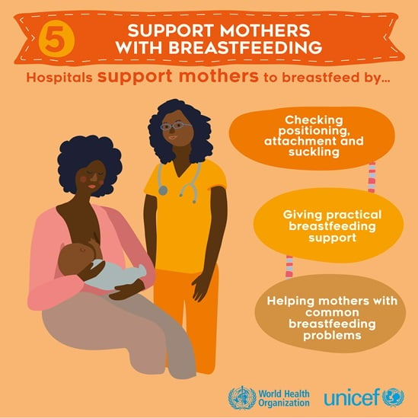
Step 5: Breastfeeding Support
Support mothers to initiate and maintain breastfeeding and manage common difficulties.
Rationale:
Most mothers need practical help in learning how to breastfeed.
Even experienced mothers encounter new challenges with breastfeeding a newborn.
Early adjustments to position and attachment can prevent breastfeeding problems at a later time.
Frequent coaching and support helps build maternal confidence.

Slide 16
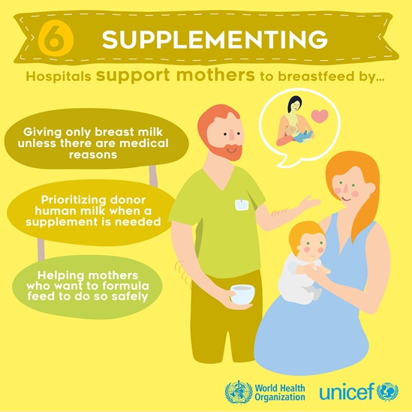
Step 6: No Routine Supplementation
Do not provide breastfed newborns any food or fluids other than breast milk, unless medically indicated.
Rationale:
Any foods or fluids other than breastmilk may interfere with establishment of breastfeeding.
Newborns have small stomachs, and those fed supplements may suckle less vigorously thus insufficiently stimulate milk production.
Foods and liquids may contain harmful bacteria and carry risk of disease.

Slide 17
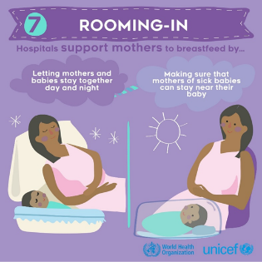
Step 7: Rooming-In 24 Hours a Day
Enable mothers and their infants to remain together and to practise rooming-in 24 hours a day.
Rationale:
Enables mothers to practise responsive feeding by recognizing and responding to cues.
Close proximity facilitates establishment of breastfeeding.

Slide 18
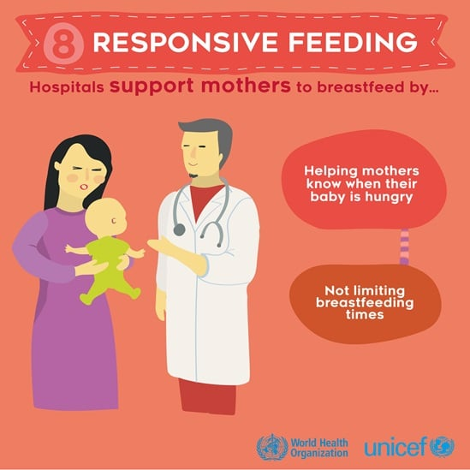
Step 8: Responsive Feeding
Support mothers to recognize and respond to their infants’ cues for hunger and satiation.
Rationale:
Breastfeeding involves recognizing and responding to infant’s display of hunger and feeding cues and readiness to feed.
Responsive feeding (on demand or baby-led feeding) puts no restriction on frequency of length of feeds. Mothers advised to breastfeed whenever the infant is hungry or as often as the infant wants.
Crying is a late cue; it’s better to feed the baby earlier since positioning and attachment are difficult when baby is distressed.

Slide 19
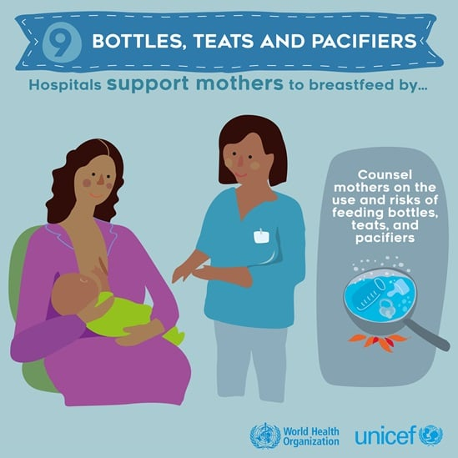
Step 9: Appropriate Use of Feeding Bottles, Teats, and Pacifiers
Counsel mothers on the use and risks of using feeding bottles, teats, and pacifiers.
Rationale:
Proper guidance and counselling are enables mothers and families to make decisions on use or avoidance of pacifiers and/or feeding bottles and teats.
Hygiene, oral formation, and recognition of feeding cues are reasons for caution to use pacifiers and/or feeding bottles and teats.

Slide 20
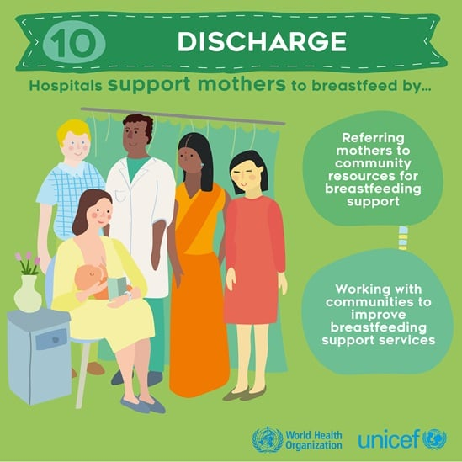
Step 10: Care at Discharge
Coordinate discharge so that parents and their infants have timely access to ongoing support and care.
Rationale:
Mothers need sustained support to continue breastfeeding.
Breastfeeding support is critical in succeeding days and weeks after discharge to identify and address challenges (return to work or school, etc.).
Maternity centres must know about and refer mothers to a variety of community resources.

Slide 21
Current Context of Breastfeeding in Kenya

Slide 22
Exclusive Breastfeeding Rates in Kenya
In Kenya, although exclusive breastfeeding practices have increased over the last two decades (32 percent in 2008 to 61 percent in 2014), the prevalence hasn’t changed recently with only 60 percent of children < six months exclusively breastfed in 2022 (KNBS and ICF 2023; KNBS et al. 2015; KNBS and ICF Macro 2010).
Exclusive breastfeeding at 4–5 months is even lower at only 38 percent (KNBS and ICF 2023).
Improving rates of breastfeeding is critical for Kenya’s goal of improving maternal, newborn, infant, and young child health and nutrition.

Slide 23
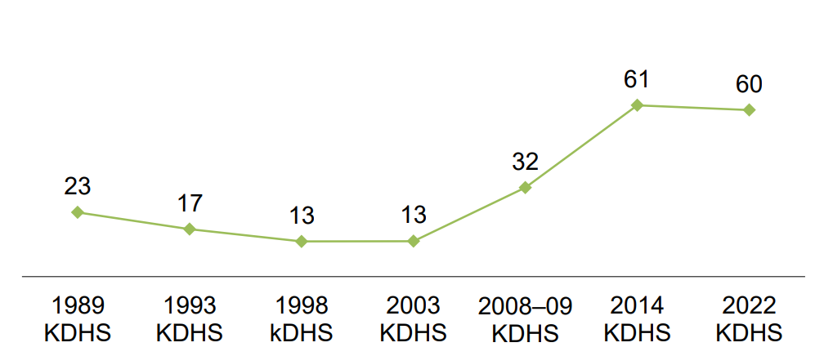
Trends in Exclusive Breastfeeding in Kenya
Percent of Children Aged 0–5 Months Who Are Exclusively Breastfed
Source: KNBS and ICF 2023

Slide 24
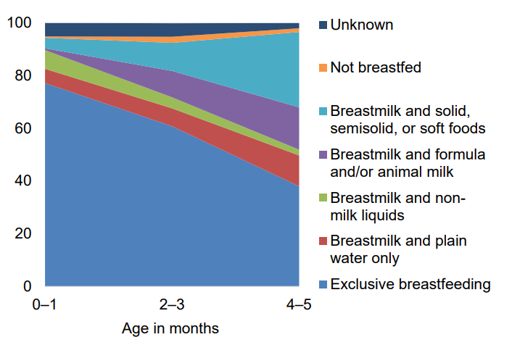
Infant Feeding Practices by Age
Percent Distribution of Youngest Children Aged 0–5 Months
At age 0–1 month, 77 percent of children are exclusively breastfed. By age 4–5 months, only 38 percent are exclusively breastfed and the majority of children are receiving liquids or foods other than breastmilk, with solid, semi-solids, or soft foods being the highest percentage (29 percent).
Source: KNBS and ICF 2023

Slide 25
Strategies for Improving Breastfeeding Practices in Kenya
Kenya Strategy for Maternal, Infant, and Young Child Nutrition (MIYCN) 2021–2026 highlights the following:
improving infant and young child nutrition
scaling up BFHI
promoting skilled breastfeeding counselling
strengthening capacity of health workers
mentorship, on-the-job training, and continuing medical education.
The Kenya National Nutrition Action Plan prioritises MIYCN, seeking to scale up improved care practices and services. One key objective is increasing the rate of exclusive breastfeeding by 20 percent or more.
Kenya is in the process of scaling up BFHI. The BFHI Task Force of the MIYCN Technical Working Group is making efforts to improve Step 2 by developing facility implementation guidance for BFHI and adapting the WHO and UNICEF BFHI Training Course for Maternity Staff for Kenya.

Slide 26
Importance of Breastfeeding Counselling

Slide 27
Breastfeeding Counselling
Skilled breastfeeding counselling has shown improvements in early initiation of breastfeeding, exclusive breastfeeding, and continued breastfeeding (Haroon et al. 2013; Sinha et al. 2015).
WHO recommends all pregnant women and mothers with young children receive breastfeeding counselling.
Breastfeeding counselling should occur six times from before birth to age two.
Counselling should be implemented alongside other interventions to promote and support breastfeeding.
Skilled breastfeeding counselling requires health facility staff has specific knowledge, skills, and behaviors (competencies).

Slide 28
Obstacles to Breastfeeding Counselling
Effective breastfeeding counselling relies on health workers possessing strong competencies to support women to breastfeed.
However, health workers often lack the competencies necessary for preparing mothers to breastfeed successfully (WHO 2018).
A systematic review concluded that improving health workers’ counselling skills is an essential component of increasing exclusive breastfeeding rates (Kavle et al. 2017).

Slide 29
Importance of Competencies
Competencies are the building blocks for assessing, developing, and evaluating staff skills.
To ensure staff are providing high quality skilled breastfeeding counselling, reinforcing and improving competencies is key.

Slide 30
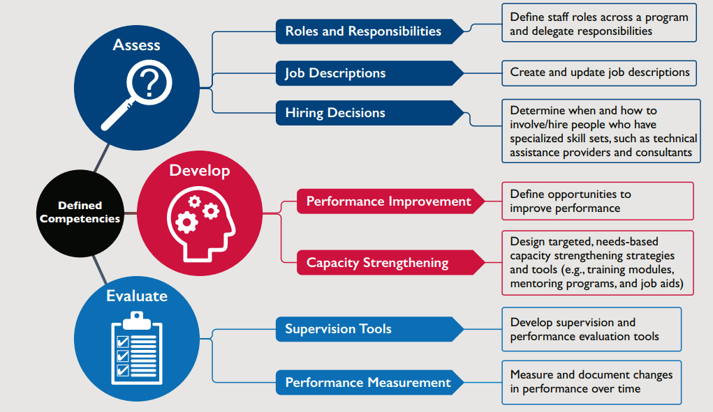
How Competencies Align Tools and Interventions to Strengthen and Reinforce Skills
(USAID Advancing Nutrition 2020, 2)

Slide 31
BFHI Step 2 and Building Competencies
Step 2 of the BFHI Ten Steps to Successful Breastfeeding:
Ensure that staff have sufficient knowledge, competence, and skills to support breastfeeding.
Health facility staff who provide infant feeding services, including breastfeeding support, should have sufficient knowledge, competence, and skills to support women to breastfeed.
To build health facility staff knowledge, competence, and skills:
In-service training
Mentorship and supportive supervision
Read resources and documents
Continuing medical education
Pre-service education/training

Slide 32
Breastfeeding Counselling Mentorship Program

Slide 33
Rationale, Goals, and Objectives

Slide 34
Process for Choosing Mentorship
February– September 2021
November 2021
June 2022
March–September 2023
November 2023
Conducted a scoping exercise
Held a learning intervention: co-creation workshop
Hosted a mentorship package design workshop
Implementation research took place
Held two workshops
Learn about current efforts to develop breastfeeding counselling competencies.
Identify and prioritize gaps or weaknesses.
Select an intervention that addresses gaps or weaknesses and complements efforts in Kenya.
Define what type of capacity strengthening activity would suit the needs, timeline, and long-term investment that the BFHI Task Force would support.
Participants select a facility-based mentoring approach.
Identify points of care for mentoring.
Prioritise competencies.
Establish criteria for selecting mentors and mentees.
Determine the appropriate mentor-to-mentee ratio.
The mentorship program was piloted in the antenatal care (ANC) and postnatal care departments of Mbagathi County Referral Hospital (a Level 5 health facility) in Nairobi County, Kenya from March–September 2023 as part of an implementation research study.
Manuscript co-authors learned how to draft a manuscript for submission to a journal.
Stakeholders met with representatives from Mbagathi County Referral Hospital to review and update the mentorship program package based on the learnings from the implementation research.

Slide 35
Rationale for Choosing Mentorship
A mentoring program contributes to Kenya’s current efforts to scale-up BFHI.
BFHI is a broad program. The mentorship program specifically aims to support step 2 of BFHI to, “ensure that staff have sufficient knowledge, competence, and skills to support breastfeeding.”
Several strategies can build health worker knowledge, competence, and skills, such as pre-service education, in-servicing training, as well as mentorship. We have chosen to focus on mentorship.
Mentorship is a critical bridge between traditional, didactic training and hands-on, practical training. Strong mentorship programs support the on-the-job application of skills learned during a course.

Slide 36
Gaps in Efforts to Strengthen Breastfeeding Counselling Competencies in Kenya
Breastfeeding counselling is not well integrated into health systems in Kenya.
Health workers face a range of on-the-job challenges.
National-level curricula, guidelines, implementation guidance, and tools did not clearly describe competencies needed to provide quality breastfeeding counselling.
Current training on breastfeeding counselling is insufficient.
Health workers have limited opportunities for in-service education and continuing professional development on breastfeeding counselling.
Health workers do not have access to sufficient job aids to support breastfeeding counselling.
There are no structured supervision or mentorship programs to support health workers providing breastfeeding counselling.

Slide 37
Why Mentorship to Strengthen Breastfeeding Counselling Competencies?
Developing competencies requires more than a one-off training.
Mentorship is part of the Kenya Strategy for MIYCN 2021–2026.
Kenya has plans to adapt the BFHI Training Course for Maternity Staff (WHO and UNICEF 2020a), so there is a strong foundation around which to structure a mentorship program.
Kenya seeks to scale up BFHI and a mentorship program would contribute to efforts to achieve Step 2 of the BFHI Ten Steps and sustainably strengthen strengthen health worker competencies.
Mentorship is a flexible teaching and learning process that can address on-the-job challenges.
There are limited opportunities for continuing professional development and refresher training on breastfeeding counselling for health care workers. A mentorship program would fill this gap in a meaningful way.
A breastfeeding counselling mentorship package would create a critical bridge between the BFHI, the BFHI Training Course for Maternity Staff (WHO and UNICEF 2020a), and the Competency Verification Toolkit (WHO and UNICEF 2020b), helping to operationalize and embed these competencies across facility staff.

Slide 38
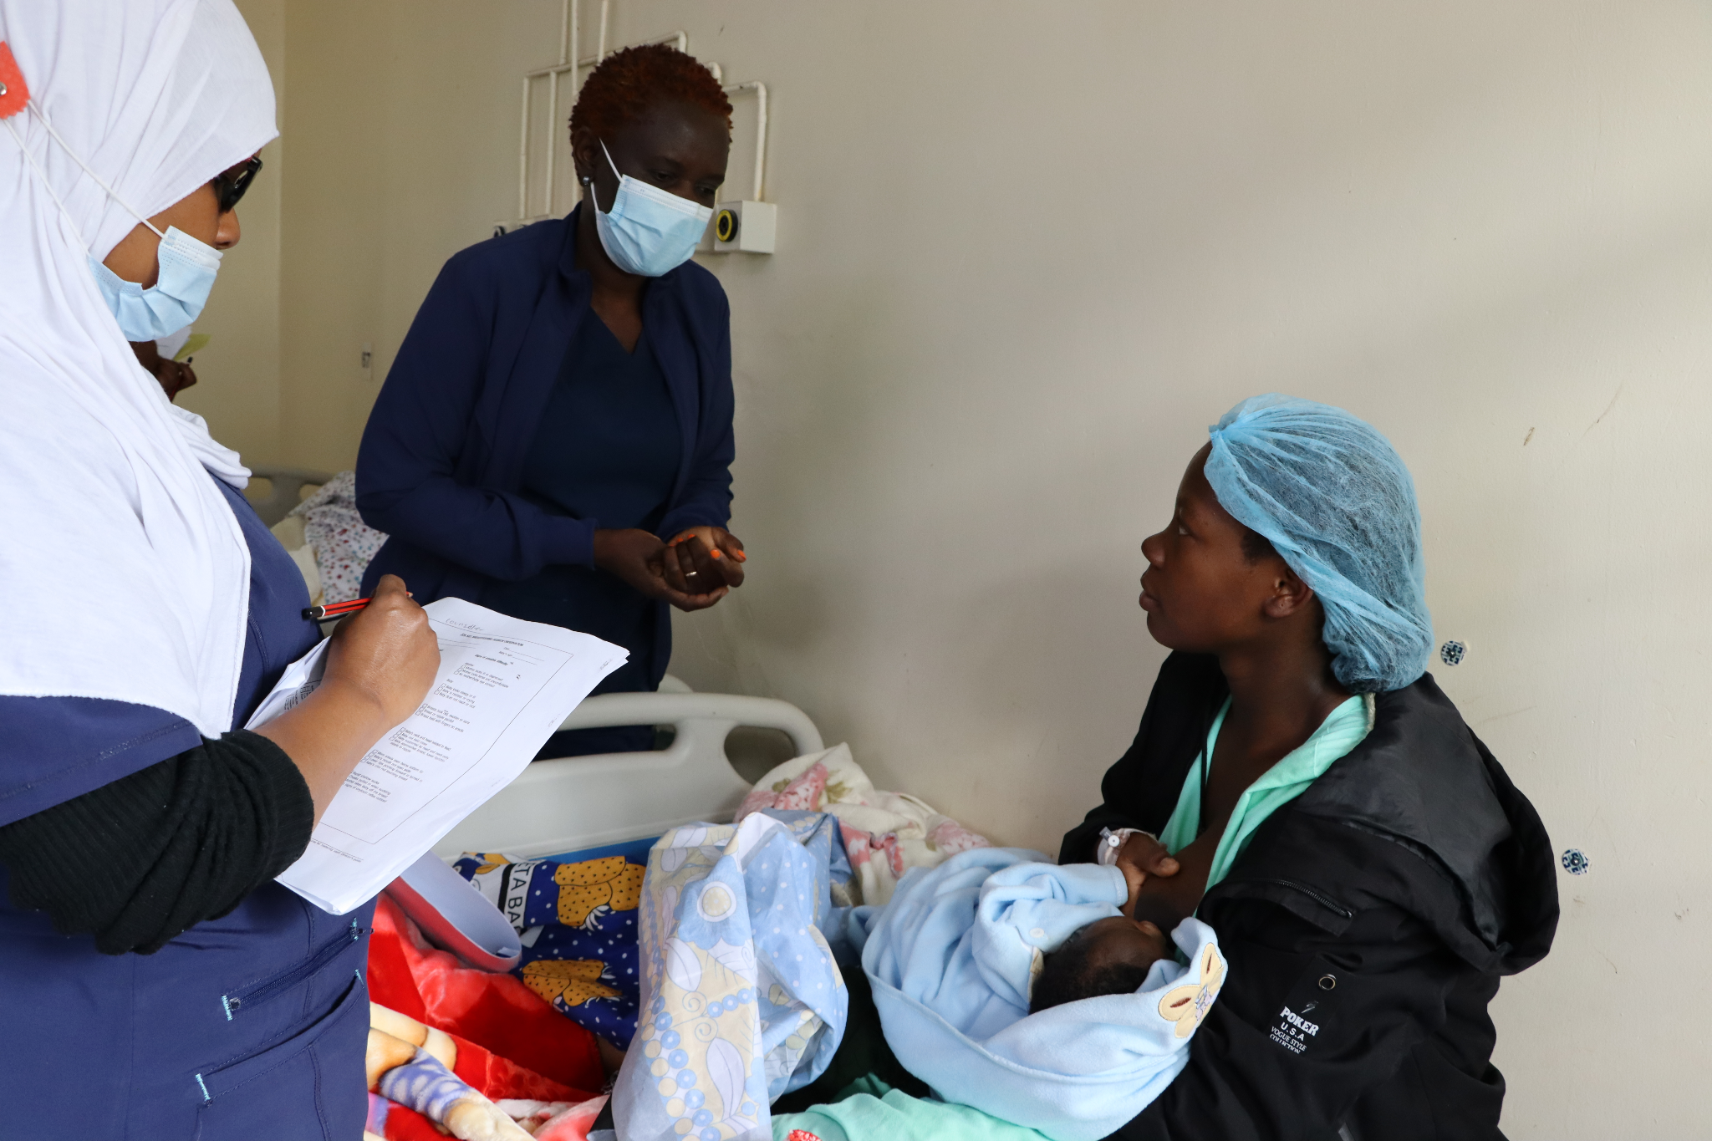
Goals and Objectives of the Mentorship Program
The overarching goal is to improve the quality of breastfeeding counselling provided by health workers.
The specific objectives of the program are to—
Reinforce and strengthen 7 of the 16 breastfeeding counselling competencies needed for implementation of BFHI.
Support mentees to apply skills learned in the BFHI Training Course for Maternity Staff (WHO and UNICEF 2020a) during counselling sessions with clients.
Cultivate a skilled team of on-site mentors who can champion and support quality breastfeeding counselling and serve as a resource for mentees.
Create an enabling environment for providing quality breastfeeding counselling at all relevant service delivery points.
Photo credit: Fridah Bwari/Save the Children

Slide 39
Competencies Prioritised for the Mentorship Program
Use listening and learning skills whenever engaging in a conversation with a mother.
Engage in antenatal conversation about breastfeeding.
Facilitate breastfeeding within the first hour, according to cues.
Discuss with a mother how breastfeeding works.
Assist mother getting her baby to attach to the breast.
Help a mother to breastfeed a small or sick baby.
Ensure seamless transition after discharge.

Slide 40
Description of the Program

Slide 41
Program Structure
Health workers (mentees) are mentored by a more experienced health worker (mentor) based at the same health facility after completion of—
BFHI Training Course for Maternity Staff for mentors and mentees
Core Concepts in Mentorship Training course for mentors.
Mentors work with mentees to set goals and prioritise competencies for the mentorship program.
Mentors will observe mentee counselling interactions 1–3 times per week, perform competency assessments, and provide feedback.
Mentors and mentees check-in at least every one or two weeks to debrief counselling sessions, provide affirming and corrective feedback, conduct clinical teaching, and encourage mentees to apply new counselling skills.

Slide 42
What is a Mentor and a Mentee?
Mentor:
An experienced and empathetic person, proficient in her/his content area, who teaches and coaches another individual (mentee) or a group of individuals (mentees) in-person and/or virtually to ensure competent workplace performance and provide ongoing professional development
Selected for the program in collaboration with the health facility management team based on the selection criteria.
Mentee:
A direct care provider who delivers breastfeeding counselling to clients. She/he is a dedicated skilled health provider who seeks to grow and develop personally and professionally to successfully achieve her/his goals to strengthen her/his breastfeeding counselling competencies with the support of a mentor.
Selected for the program in collaboration with the health facility management team, the BFHI implementation team, and mentors, using the selection criteria.

Slide 43
Minimum Requirements for Mentors
Completed the BFHI training
Provides direct care to clients in one of the prioritised service delivery point(s)
Has met all qualifications to work as a doctor, nurse, nutritionist, clinical officer, or midwife
Has a minimum of two years of experience providing maternal and newborn care, but five or more years is preferred
Demonstrates a high level of competency (i.e., knowledge, skills, and attitudes) in providing breastfeeding counselling, observing breastfeeding counselling, and accurately assessing breastfeeding counselling competencies
Senior management is supportive and agrees to allow staff to serve as a mentor
Conversant with the Breast Milk Substitutes Act of 2012, the International Code of Marketing of BMS, and the subsidiary BMS regulations of 2021
Avoids conflicts of interest particularly with companies that produce BMS designated products, or from their parent or subsidiary companies, or political leaders. This is imperative to ensure direct care providers protect families from commercial pressure. All mentors must sign a code of conduct indicating adherence to this.

Slide 44
Minimum Requirements for Mentees
Completed the BFHI training
Provides direct care to clients in one of the prioritised service delivery point(s)
Has met all qualifications to work as a doctor, nurse, nutritionist, clinical officer, midwife, or breastfeeding peer supporter
Senior management is supportive and agrees to allow staff to participate as a mentee
Avoids conflicts of interest particularly with companies that produce BMS designated products, or from their parent or subsidiary companies, or political leaders. This is imperative to ensure direct care providers protect families from commercial pressure. All mentors must sign a code of conduct indicating adherence to this.

Slide 45
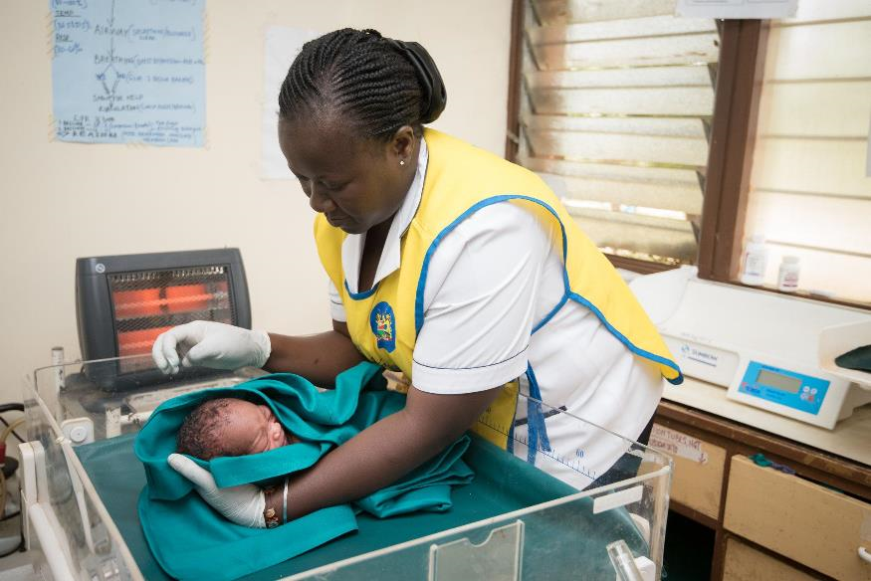
Facilities and Service Delivery Points
The mentorship program is intended to be implemented at four levels of health facilities in Kenya:
level 3b, health centers
level 4, primary referral hospitals
level 5, secondary referral hospitals
level 6, national referral hospitals.
It may take place in any of the following service delivery points:
antenatal care services
labour and childbirth services
postnatal care services
newborn care services
paediatric care services.
Photo credit: Allan Gichigi/MCSP

Slide 46
Implementation Process
The implementation process includes 10 actions:
Train health facility staff in the BFHI Training Course for Maternity Staff.
Identify and prioritise service delivery points.
Select and train mentors.
Select mentees.
Pair mentors and mentees.
Orient mentors and mentees.
Conduct mentoring.
Conduct monthly meetings.
Assess competencies for graduation.
Monitor the program.
There are also several steps before implementation to establish the mentorship program at a facility including—
Sensitise facility management.
Identify program leadership.
Conduct a BFHI health facility self-assessment.
Conduct an inception meeting.
Acquire resources.

Slide 47
Implementation Process (2)
When a health facility is implementing the mentorship program for the first time, the entire process, from establishing the program structure at the health facility to graduation of the first cohort of mentees could take between 8–10 months to complete.
The mentorship program can become a continuous activity at a health facility to strengthen breastfeeding counselling competencies of health workers working in maternal, newborn, and child care, by selecting new cohorts of mentees to become part of the mentorship program and graduating others.
The figure on the following slide depicts the ten implementation actions and pre-steps and the estimated time that each of the actions may take.

Slide 48
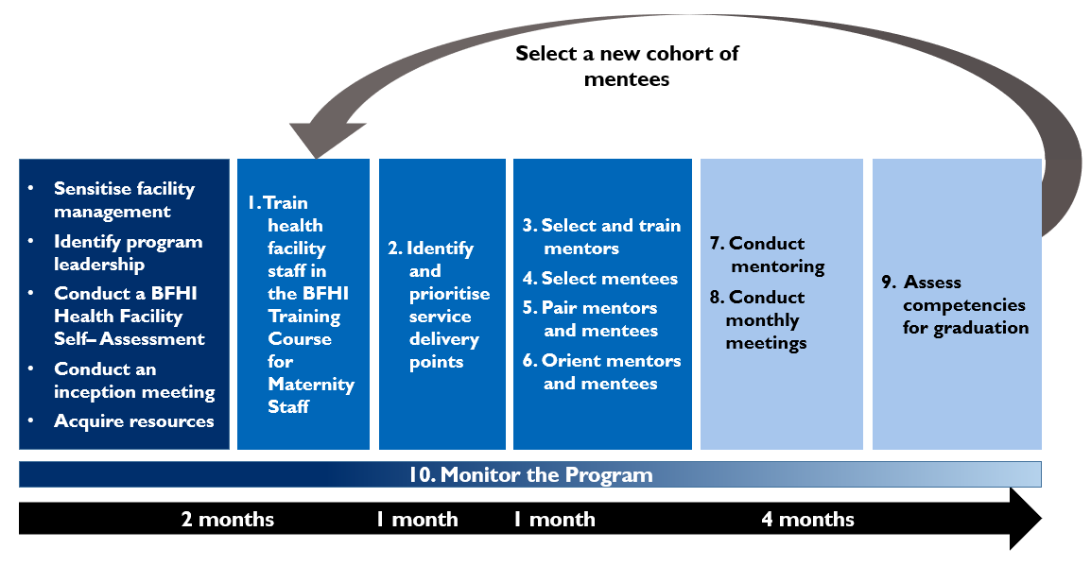
Actions in Implementing the Breastfeeding Counselling Mentorship Program at a Health Facility

Slide 49
Establishing the Program

Slide 50
Establishing the Program
Sensitise facility management about BFHI and the mentorship program.
Identify breastfeeding counselling mentorship program leadership.
Conduct a BFHI health facility self-assessment.
Conduct an inception meeting.
Acquire resources.

Slide 51
Identify Breastfeeding Counselling Mentorship Program Leadership
The facility in-charge and the health facility management team (HFMT):
Promote the mentorship program, introduce the program to relevant staff, and provide leadership and support.
Nominate the BFHI facility coordinator, who is the champion for BFHI in the facility and manages the mentorship program.
Nominate members of the BFHI Facility Implementation Team, who will support the BFHI facility coordinator to manage the mentorship program.
Members of the BFHI Facility Implementation Team include—
health facility in-charge
head of the labour and delivery ward
head of the postnatal ward
head of the nutrition department
head of paediatrics (inpatient and outpatient)
head of maternal and child health unit
facility continuous quality improvement (CQI) person.

Slide 52
Roles and Responsibilities of BFHI Facility Coordinator
Oversee the mentorship program.
Convene the BFHI Facility Implementation team meetings, as needed, but at least once every two months.
Organise an inception meeting for the HFMT and heads of departments (HODs).
Organise orientation meetings with mentors and mentees.
Organise the BFHI trainings for mentors and mentees and the Core Concepts in Mentorship Training course for mentors.
Ensure that mentors and mentees have the necessary resources for implementation of the program.
Organise and plan the agenda for monthly meetings with mentors and mentees.
Collect the “Mentor Feedback Form” from mentees.
Convene and coordinate other related trainings, as needed.
Offer support and guidance to mentors and mentees throughout implementation of the program.

Slide 53
Roles and Responsibilities of the BFHI Facility Implementation Team (1)
Ensure the mentorship program is implemented as planned.
Participate in BFHI Facility Implementation Team meetings.
Support the BFHI facility coordinator to organise—
an inception meeting for the HFMT and HODs
orientation meetings with mentors and mentees
the BFHI training and the Core Concepts in Mentorship Training
monthly meetings.
Identify and select mentor and mentees, based on the selection criteria.
Determine the best ratio for mentor-to-mentee and the mentoring approach(es).

Slide 54
Roles and Responsibilities of the BFHI Facility Implementation Team (2)
Pair mentors to mentees, in collaboration with mentors.
Support mentors and mentees working in their service delivery point.
Engage the mentors and mentees in CQI activities in their respective service delivery points.
Update the HFMT on progress of the mentorship program.
Update the Sub-County Health Management Team and County Health Management Team on progress of the mentorship program, as required.
Conduct selected BFHI implementation activities, such as facility self-assessments.
Monitor the breastfeeding counselling mentorship program indicators.

Slide 55
Conduct a BFHI Health Facility Self-Assessment
Purpose: To assess the facility’s preparedness and compliance with BFHI
It should help to identify—
gaps in implementation of the BFHI Ten Steps to Successful Breastfeeding
practices that need to change or need improvement
health workers who provide breastfeeding counselling
service delivery points where breastfeeding counselling is provided.
Findings will inform—
selection of mentors and mentees
procurement efforts
priority service delivery points for the mentorship program
focus competencies for the mentorship program.

Slide 56
Conduct an Inception Meeting
Purpose: launch the program, make plans, and develop timelines for the implementation of the mentorship program.
The BFHI facility coordinator organises the inception meeting with support from the BFHI Facility Implementation Team.
Invite the HFMT and HODs to this meeting.

Slide 57
Acquire Resources
Those involved in the mentorship program—mentors, mentees, administrators—must have sufficient time to engage in the mentorship program for it to be successful.
Implementing the mentorship program requires the following resources:
visualisation boards for tracking key indicators
job aids (i.e., counselling checklists, mentoring reminders) and mentorship program tools (i.e., observation tools, progress tracking logs) for mentors and mentees (Annex 4a and 4b)
information, education, and communication materials for BHFI for the mother being counselled (i.e., counselling cards, pamphlets, posters, videos)
secure place to store mentoring tools and logs (i.e., binders, folders, cabinets)
certificates of completion of the mentorship program.

Slide 58
Next Steps

Slide 59
Next Steps
The facility in-charge and the HFMT will—
Nominate the BFHI facility coordinator.
Nominate members of the BFHI Facility Implementation Team.
Conduct a BFHI Health Facility Self-Assessment.
Organise an inception meeting.

Slide 60
Summary

Slide 61
Summary
The goal of the breastfeeding counselling mentorship program is to improve the quality of breastfeeding counselling provided by health workers.
Mentors teach and coach mentees to ensure competency in breastfeeding counselling.
The mentorship program is one way that a facility can achieve Step 2 (staff competency) of the BFHI Ten Steps.
There are several steps to implement the mentorship program at a facility. The facility in-charge and HFMT, along with the BFHI facility coordinator and BFHI Facility Implementation Team, are responsible for program implementation.

Slide 62
References (1)
Haroon, Sarah, Jai K. Das, Rehana A. Salam, Aamer Imdad, and Zulfiqar A. Bhutta. 2013. “Breastfeeding Promotion Interventions and Breastfeeding Practices: A Systematic Review”. BMC Public Health. 13(Suppl 3): S20. https://doi.org/10.1186/1471-2458-13-S3-S20
Kavle, Justine A., Elizabeth LaCroix, Hallie Dau, and Cyril Engmann. 2017. “Addressing Barriers to Exclusive Breastfeeding in Low- and Middle-Income Countries: A Systematic Review and Programmatic Implications.” Public Health Nutrition. 20(17)1475–2727. https://doi.org/10.1017/S1368980017002531
KNBS (Kenya National Bureau of Statistics) and ICF. 2023. “Kenya Demographic and Health Survey 2022.” Accessed November 20, 2023. https://dhsprogram.com/pubs/pdf/FR380/FR380bis.pdf.
KNBS (Kenya National Bureau of Statistics), National AIDS Control Council/Kenya, Kenya Medical Research Institute, National Council for Population and Development/Kenya, and ICF International. 2015. “Kenya Demographic and Health Survey 2014.” Accessed June 30, 2022. https://dhsprogram.com/pubs/pdf/fr308/fr308.pdf.
KNBS (Kenya National Bureau of Statistics) and ICF Macro. 2010. “Kenya Demographic and Health Survey 2008–09.” Accessed June 30, 2022. https://dhsprogram.com/pubs/pdf/fr229/fr229.pdf.
Sinha, Bireshwar, Ranadip Chowdhury, M. Jeeva Sankar, Jose Martines, Sunita Taneja, Sarmila Mazumder, Nigel Rollins, et al. 2015. “Interventions to Improve Breastfeeding Outcomes: A Systematic Review and Meta-Analysis.” Acta Paediatrica. 104(467):114–135. https://doi.org/10.1111/apa.13127.

Slide 63
References (2)
USAID Advancing Nutrition. 2020. Defining Social and Behavior Change Competencies for Multi-Sectoral Nutrition A List for Assessing, Developing, and Evaluating Staff Skills. Arlington, VA: USAID Advancing Nutrition. https://www.advancingnutrition.org/sites/default/files/2020-05/defining_social_and_behavior_change_brief.pdf
WHO (World Health Organization). 2015. Roles and Responsibilities of Government Chief Nursing and Midwifery Officers: A Capacity-Building Manual. Geneva: WHO. https://apps.who.int/iris/handle/10665/351684.
WHO (World Health Organization). 2018. Guideline: Counselling of Women to Improve Breastfeeding Practices. Geneva: WHO. https://www.who.int/publications/i/item/9789241550468.
WHO (World Health Organization) and UNICEF (United Nations Children's Fund). 2020a. Baby Friendly Hospital Initiative (BFHI) Training Course for Maternity Staff: Director’s Guide. Geneva: WHO. https://apps.who.int/iris/bitstream/handle/10665/333674/9789240008939-eng.pdf
WHO (World Health Organization) and UNICEF (United Nations Children's Fund). 2020b. Competency Verification Toolkit: Ensuring Competency of Direct Care Providers to Implement the Baby-Friendly Hospital Initiative. Geneva: WHO. https://www.who.int/publications/i/item/9789240008854.

Slide 64
USAID ADVANCING NUTRITION

