Slide 1
Core Concepts in Mentorship Training for the Breastfeeding Counselling Mentorship Program
Photo credit: Allan Gichigi/MCSP

Slide 2
Welcome, Introductions, and Objectives

Slide 3
Introductions
What is your name?
What is your job/title?
Why are you here? What do you hope to get from this training?

Slide 4
Goal and Course Objectives
The goal of the training is to prepare mentors for their role in the breastfeeding counselling mentorship program by providing them with the skills, knowledge, and resources necessary to be an effective clinical mentor.
At the end of the course, it is expected that participants will be able to—
Describe the structure of the mentorship program.
Define clinical mentoring.
Identify mentoring strategies.
Explain the benefits of clinical mentoring.
Describe how to build a positive relationship with a mentee.
Demonstrate effective feedback and communication skills.
Choose the appropriate mentoring strategy for a given teaching moment.

Slide 5
Session 1: Orientation to the Breastfeeding Counselling Mentorship Program

Slide 6
Learning Objectives
By the end of this session, participants will be able to—
Describe the structure of the mentorship program.

Slide 7
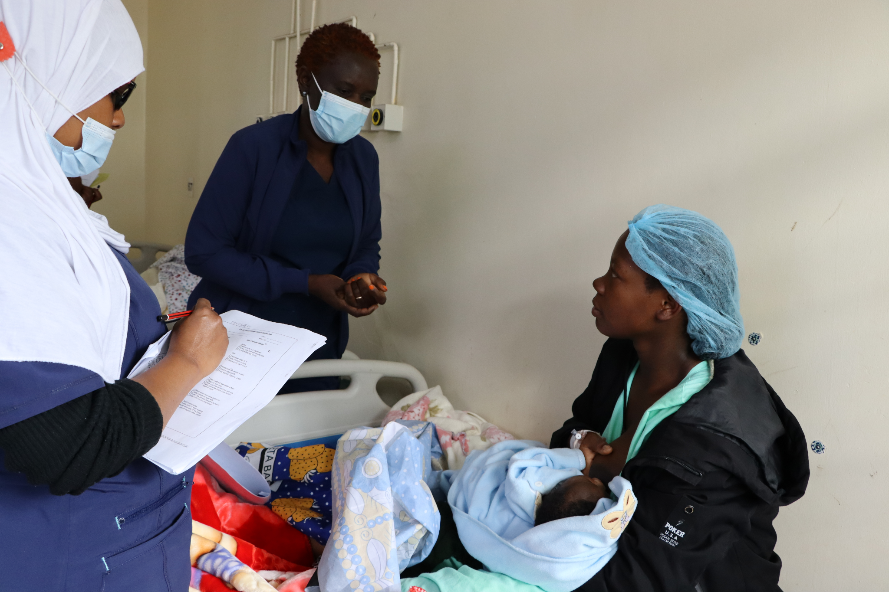
Review of Key Concepts: The Importance of Breastfeeding
Breastfeeding has health, nutrition, and cognitive benefits for both children and mothers.
International recommendations include—
initiating breastfeeding within one hour of birth
exclusive breastfeeding for the first six months
continued breastfeeding with complementary feeding until two years of age and beyond.
Photo credit: Fridah Bwari/Save the Children

Slide 8
Review of Key Concepts: Breastfeeding Counselling
Skilled breastfeeding counselling has shown improvements in early initiation of breastfeeding, exclusive breastfeeding, and continued breastfeeding.
The World Health Organization (WHO) recommends all pregnant women and mothers with young children receive breastfeeding counseling.
Effective counseling requires specific knowledge, skills, and behaviors (competencies).

Slide 9
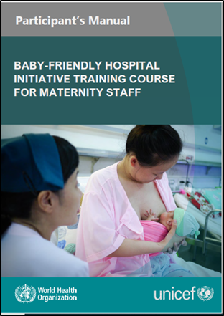
Review of Key Concepts: The Baby-Friendly Hospital Initiative
WHO and UNICEF released updated BFHI implementation guidance in 2018.
Step 2, of the Ten Steps to Successful Breastfeeding, is to ensure that staff have sufficient knowledge, competence, and skills to support breastfeeding.
The BFHI Training Course for Maternity Staff teaches health workers about BFHI.
The Competency Verification Toolkit provides guidance and tools for countries to assess staff competency in the knowledge, skills, and attitudes needed to implement the Ten Steps.

Slide 10
Process of Developing the Breastfeeding Mentoring Counselling Program
February– September 2021
November 2021
June 2022
March–September 2023
November 2023
Conducted a scoping exercise
Held a learning intervention: co-creation workshop
Hosted a mentorship package design workshop
Implementation research took place
Held two workshops
Learn about current efforts to develop breastfeeding counselling competencies.
Identify and prioritize gaps or weaknesses.
Select an intervention that addresses gaps or weaknesses and complements efforts in Kenya.
Define what type of capacity strengthening activity would suit the needs, timeline, and long-term investment that the BFHI Task Force would support.
Participants select a facility-based mentoring approach.
Identify points of care for mentoring.
Prioritise competencies.
Establish criteria for selecting mentors and mentees.
Determine the appropriate mentor-to-mentee ratio.
The mentorship program was piloted in the antenatal care (ANC) and postnatal care departments of Mbagathi County Referral Hospital (a Level 5 health facility) in Nairobi County, Kenya from March–September 2023 as part of an implementation research study.
Manuscript co-authors learned how to draft a manuscript for submission to a journal.
Stakeholders met with representatives from Mbagathi County Referral Hospital to review and update the mentorship program package based on the learnings from the implementation research.
Notes:
Notes for improving this graphic:
Edits we are planning to make to this image:
-ensure blue is branding compliant
-no spaces between the en dashes and words in the dates
-hanging indents for all bullets
-Ideally all the text boxes should end at the same level (so some boxes may need to be made longer)

Slide 11
Implementation Research on the Feasibility of a Breastfeeding Counselling Mentorship Program (1)
Tested the breastfeeding counselling mentorship program at Mbagathi County Referral Hospital in Nairobi County from March–September 2023.
Primary objective: Evaluate the feasibility of the mentorship program.
Sub-objectives:
Identify factors that enable and hinder implementation.
Determine if the program improves mentees’ knowledge, practices, and self-efficacy to provide quality breastfeeding counselling.
Determine if the program improves pregnant and postpartum women’s perceptions of breastfeeding counselling.

Slide 12
Implementation Research on the Feasibility of a Breastfeeding Counselling Mentorship Program (2)
Trained and enrolled 7 mentors and 21 mentees in the program
Conducted mentorship in the outpatient antenatal care (ANC) clinic, inpatient ANC ward, labour and delivery ward, and inpatient postnatal care (PNC) ward
Evaluated the feasibility of the mentorship program by conducting—
electronic knowledge tests
electronic surveys with mentors and mentees
interviews with clients in the service delivery points where mentorship took place
focus group discussions with mentors and mentees
interviews with health facility leadership.
Used the results from the implementation research to update the mentorship program package (i.e., implementation guidance, this training, tools, job aids, and forms) in November 2023.

Slide 13
Rationale for a Mentorship Program to Strengthen Breastfeeding Counselling Competencies
Kenya embraced the BFHI Training Course for Maternity Staff, which serves as a strong foundation around which to structure a mentorship program.
Kenya seeks to scale up BFHI and a mentorship program would contribute to efforts to achieve Step 2 of the BFHI Ten Steps and sustainably strengthen strengthen health worker competencies.
Mentorship is a flexible teaching and learning process that can address on-the-job challenges.
There are limited opportunities for continuing professional development and refresher training on breastfeeding counselling for health care workers. A mentorship program would fill this gap in a meaningful way.
A breastfeeding counselling mentorship package would create a critical bridge between the BFHI, the BFHI Training Course for Maternity Staff, and the BFHI Competency Verification Toolkit, helping to operationalize and embed these competencies across facility staff.

Slide 14
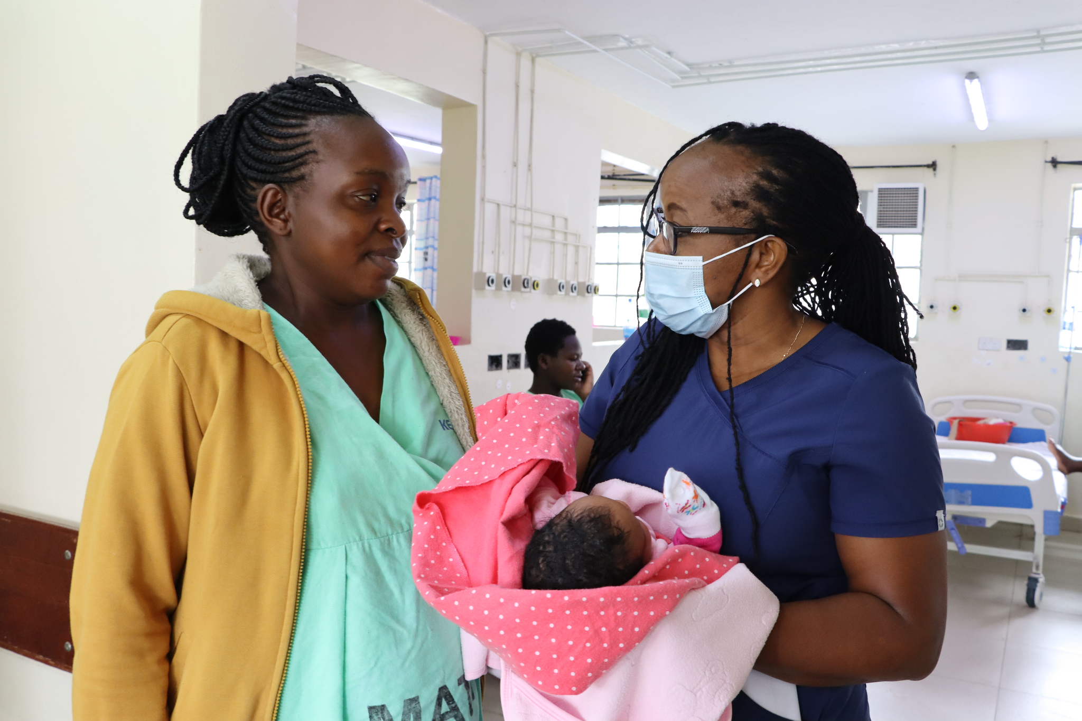
Goal and Objectives of the Mentorship Program
Goal: Improve the quality of breastfeeding counselling provided by health workers.
Objectives:
Reinforce and strengthen 7 of the 16 breastfeeding counselling competencies needed for implementation of BFHI.
Support mentees to apply skills learned in the BFHI Training Course for Maternity Staff during breastfeeding counselling sessions with clients.
Cultivate a skilled team of on-site mentors who can champion and support quality breastfeeding counselling and serve as a resource for mentees.
Create an enabling environment for providing quality breastfeeding counselling at all relevant service delivery points.
Photo credit: Fridah Bwari/Save the Children

Slide 15
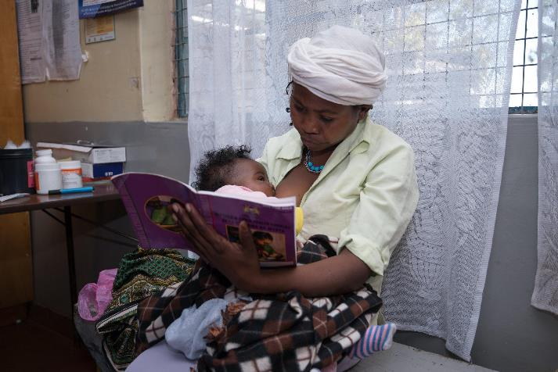
Mentorship Program Package
Implementation Guidance for a Facility-Based Breastfeeding Counselling Mentorship Program:
Includes mentor and mentee job aids and monitoring and reporting forms
Includes slide decks to use during orientation and inception meetings
Core Concepts in Mentorship Training course and accompanying materials:
Facilitator’s Guide
Participant’s Manual
slide deck
Photo credit: Allan Gichigi/MCSP

Slide 16
Key Definitions
A mentor is an experienced and empathetic person, proficient in her/his content area, who teaches and coaches another individual (mentee) or a group of individuals (mentees) in-person and/or virtually to ensure competent workplace performance and provide ongoing professional development.¹
A mentee is a direct care provider who delivers breastfeeding counseling to clients. She/he is a dedicated skilled health provider who seeks to grow and develop personally and professionally to successfully achieve her/his goals to strengthen her/his breastfeeding counseling competencies with the support of a mentor. For this mentorship program, mentees are working in the antenatal care services, postpartum care unit, newborn care unit, or in the child welfare clinic.
MCSP (Maternal and Child Survival Program). 2018. “Mentoring for Human Capacity Development: Implementation Principles and Guidance.” Accessed June 30, 2022. https://www.mcsprogram.org/resource/mentoring-human-capacity-development-implementation-principles-guidance/

Slide 17
Description of the Mentorship Program
In-house, facility-based mentorship program whereby mentors and mentees are based at the same facility.
Designed to be used at three levels of health facilities: level 3B, level 4, and level 5.
Can be implemented at several service delivery points, including antenatal care services, labour and childbirth services, postnatal care services, newborn care services, and paediatric services.
Mentors and mentees are trained in the BFHI Training Course for Maternity Staff.
When mentoring starts, mentees receive regular feedback and support from their mentor as they practice the skills taught in the BFHI maternity training in their day-to-day work.
Mentors and mentees engage in quality improvement activities at the health facility.
Typically takes four months for a mentee to acquire focus competencies.

Slide 18
Competencies Prioritised for the Mentorship Program
Use listening and learning skills whenever engaging in a conversation with a mother.
Engage in antenatal conversation about breastfeeding.
Facilitate breastfeeding within the first hour, according to cues.
Discuss with a mother how breastfeeding works.
Assist mother getting her baby to attach to the breast.
Help a mother to breastfeed a small or sick baby.
Ensure seamless transition after discharge.
WHO (World Health Organization) and UNICEF (United Nations Children's Fund). 2020a. Baby Friendly Hospital Initiative (BFHI) Training Course for Maternity Staff. Geneva: WHO. https://www.who.int/publications/i/item/9789240008915.

Slide 19
Facility Management of the Mentorship Program
The BFHI facility coordinator manages the mentorship program.
The BFHI Facility Implementation Team works closely with the coordinator to oversee the mentorship program. Members include—
health facility in-charge
head of the labour and delivery ward
head of the postnatal ward
head of the nutrition department
head of paediatrics (inpatient and outpatient)
head of maternal and child health unit
the facility continuous quality improvement focal person.

Slide 20
Implementing the Breastfeeding Counselling Mentorship Program (1)
Action 1: Train health facility staff in the BFHI Training Course for Maternity Staff.
Action 2: Identify and prioritise service delivery points.
Action 3: Select and train mentors.
Action 4: Select mentees.
Action 5: Pair mentors and mentees.

Slide 21
Implementing the Breastfeeding Counselling Mentorship Program (2)
Action 6: Orient mentors and mentees.
Action 7: Conduct mentoring.
Action 8: Conduct monthly meetings.
Action 9: Assess competencies for graduation.
Action 10: Monitor the program.

Slide 22
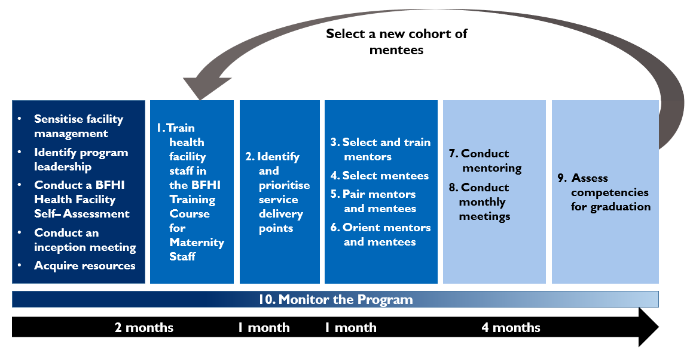
Sequence and Timing of Actions for Implementing the Breastfeeding Counselling Mentorship Program at a Health Facility

Slide 23
Minimum Requirements for Selecting Mentors
ACTION 3: SELECT AND TRAIN MENTORS
Completed the BFHI Training Course for Maternity Staff
Provides direct care to clients in one of the prioritised service delivery point(s)
Has met all qualifications to work as a doctor, nurse, nutritionist, clinical officer, or midwife
Has a minimum of two years of experience providing maternal and newborn care
Demonstrates a high level of competency (i.e., knowledge, skills, and attitudes) in providing breastfeeding counselling,observing breastfeeding counselling, and accurately assessing breastfeeding counselling competencies
Senior management is supportive and agrees to allow staff to serve as a mentor
Conversant with the Breast Milk Substitutes (BMS) Act of 2012, the International Code of Marketing of BMS, and the subsidiary BMS regulations of 2021
Avoids conflicts of interest particularly with companies that produce BMS designated products, or from their parent or subsidiary companies, or political leaders

Slide 24
Additional Considerations for Selecting Mentors
ACTION 3: SELECT AND TRAIN MENTORS
Availability
Other responsibilities
Reliability
Level of professional expertise
Experience being in a supervisory role
Experience with mentoring and pre-service professional education
Ability to be a leader and influence people
Knowledge about maternity care and infant feeding practices within the BFHI context to accurately detect both correct and incorrect knowledge, skills, and attitudes (behaviours)
Communication and organisational skills
Critical thinking and problem-solving skills
Resilience and adaptability
Supportive and positive attitude in approach to work
Attention to detail
Commitment to improving the quality of care for patients
Willingness to learn new skills
Willingness to commit to participating in the mentorship activities for the duration of the mentorship program

Slide 25
Roles and Responsibilities of Mentors
ACTION 3: SELECT AND TRAIN MENTORS
Provide mentoring, supporting the mentee(s) on all aspects of breastfeeding counselling, strengthening the mentees’ knowledge, skills. and attitudes.
Demonstrate and model breastfeeding counselling competencies.
Observe mentee(s) providing breastfeeding counselling, using the appropriate Observation Tool for the service delivery point.
Focus on observing counselling interactions and providing feedback to the mentee(s)—both affirming and corrective.
Facilitate professional growth in a non-punitive way.
Encourage learning and improvement in breastfeeding counselling competencies.
Build a rapport with mentee(s).
Plan and conduct weekly check-ins with their assigned mentee(s) to review documentation and action points from the previous meetings.
Be available to answer mentees’ questions and provide support to mentee(s).
Make use of job aids and tools.
Fill out monitoring and reporting forms.
Participate in monthly mentoring meetings.

Slide 26
Mentoring: Demonstration, Observation, Debrief, and Check-In
ACTION 7: CONDUCT MENTORING
Takes place one to three times per week
Demonstration: Mentees observe mentors providing breastfeeding counselling, demonstrating the competencies, and modelling best practices.
Observation:
Mentors observe mentees providing breastfeeding counselling.
Mentors perform competency assessments of mentees.
Debrief: Mentors provide feedback to mentees.
Takes place once every one or two weeks
Check-in: Debrief counselling sessions observed, provide feedback, conduct clinical teaching, etc.

Slide 27
Graduation from the Mentorship Program
ACTION 9: ASSESS COMPETENCIES FOR GRADUATION
Mentees will graduate from the mentorship program when they have demonstrated high quality breastfeeding counselling.
Typically, this can be accomplished within four months of mentorship, but it may take more or less time.
Graduation from the mentorship program includes a combination of—
Mentee confident to demonstrate each task relevant to the focus competencies in their service delivery point
Mentor confident in the mentee’s ability to demonstrate each task (measured by performance indicators).

Slide 28
Next Steps: Selecting Mentees
ACTION 4: SELECT MENTEES
The BFHI Facility Implementation Team selects mentees.
They will consult mentors during the selection process.
They will use criteria from the implementation guidance, including minimum requirements for mentees, as well as findings from the facility self-assessment and complementary assessment activities.

Slide 29
Minimum Requirements for Selecting Mentees
ACTION 4: SELECT MENTEES
Completed the BFHI Training Course for Maternity Staff
Provides direct care to clients in one of the prioritised service delivery point(s)
Has met all qualifications to work as a doctor, nurse, nutritionist, clinical officer, midwife, or breastfeeding peer supporter
Senior management is supportive and agrees to allow staff to participate as a mentee
Avoids conflicts of interest particularly with companies that produce BMS designated products, or from their parent or subsidiary companies, or political leaders.

Slide 30
Roles and Responsibilities of Mentees
ACTION 4: SELECT MENTEES
Actively participate in mentorship activities for the duration of the program
Apply new learning on breastfeeding counselling in their daily work.
Practise the skills focused on during mentoring observations.
Participate in weekly check-ins and monthly mentorship meetings.
Complete the reporting forms.
Make use of job aids.

Slide 31
Next Steps: Pairing Mentors and Mentees
ACTION 5: PAIR MENTORS AND MENTEES
The BFHI Facility Implementation Team determines the best ratio for mentor-to-mentee (i.e., one-to-one, one mentor to three mentees)
They will consult mentors during the pairing process.
Considerations for pairing:
cadre of the mentor and mentee
mentor-to-mentee ratio chosen
unit where the mentor and mentee work
skill level of mentees
roles of mentors and mentees in the facility
personality
age and experience.

Slide 32
Next Steps: Orientation Meetings for the Mentorship Program (1)
ACTION 6: ORIENT MENTORS AND MENTEES
Following the selection and pairing, there will be two orientation meetings, each serving a different purpose:
Mentor only orientation meeting:
review of the description of the program
expectations of mentors (roles and responsibilities)
how to start mentoring and review of mentoring approaches
review of mentor-mentee pairing selections
explanation of program reference materials, job aids, monitoring and reporting forms, and information, education, and communications (IEC) materials and how to use them
start and end dates and length of the mentorship program
schedule of monthly mentoring meetings
outstanding questions

Slide 33
Next Steps: Orientation Meetings for the Mentorship Program (2)
ACTION 6: ORIENT MENTORS AND MENTEES
Mentor and mentee orientation meeting:
In addition to the topics covered in the mentor only orientation, this orientation will cover—
brief overview of clinical mentoring
minimum requirements for selecting mentors and mentees
additional considerations for selecting mentors and mentees
expectations of mentees (roles and responsibilities)
explanation of the process of pairing of mentees to mentors
mentees complete the “Mentee Self-Evaluation Form”

Slide 34
Key Points
The goal of the mentorship program is to improve the quality of breastfeeding counselling provided by health workers.
Mentorship was chosen as the preferred approach for strengthening breastfeeding counselling competencies for a number of reasons; it is a flexible teaching and learning process that can address on-the-job challenges, it can fill the gap between trainings and continuing professional development, and it contributes to the Kenya Ministry of Health’s efforts to scale up BFHI.
Mentors have a critical role to play in the mentorship program and were selected based on established criteria.
Next steps before mentoring begins include selecting mentees, pairing mentors with mentees, and orientation meetings to learn and understand more about your roles and responsibilities in the program.

Slide 35
Session 2: What is Clinical Mentoring?

Slide 36
Learning Objectives
By the end of this session, participants will be able to—
Define clinical mentoring and distinguish it from supportive supervision.
Articulate the rationale for, and objectives of, clinical mentoring.
Outline characteristics of effective mentors.
Explain common challenges of mentoring.

Slide 37
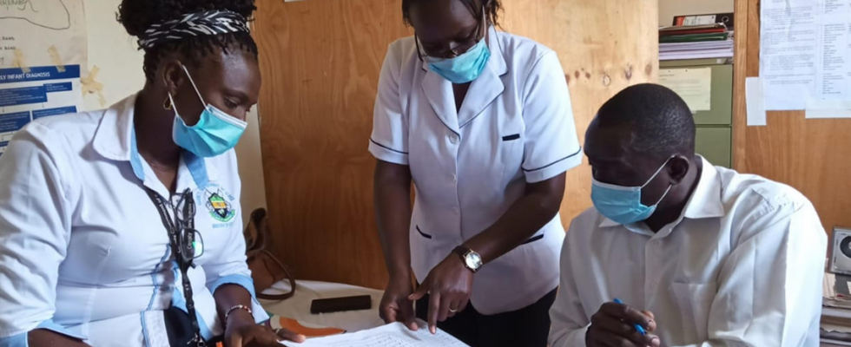
Partner Brainstorm
What Is Clinical Mentoring?
Photo credit: JSI

Slide 38
Clinical Mentoring: Definition
A sustained, collaborative relationship in which a highly experienced health care provider guides improvement in the quality of care delivered by other providers and the health care systems in which they work

Slide 39
What Breastfeeding Counselling Mentors Do
Build relationships.
Strengthen confidence through positive feedback.
Identify areas for improvement.
Provide responsive coaching and model best practices.
Collect and report on data as part of the mentorship program.

Slide 40
Why Clinical Mentoring for Breastfeeding Support?
Quality counselling and support results in a 90 percent increase in exclusive breastfeeding rates for infants aged 0–5 months.¹
Health workers are key to giving support, and counselling skills are complex.
Training alone is limited in providing opportunities for practicing skills learned during training.
Mentorship is a flexible learning and teaching approach that is effective in improving clinical competence.²
Haroon, S., J.K. Das, R.A. Salam, A. Imdad, & Z.A. Bhutta. 2013. “Breastfeeding Promotion Interventions and Breastfeeding Practices: A Systematic Review”. BMC Public Health, 13 (Suppl 3): S20. https://doi.org/10.1186/1471-2458-13-S3-S20
Feyissa, G.T., D. Balabanova, M. Woldie. 2019. “How Effective are Mentoring Programs for Improving Health Worker Competence and Institutional Performance in Africa? A Systematic Review of Quantitative Evidence.” Journal of Multidisciplinary Healthcare 12(5): 989–1005. https://doi.org/10.2147/JMDH.S228951.

Slide 41
Activity: Mentoring vs. Supervision (1)
In which category would you place the following?
Which fall into both categories?
Supervision
Mentoring

Slide 42
Mentoring vs. Supervision (2)
Overlap:
Monitoring
Available via distance communication for support between visits
Mentoring
Coaching
Participatory
Encourages self-evaluation
Building a relationship and trust
Focused on building confidence, skills development
Focused on the individual
Driven by the health care worker/receiver
Collaborative, relationship of equals
Individualized view
Typically of a fixed duration
Supervision
Critical
Hierarchical
Responsible for performance
Focused on reports, forms, and data collection
Performance management
Accountable for performance
Focused on the success of the team
Driven by standards for the department/team
Big picture view
Sustained over a long period of time

Slide 43
Components of Mentoring (1)
ITECH (International Training Education Center on HIV). 2008. “Basics of Clinical Mentoring.” Accessed June 30, 2022. https://www.go2itech.org/HTML/CM08/toolkit/training/index.html

Slide 44
Components of Mentoring (2)
ITECH (International Training Education Center on HIV). 2008. “Basics of Clinical Mentoring.” Accessed June 30, 2022. https://www.go2itech.org/HTML/CM08/toolkit/training/index.html

Slide 45
Components of Mentoring (3)
ITECH (International Training Education Center on HIV). 2008. “Basics of Clinical Mentoring.” Accessed June 30, 2022. https://www.go2itech.org/HTML/CM08/toolkit/training/index.html

Slide 46
Components of Mentoring (4)
ITECH (International Training Education Center on HIV). 2008. “Basics of Clinical Mentoring.” Accessed June 30, 2022. https://www.go2itech.org/HTML/CM08/toolkit/training/index.html

Slide 47
Components of Mentoring (5)
ITECH (International Training Education Center on HIV). 2008. “Basics of Clinical Mentoring.” Accessed June 30, 2022. https://www.go2itech.org/HTML/CM08/toolkit/training/index.html

Slide 48
Components of Mentoring (6)
ITECH (International Training Education Center on HIV). 2008. “Basics of Clinical Mentoring.” Accessed June 30, 2022. https://www.go2itech.org/HTML/CM08/toolkit/training/index.html

Slide 49
Characteristics of a Good Mentor
Experienced in the subject area
Good technical knowledge of breastfeeding, as well as understanding the challenges and obstacles faced by new mothers
Enthusiastic and comfortable incorporating diverse situations/experiences into teaching
Able to help mentee turn “mistakes” into learning
Takes a “back-seat” approach to teaching, avoiding lectures
Allows mentee to explore and learn on his/her own
Understands clinical systems to help mentees address systemic issues

Slide 50
Characteristics of Effective Mentoring Relationships
Is warm, safe, respectful, trustful
Both mentor and mentee want to be involved
Mentor uses active and reflective listening
Mentor/mentee able to work through misunderstandings
Continuity of the relationship over time
Power is shared
Learning is two-way: mentor interested in mentee’s ideas

Slide 51
Activity
What are some challenges in conducting
clinical mentoring?

Slide 52
Challenges to Mentoring
Obstacles to health care worker/mentee learning:
Mentee stressed due to intra-clinic factors (e.g., heavy client load, disorganization)
Mentee facing personal distractions
Mentee stressed by mentor’s presence in clinic
Mentee exhibits defensiveness when engaging with the mentor
Mentee puts on the best show for the visiting mentor
Mentor observes bad (as opposed to best) practices
Varying availability of resources at the facility and from unit to unit
Health facility resources and infrastructure

Slide 53
Key Points
Clinical mentoring seeks to strengthen health care systems by strengthening the knowledge and skills of health care workers beyond the technical information of breastfeeding.
Clinical mentoring involves building relationships, increasing confidence, identifying areas for improvement, coaching and modelling, and data collection and reporting.
Effective mentors are respectful, focus on both teaching and learning, and enthusiastic about teaching.

Slide 54
Session 3: Building Relationships

Slide 55
Learning Objectives
By the end of this session, participants will be able to—
Explain the importance of building a relationship with a mentee based on trust and mutual respect.
Identify potential barriers to relationship building.
Identify techniques for building rapport.
Practise affirming statements.
Identify potential challenges and solutions if you are a mentor to your employee.

Slide 56
Building a Relationship (1)
ITECH (International Training Education Center on HIV). 2008. “Basics of Clinical Mentoring.” Accessed June 30, 2022. https://www.go2itech.org/HTML/CM08/toolkit/training/index.html

Slide 57
Building a Relationship (2)
Whatever the length of a mentorship program—
It is necessary to find a way to connect with your mentee, even if the time frame is short.
It is important to understand mentee’s social and cultural environment.
Strategize the best ways to communicate with your mentee.
Note that methods of communication will vary according to age, gender, social class, urban vs. rural setting.

Slide 58
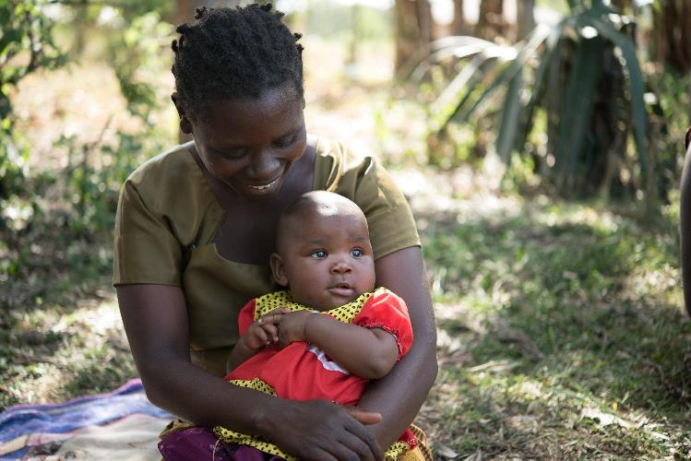
Rapport
Building a comfortable connection so that people can share information
Creating a relationship based on trust and respect
Established through both verbal and nonverbal actions
Photo credit: Allan Gichigi/MCSP

Slide 59
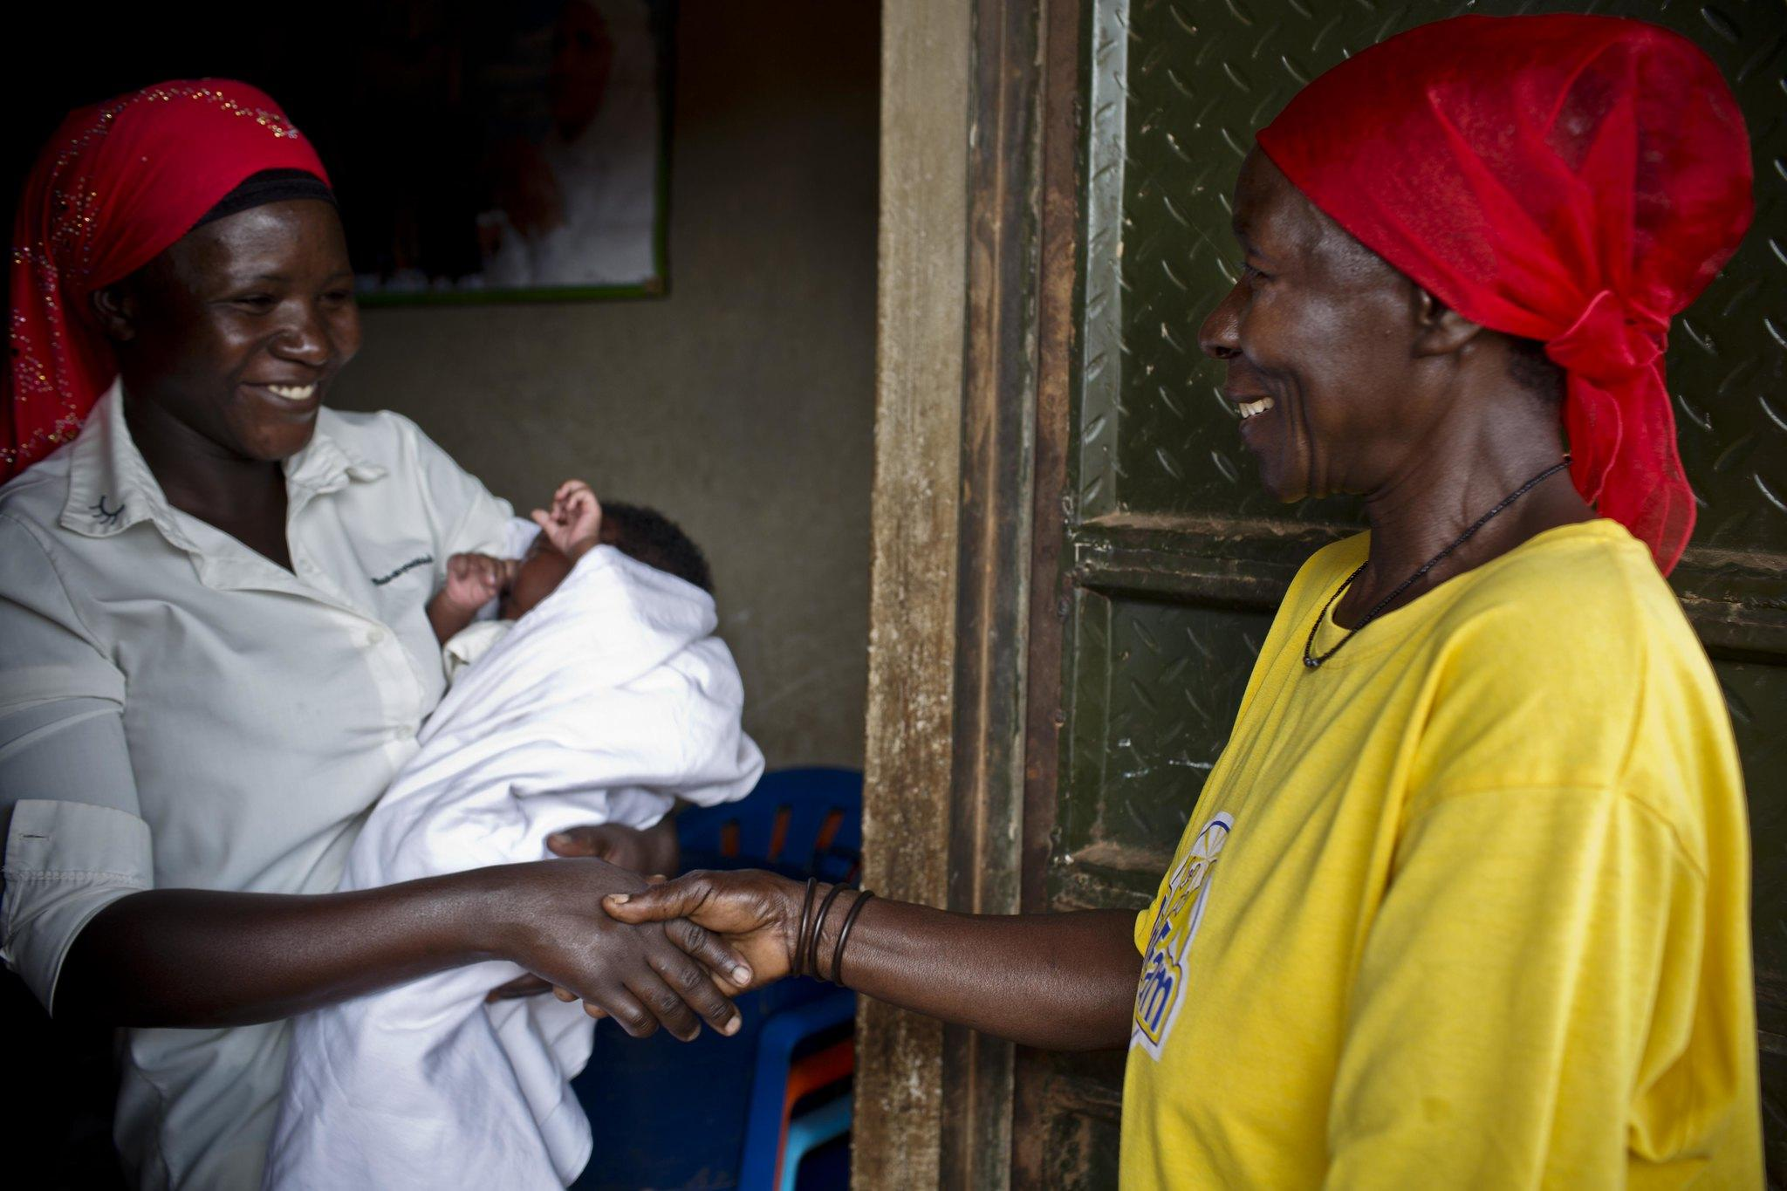
Techniques for Building Rapport
Introduce yourself in an open and friendly way.
Use the same language as mentee.
Show patience; do not interrupt.
Ensure meetings are private and not interrupted.
Demonstrate that you are interested and engaged through your non-verbal communication.
Get to know each other. Take an interest in your mentee.
Share things about yourself.
Use affirming statements.
Photo credit: Kate Holt/MCSP

Slide 60
Affirming Statements (1)
Affirm: To acknowledge the positive in someone else to support and encourage that person to build upon his or her successes.
Affirming statements are words of encouragement that increase mentees belief in themselves and their abilities.

Slide 61
Affirming Statements (2)
Examples:
Tips:
Be specific.
Be genuine.
Be consistent.
Reflect the culture.
Great question! You are really thinking.
You connect well with your clients. You seem to really enjoy them.
That was a challenging situation. Yet you stayed calm and worked through it. Well done!
You took time to ask the mother what she knows about breastfeeding, rather than simply listing the benefits. Did you notice that this led to a deeper conversation?
You were patient and respectful to the mother. This is so important!

Slide 62
Affirmation Dialogues
Now it’s your turn…how might you respond affirmatively to the following?
#1 Mentee: I almost forgot to talk about breastfeeding support available after discharge!
Mentor: But you remembered! You are really improving in that respect.
#3 Mentee: I finally felt a connection with Mrs. V.
Mentor: ?
#4 Mentee: Mrs. K’s baby was not interested in breastfeeding after the long labour. I encouraged Mrs. K to keep the baby in skin-to-skin.
Mentor: ?
#2 Mentee: I was unsure of how to react to Mrs. F’s comment.
Mentor: I liked how you answered in a non-judgemental way.

Slide 63
Activity: Affirming Each Other
Write down 3–4 positive accomplishments or efforts you have made in becoming the best [insert your job title here] you can be for your clients.
Pair up with a new partner.
Take turns reading your accomplishments.
Partner responds with an affirming statement.

Slide 64
Activity: When You Are Your Mentee’s Manager
What are some challenges you anticipate if you are paired as a mentor to a person that you manage?
What are some potential strategies to overcome those challenges?

Slide 65
Tips for Managing the Mentor-Mentee Relationship When Your Mentee is Your Employee
Keep mentoring meetings separate from other types of meetings.
Choose a neutral location for your mentoring meetings.
Help the mentee establish personal goals, but keep these separate from performance reviews or other work-related objectives.
Try to leave hierarchy out of the mentor-mentee relationship. Remember…learning should be two-way in a mentor-mentee relationship!

Slide 66
Key Points
Relationships are the foundation of effective clinical mentoring.
Strategies to build rapport include listening, patience, eye contact, and use of affirming statements.
There can be barriers to building mentorship relationships, based on cultural differences and expectations, as well as personal and professional factors. Mentors can come prepared with strategies to overcome these barriers.
Notes:
Distribute copies of Handout 2.1: Building a Relationship with a Mentee as a resource for the mentors to refer back to.

Slide 67
Session 4: Effective Communication and Feedback Skills

Slide 68
Learning Objectives
By the end of the session, participants will be able to—
Identify the basic principles of feedback.
Explain the important role of feedback in the context of clinical mentoring.
Demonstrate effective communication styles and constructive feedback.

Slide 69
Mentor-Mentee Communication
People learn best from mentors who are sincere, approachable, and non-judgemental.
These qualities are communicated by facial expressions, followed by tone, and, to a limited extent, by words.
People often remember more about how a subject is communicated than the speaker’s knowledge of the subject.
Photo credit: Allan Gichigi/MCSP

Slide 70
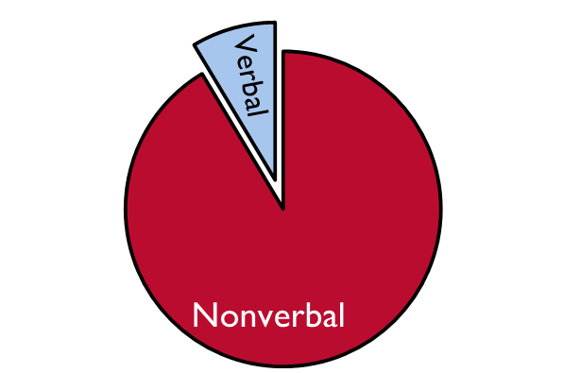
Types of Communication
Communication can be either—
Verbal: Spoken words
Nonverbal:
The way we stand and sit
Facial expressions
Silence
Eye contact
Gestures (smiling, leaning forward, nodding)

Slide 71
Activity: Nonverbal Communication
What do these mean?

Slide 72
Communication Process
A message sender creates a message for the message receiver.
The receiver and the sender react, asking for more information and getting answers, to find out whether the message has been understood.
Sender
Message
Receiver
Reaction

Slide 73
Communication Skills
Techniques for effective communication include—
active listening
reflecting
summarising.

Slide 74
Active Listening (1)
An essential component of good communication
Often, instead of truly listening to what the other person is saying, we’re thinking about what our response will be to what they’re saying, or what we want to say next, or something else entirely.

Slide 75
Active Listening (2)
USAID Advancing Nutrition/UNICEF IYCF Digital Image Bank (iycf.advancingnutrition.org)

Slide 76
Reflective Listening (1)
A process of verbally “reflecting” back what someone has said that—
helps the mentor check whether s/he understands the mentee
helps the mentee feel understood and respected as a health care worker
can help the mentee clarify thoughts and feelings.

Slide 77
Reflective Listening (2)
Confirm that you have understood the mentee by using statements such as—
“I understand that you feel like there’s not enough time to do a breastfeeding counselling session. Is that right?”
“It sounds like you’re concerned about the mother’s understanding of exclusive breastfeeding.”
“You’re wondering if this mother should try a different breastfeeding position.”

Slide 78
Summarising (1)
Process of synthesizing and stating what a mentee has said in order to capture key concerns and issues
Helps to confirm that the message that is sent is the message that is received

Slide 79
Summarising (2)
Use summarising—
to check that you have understood the mentee’s story or issue
when changing topics, closing discussion, or clarifying something
to collect your thoughts
to show the mentee that you have heard and respect his/her point of view.

Slide 80
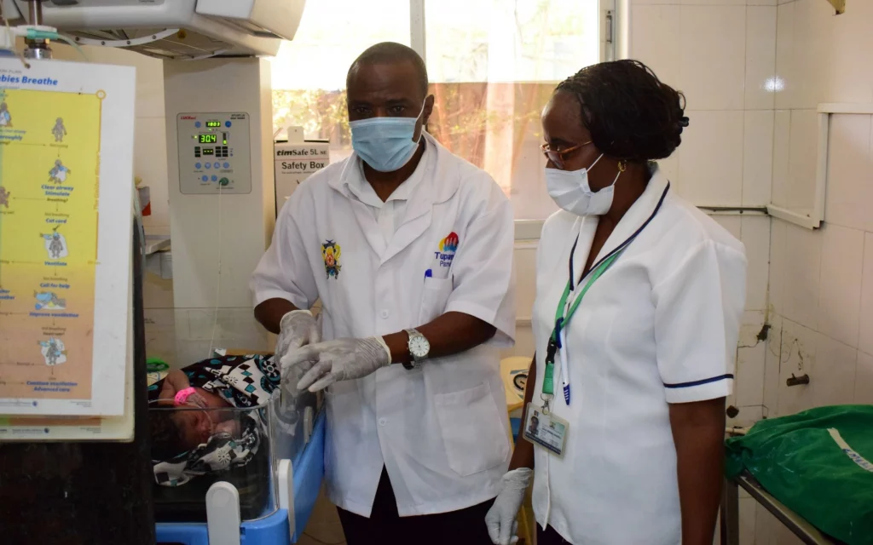
Activity: Active Listening, Reflective Listening, and Summarising
Divide into pairs.
There will be three activities to practise active listening, reflective listening, and summarising.
For each activity, each pair should choose a listener and a speaker to start. And then the roles will switch.
Photo credit: Options Consultancy Services Limited

Slide 81
Barriers to Communication (1)
ITECH (International Training Education Center on HIV). 2008. “Basics of Clinical Mentoring.” Accessed June 30, 2022. https://www.go2itech.org/HTML/CM08/toolkit/training/index.html

Slide 82
Barriers to Communication (2)
Other barriers include—
talking too much, not giving mentee time to express him/herself
being critical and/or judgemental
laughing at or humiliating mentee
contradicting or arguing with mentee
being disrespectful of mentee’s beliefs, way of life, method of providing client care
lack of trust or rapport.

Slide 83
Providing Feedback
Photo credit: Allan Gichigi/MCSP

Slide 84
Feedback
What: Comments in the form of opinions about or reactions to something
Why:
Initiate and improve communication.
Evaluate or modify a process or product.
Enable improvements to be made.
Provide useful information for future decisions and development.

Slide 85
Feedback and Clinical Mentoring
Feedback is a vital aspect of the mentor-mentee relationship.
If the mentor is unable to give feedback effectively, and/or the mentee is unable to receive constructive feedback…
…not much will be accomplished!
Note:
Feedback can be affirming or corrective.
Offer it in a way that can be received by the mentee.
It should always be for learning.

Slide 86
Small Group Discussion: Feedback and Clinical Mentoring
What unique factors about the health care setting do mentors need to consider when giving feedback to the mentee?

Slide 87
Two Approaches to Feedback
Scenario
You are a clinical mentor observing a mentee during a child welfare clinic visit for a baby that was discharged from the hospital recently. The weighing and measuring steps reveal that the baby is not gaining weight adequately. The mother looks visibly worried and reports that her baby seems hungry all the time and might not be latching as well as she did in the hospital.
The mentee uses a frustrated tone of voice and says, “Mrs. K, if you do not feed your child, he will die.”
How should the clinical mentor provide feedback to the mentee after the visit?

Slide 88
Feedback Scenario #1
Providing Feedback:
Approach #1

Slide 89
Feedback Scenario #2
Providing Feedback:
Approach #2

Slide 90
Group Discussion
What were the differences between the two approaches?
What did the mentee learn in the first scenario? The second?
How might the mentor provide feedback in front of the client?
Other thoughts?

Slide 91
Feedback: Basic Principles (1)
Ask permission or identify that you are giving feedback:
“Can I give you some feedback on that follow-up client visit?”
“I’d like to provide feedback on what I observed during my visit today.”
Encourage self-assessment:
Ask the mentee for his/her experiences of the encounter first.
Use the first person: “I think,” “I saw,” “I noticed.”
Be specific in describing what you observed.
State facts, not opinions, interpretations, or judgements.
Don’t exaggerate or generalize:
Avoid terms such as, “you always,” or “you never.”
Focus on 1–2 critical areas at a time.

Slide 92
Feedback: Basic Principles (2)
Address what a person did...
“You skipped several sections of the counselling script.”
…not your interpretation of his/her motivation or reason for it.
“I know you want to finish quickly because it’s almost lunchtime, but you skipped several sections…”
Include positive affirmations, even when pointing out behaviour to change.
Don’t be judgmental or use labels.
Avoid words like “lazy,” “careless,” or “forgetful.”
Make suggestions for improvement with statements like
“You may want to consider…”
“Another option is to…”

Slide 93
Three Components of Learning
Knowledge: Things mentees must know or understand
Breast anatomy
Patterns of breastfeeding (i.e., how a baby feeds in the first 36 hours versus at two months of age)
Why early initiation of breastfeeding within the first hour after birth is recommended
Skills: Things mentees must be able to do well
Assisting a mother with good positioning or attachment
Active listening
Attitudes: Things mentees need to feel or believe in
Empathy for the challenges of new mothers
The value of breastfeeding counselling to assist mothers

Slide 94
Effective Learning Approaches
Knowledge
Reading material, lectures, diagrams/models, videos, problem-solving, teaching back
Skills
Demonstrations, role plays, practice sessions, self-reflection, feedback
Attitudes
Role plays, case studies, videos, testimonials

Slide 95
Small Group Work
Feedback Scenarios

Slide 96
Key Points
Good communication—both verbal and nonverbal—is essential for an effective mentoring relationship.
Communication techniques such as appropriate body language, active/reflective listening, and summarising can aid communication.
Feedback is integral to adult learning and is a vital component of the clinical mentoring relationship.
Knowledge about a subject is important for teaching but knowing how to communicate the knowledge is critical for learning.
Feedback may be either positive or corrective (or both).
Feedback should be descriptive, objective, and nonjudgmental, focusing on the individual’s actions.

Slide 97
Session 5: Clinical Teaching Skills

Slide 98
Learning Objectives
By the end of this session, participants will be able to—
Define a teaching moment.
Use clinical teaching, side-by-side mentoring, and case presentations as teaching strategies.

Slide 99
Patient-Centred Teaching
Client-centred teaching =
Teaching what needs to be taught, for the sake of client
vs.
Teacher-centred teaching =
Teaching what one knows, even if it does not address the client’s problems
Client- and family-centred care encourages active collaboration and shared decision-making between clients, families, and providers to design and manage a customised and comprehensive care plan.

Slide 100
Teaching Moment
An opportunity to share a piece of information, demonstrate a technique, or expand on the implications of a clinical observation
Examples:
Demonstrating a breastfeeding counselling visit
Allowing your mentee to feel/hear/observe possible obstacles to breastfeeding (e.g., poor attachment, poor positioning) during a counselling visit that you, as mentor, notice
Asking a mentee to contribute additional suggestions she may have to the mother to overcome challenges

Slide 101
Clinical Teaching Moments: Taking Advantage
Breastfeeding counselling mentors should seize every opportunity that they can to teach mentees how to deliver the highest quality breastfeeding counselling services.
ITECH (International Training Education Center on HIV). 2008. “Basics of Clinical Mentoring.” Accessed June 30, 2022. https://www.go2itech.org/HTML/CM08/toolkit/training/index.html

Slide 102
When and Where Do Teaching Moments Occur? (1)
In a variety of settings:
Prenatal clinics, maternity wards, labour and delivery wards, etc.
Anytime:
While a client is present in the room
Following a client visit
Planned for the future

Slide 103
When and Where Do Teaching Moments Occur? (2)
Don’t wait too long to give feedback. The closer the feedback is to the actual event, the more likely the mentee will remember the teaching point.
Certain feedback requires more immediate timing:
Example: the mentee is doing something in error or omitting a very important step
If you provide feedback during a client encounter—
Do not alarm the mentee or client. Put them both at ease.
Be very calm and patient as you explain your recommendation.

Slide 104
Content of a Teaching Moment
Can be about any aspect of service provision within the clinical setting:
Methodology or process of a counselling session or procedure
Background on physiology (such as how breastmilk is produced)
Client rapport/interpersonal communication patterns
Building confidence (such as giving a mother positive feedback and emotional support)
Strategies for maintaining client confidentiality within the clinic setting
Suggesting appropriate options for support (such as the woman’s husband, mother, or mother-in-law)

Slide 105
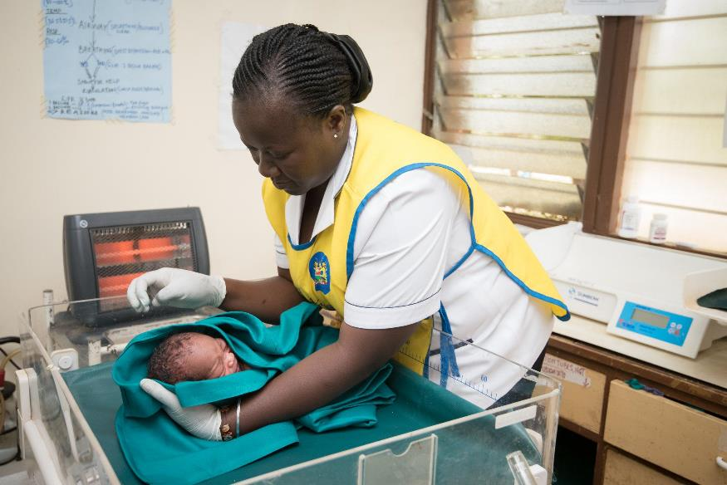
Mentoring Strategies
Clinical teaching
Side-by-side mentoring
Case presentations
Photo credit: Allan Gichigi/MCSP

Slide 106
Clinical Teaching (1)
Defined as teaching and reinforcing skills at client’s bedside and/or in the clinic setting:
a common approach in medical education
reinforces classroom learning
allows mentor to model important clinical skills, attitudes, and communication in the context of client care, as well as observe mentee’s skills.
Strengths and weaknesses of mentees become very clear at the bedside.
Notes:
Clinical teaching is an important part of the process of adult learning, as it reinforces classroom learning.
Strengths and weaknesses of mentees become clear at the bedside, because mentors can watch mentees interact with clients. Mentors can experience what mentees do and how they act with clients first hand, in a way that cannot happen outside of a client encounter.
*Source: http://www.oucom.ohiou.edu/fd/monographs/bedside.htm

Slide 107
Clinical Teaching (2)
Before meeting with the client:
Mentor and mentee should discuss the purpose and structure of the session:
Identify appropriate clients.
Set goals for the session.
Agree on roles and expectations.
Discuss the expected time frame.

Slide 108
Clinical Teaching (3)
Six steps:
Assess the situation.
Discuss the rationale.
Reinforce what was done well.
Give guidance about errors and omissions.
Teach a general principle.
Conclude.

Slide 109
Clinical Teaching (4)
After consultation:
Review and summarise key points.
Solicit questions from mentee and discuss any identified problems.
Offer specific positive and constructive feedback.
Agree on an area of improvement and formulate a plan for how to improve.

Slide 110
Demonstration
Clinical Teaching Approach

Slide 111
Side-by-Side Mentoring
As the name implies, this technique involves working alongside the mentee.
Useful for a busy clinic or hospital setting
Mentor and mentee alternate duties of seeing and examining the clients, writing relevant information in client’s health record, and checking lab results.

Slide 112
Side-by-Side Mentoring: Benefits
Mentor can observe mentee at work and identify and address challenges.
Mentor acts as a role model when he/she is performing the counselling session.
Clients are seen more quickly than if the mentee sees the clients alone.
Visits are more comprehensive and thorough.
Mentees do not feel like they are being watched, but rather supported by a colleague.

Slide 113
Case Presentations: Defined
A mentee presents a case from a real-life situation they encountered to other mentees (and mentors), followed by discussion questions about how to characterise, describe, and/or act on the situation presented.
This training methodology provides mentees with an opportunity to reflect on a real-life situation in a setting where they have the time to analyse the scenario, problem solve, and apply new skills and knowledge without the pressure of a clinic/hospital environment.
Allows exploration of various strategies to address complex issues

Slide 114
Case Presentations: How to Do Them (1)
Invite a staff member to present a difficult or challenging case they have encountered. The presentation should include the following:
Issue client presented with
Age, gender, relevant social history
Medical history (including lactation history with previous children)
Current profile: type of birth, number of live births (i.e., one child or twins), symptoms, breastfeeding status, medications (including herbal preparations and supplements), etc.
Assessment of mother/baby/breastfeeding session
What they did in the situation
Effective case presentations include adequate client detail and specific decision points.

Slide 115
Case Presentations: How to Do Them (2)
Thank the staff person. Discuss the case:
What was good about the way the case was handled?
What recommendations would improve management of the case?
Provide your own feedback/observations on the case.

Slide 116
Case Presentations: Rationale
Case presentations are an effective way to train health care workers in the delivery of breastfeeding counselling, particularly in multidisciplinary teams.
Case presentations are used to discuss best practices and effective health care worker behaviours.
They are opportunities to discuss options for how the mentee could have responded to the client’s situation, and different approaches to care.

Slide 117
What Will Mentoring Look Like for You? Demonstration
Recommend beginning mentoring with the mentor demonstrating good quality breastfeeding counselling.
The mentor demonstrates the competencies, especially focusing on the competencies that your mentee(s) has prioritised for their learning.
The mentee observes, asks questions, and learns from the mentor.
Aside from the mentee learning by observing, the mentor may also use clinical teaching or side-by-side mentoring to complement the learning experience.
Demonstration continues until the mentee is ready to take the lead, but should consistently modelling good counselling skills for the mentee throughout the mentorship program.

Slide 118
What Will Mentoring Look Like for You? Observing
Once a mentee feels comfortable, he/she switches roles with the mentor and the mentor observes the mentee.
During observations—
The mentee practises the competencies he/she has prioritised for their learning and mentors assess those competencies.
Clinical teaching and side-by-side mentoring can be used for “teaching moments”.
The mentor may provide feedback, or they may do this later during a debrief and/or check-in.
Mentees can also use case presentations to share client counselling sessions with the mentor that the mentor did not observe.

Slide 119
What Will Mentoring Look Like for You? Debrief
After any demonstration or observation, mentors and mentees should debrief.
This may be a short discussion following a client encounter or a longer debrief that is part of a check-in.
Debriefs can happen one-to-one or can happen with one mentor and several mentees depending on the mentoring approach and ratio chosen.
However, you should always provide sensitive feedback one-on-one and in a private location.

Slide 120
What Will Mentoring Look Like for You? Check-In
You will conduct an initial meeting with your mentee(s) to help your mentee(s) set goals for the mentoring program.
Thereafter, you will check-in with your mentee(s) at least every one or two weeks.
You can conduct these one-on-one or as a group (mentor and several mentees).
In cases where mentor-led small groups are the norm, the mentor should still plan to check-in with each mentee one-to-one to discuss individual goals and any sensitive or confidential information.
The “Clinical Practice Discussion Guide” helps to guide check-ins.

Slide 121
Leading by Example
Think aloud and highlight the process of expert reasoning.
Model concise communication and evidence-based decision-making.
Work as a hands-on role model.
Adapt to uncertainty and admit mistakes.
Link learning to caring.
Reilly, B. 2007. “Viewpoint: Inconvenient Truths about Effective Clinical Teaching.” Lancet. 370:705–711. https://doi.org/10.1016/S0140-6736(07)61347-6

Slide 122
Key Points
Client-centred teaching is at the root of what you should do as a breastfeeding counselling mentor.
Teaching moments are opportunities to improve clinical skills of a health care worker and can take place in a variety of settings. Mentors should maximise the number of teaching moments in interactions with mentees.
Clinical teaching and side-by-side mentoring reinforce classroom learning, and allow the mentor to model clinical techniques, as well as attitudes and behaviours.

Slide 123
Session 6: Mentorship Case Studies

Slide 124
Learning Objectives
By the end of this session, participants will be able to—
Apply the clinical mentoring skills and techniques learned in this course to real-life mentoring case studies.
Notes:
For each case, ask participants to think about how this scenario may play out in their settings and what other considerations they may have. Encourage participants to really think about the mentoring moments within these cases and how they can apply the lessons learned to their setting. Be sure to encourage everyone to speak and participate.
Each case should take approximately 15–20 minutes to complete. The remaining time can be used to review the answers and for discussion.
There are three different options listed below of how the case studies could be facilitated. Consider the number of participants, time available, and room restrictions to determine the best method of conducting this activity. Review the options listed below and adapt as appropriate. To provide variety in the day, more than one facilitation method should be used. Once the methods of how to conduct this activity are determined, adjust the lunch and tea breaks in the training agenda as necessary.
Facilitation options:
Option 1: Small group discussion
Divide participants into small groups.
Divide the case studies among each group.
Ask groups to work cooperatively to complete their assigned case study worksheets.
Allow adequate time for groups to complete their small group work.
Bring groups back together as a large group.
Ask groups to take turns presenting the cases to the larger group, one case/group at a time. The small groups should read the case and then discuss the answers as a large group, asking everyone in the large group for input for the answers.
Option 2: Large group discussion
Read through the case studies and accompanying questions as a large group.
Ask participants to brainstorm answers to the questions.
Record the group’s answers on flip chart paper, and ask participants to record their answers on their worksheets.
Option 3: Role play
Divide participants into pairs.
Assign the pairs each a case study.
Inform participants that they should read through the case together and then role play the case as a pair.
Each person should identify which role they will play and should answer the questions provided during the role play.
Allow adequate time for participants to role play the case.
Bring the participants back together as a large group to discuss the cases and role plays.
Ask participants if they have any questions on the cases studies.

Slide 125
Next Steps and Closing Remarks

Slide 126
Next Steps
These will differ by program, but generally include—
selecting mentees
pairing mentors and mentees
orientation meeting for mentors
orientation meeting for mentors and mentees.

Slide 127
Acknowledgments
The Core Concepts in Mentorship Training for the Breastfeeding Counselling Mentorship Program has been developed through a consultative and participatory approach that included many partners and stakeholders. The content development process was rigorous and thorough with a lot of input and feedback to build consensus. The authors are greatly indebted to all those who made contributions toward the development of this training, particularly those who participated in and steered the process and contributed technical and financial support including: United States Agency for International Development (USAID) Kenya, USAID Washington, USAID Advancing Nutrition, and Nutrition International. We also are grateful to the Council of Governors for making it possible for county directors of health, and county reproductive health, child health, and nutrition focal persons to participate in various meetings, in particular the leadership from Nairobi County. This work would also not be possible without the leadership from Mbagathi County Referral Hospital which piloted the program in 2023, including Alexander Irungu, PhD, chief executive officer; Dr. Nicholas Tinega, medical superintendent; Dr. Erica Koima, deputy medical superintendent and head of clinical services; and Linet Kwamboka Kinara, nursing services manager. We are also grateful to the mentors and mentees at Mbagathi County Referral Hospital for sharing their experiences implementing the mentorship program, as well as the numerous clients that received breastfeeding counselling during the pilot of this mentorship program and whose feedback helped to inform improvements to this guidance document.
A few other individuals made exceptional contributions to the development of this document, including: Ruth Tiampati, Child Health and Nutrition Team lead, Office of Health, Population and Nutrition, USAID Kenya; Veronica Kirogo, director of the Division of Nutrition and Dietetics Services, Ministry of Health (MoH); Caroline Arimi, program officer for Maternal, Infant, and Young Child Nutrition (MIYCN), Division of Nutrition and Dietetics, MoH; and the late Rose Wambu, former program officer for MIYCN, Division of Nutrition and Dietetics, MoH and former chair of the National MIYCN Technical Working Group. Other individuals made significant contributions, including Esther Mogusu, director of nutrition, Department of Health, Wellness, and Nutrition, Nairobi County; Brian Njoroge; and the late Professor Rachel Musoke. Annex 1 lists all contributors.
Special thanks and gratitude to the senior management of the MoH under leadership of Director General Dr. Patrick Amoth for creating an enabling environment for implementation of breastfeeding counselling services.
We would also like to acknowledge the International Training and Education Center on HIV (I-TECH) whose training content, Basics of Clinical Mentoring, including tools and resources for mentors, were heavily drawn upon in the development of this training.

